Slide 1
Writing to Learn vs. Writing in the Disciplines
NSU Write from the Start Writing and Communication Center
www.nova.edu/wcc
Notes:
Welcome to the online version of “Writing to Learn vs. Writing in the Disciplines.” In this presentation we’ll discuss two different (yet often complimentary) approaches to integrating writing into college classrooms.

Slide 2
First, let’s write
“If you could improve just one aspect of your students’ writing, what would it be?”
“If you could improve student’s understanding of just one concept in a course you teach at NSU, what would it be?”
Notes:
If you write down answers to these two questions, you can now ask yourself to what degree the answers to these two questions could be the same. Can we improve student writing in our classes in ways that focus on improving understanding of course content? Or is improving student writing separate and different from improving student achievement of course objectives?
We maintain that writing, well integrated into a course, can be done in ways that are designed to enhance student learning of course material. This short question and answer session is an example of what we call “writing to learn,” which is an informal use of writing to achieve course goals. It is the kind of activity that you might begin a class with, using less than five minutes, to get students thinking about the content of your course. Having them write their answers makes each student reflect and develop their ideas briefly in ways that simply asking a question out loud doesn’t always achieve.

Slide 3
Two models:
Writing to Learn (WTL) – short informal low-stakes writing tasks that help students think through key concepts or ideas presented in a course. Often, these writing tasks are limited to less than five minutes of class time or are assigned as brief, out-of-class assignments.
Writing in the Disciplines (WID) – longer formal high-stakes writing tasks that require students to follow the conventions of the professional community for whom the genre is produced. These texts often require specialized formatting, methodologies, and jargon to be considered successful.
Notes:
There are two basic models of using writing in a college classroom. The first, “writing to learn,” focuses on short assignments that are either ungraded or graded pass-fail, so students focus more on exploring ideas than on being correct. Students typically do not need to prepare for these assignments, or revise them after they are completed; their goal is to generate discussion and reflection.
The second model, “writing in the disciplines,” include all those discipline-specific genres and methods that we often associate with longer end-of-term projects. For these more formal projects, instructors would often provide grading rubrics, opportunities for revision and feedback, and other support.

Slide 4
WTL examples:
Students compare how two different research texts establish “facts”
Students respond to a key quotation from assigned reading
Students pause mid-lecture to write down questions they have
Students summarize recent class discussion
Students reflect on their own performance on course assignments
Other examples include reading journals, discussion starters, synthesis papers, case studies, event analyses, pre-tests, and more
Notes:
Here are some examples of common writing to learn activities. Instructors often use such activities to gather insight into whether students have grasped a concept before testing them formally. For instance, after giving a lecture on a topic, you could take a minute at the end of class and ask students to write a definition of a concept discussed, or write down an example of it. The instructor can collect these slips of paper, look them over before the next class in the matter of a few minutes, and then discuss the results at the beginning of the next class. Such activities let instructors quickly assess where the whole class is in regards to understanding course concept, rather than simply finding out whether the one student who answers a question spoken in class understands it.

Slide 5
WID examples:
Students develop research projects in their fields
Students in business compose a business plan or pitch deck
Students in education write a teaching philosophy
Students in the arts compose an artist’s statement
Students in the sciences compose lab reports
Students in the health professions develop a grant proposal
Other examples include documents created by members of a profession as part of their job, from emails to brochures to instructions to meeting minutes. Technical writers design usability tests, for instance.
Notes:
Here are some examples of common writing in the disciplines activities. For instructors who currently require some form of end-of-term paper or project, this might be very familiar. And the exact design of these projects will be very different depending on the genre being produced, and the field it is being produced for. These kinds of projects focus more on assessing student performance over a long period, and often using several distinct skills. If this is the only writing students turn in during the semester, it can be frustrating to learn at the end of the class that students have not grasped a concept or understood the assignment’s purpose. But if these kinds of assignments are part of a sequence of writing activities that allow you to provide feedback throughout the semester as students form ideas and plans, then they are more likely to be successful.

Slide 6
An extended WTL activity :
Designed for COMP 2000, NSU’s course focused on research writing
Assignment Description: After reading an assigned journal article, students write a one-page "thought piece" outside of class with two goals: 1. Summarize the article’s purpose, 2. Respond to the article. In class, students share their responses in small groups and/or with the whole class, and the class holds a guided discussion focused on understanding both the specific article and the generic characteristics of research writing in the discipline of composition.
Sample Document
Notes:
Here is a brief description of an extended writing to learn activity used in a class focused on learning to write research. A longer description of it is linked from the “Sample Document” link in the bottom right. It is a writing to learn activity that asks students to write a short response to a published piece of scholarship the whole class is reading. Students use these responses as the basis for group discussions in class, and then the instructor guides a class discussion allowing groups to respond to each other, and draw out important features of the research article that they can apply to their own projects. The instructor then pulls quotations of student writing from the submitted thought pieces to continue the conversation in the next class period. There is no requirement for the instructor to reply to each individual thought piece, only to read through them quickly and pull out quotations the instructor feels the class could benefit from revisiting.

Slide 7
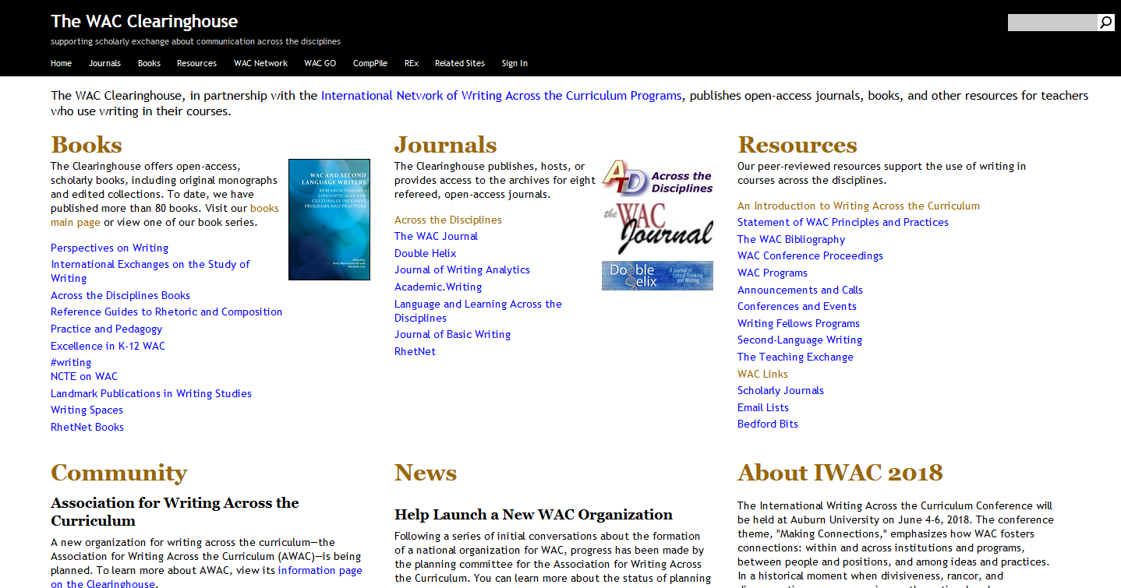
WAC, WTL, and WID resources
The WAC Clearinghouse – https://wac.colostate.edu/
Notes:
For more examples and ideas related to writing to learn, writing in the disciplines, and writing across the curriculum, the best site is the WAC Clearinghouse.

Slide 8
Questions?
www.nova.edu/wcc wcc@nova.edu
Notes:
Thank you for your interest in improving student learning at NSU through writing. If you have questions or want to work with our staff to please go to our web site or contact us at wcc@nova.edu. We look forward to working with you.

