Slide 1
Document Tracking for Ariba Approval Threshold
Beth Lettie, OIIT

Slide 2
Reporting vs. Searching
Reports
  Best used for viewing large document sets and aggregating data
Searches
  Best used for monitoring small document sets or obtaining very detailed information
Data Access
  Center reports show ALL documents for an Activity Code
  Searches show only documents created or approved/watched by current user

Slide 3
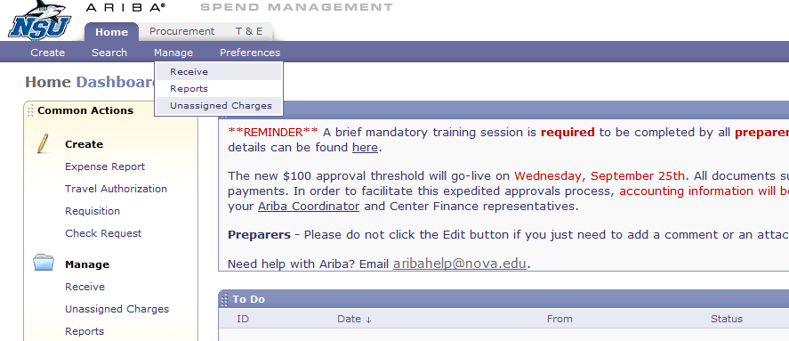
Report Execution
Navigate to the reports via Manage -> Reports

Slide 4
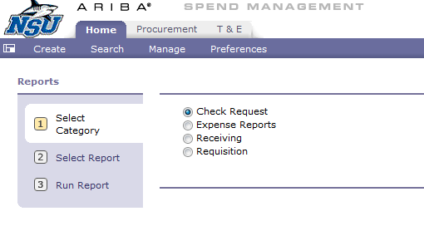
Report Execution (cont.)
Select the report Category

Slide 5
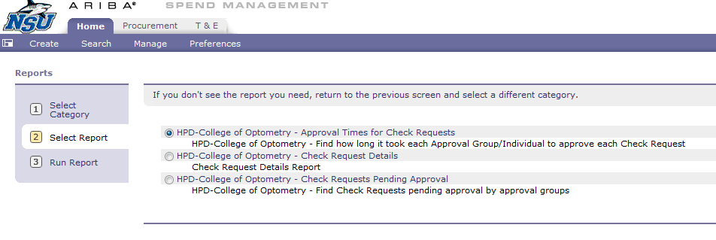
Report Execution (cont.)
Select the Report Type – Check Requests

Slide 6
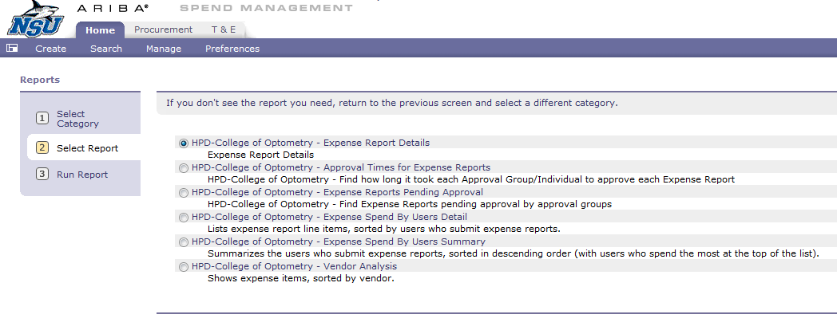
Report Execution (cont.)
Select the Report Type – Expense Reports

Slide 7
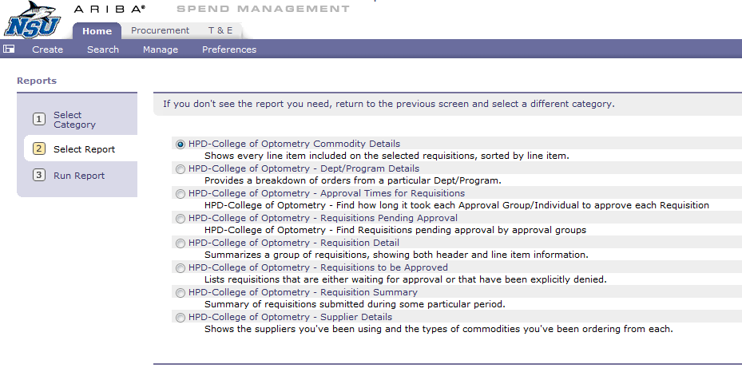
Report Execution (cont.)
Select the Report Type – Requisitions

Slide 8
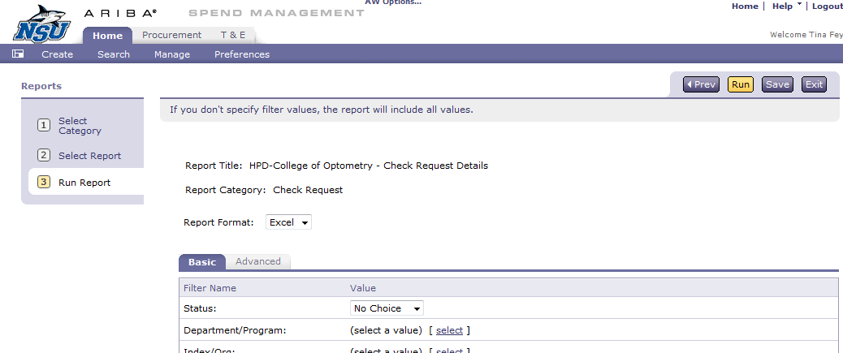
Report Execution (cont.)
Select the Report Format

Slide 9
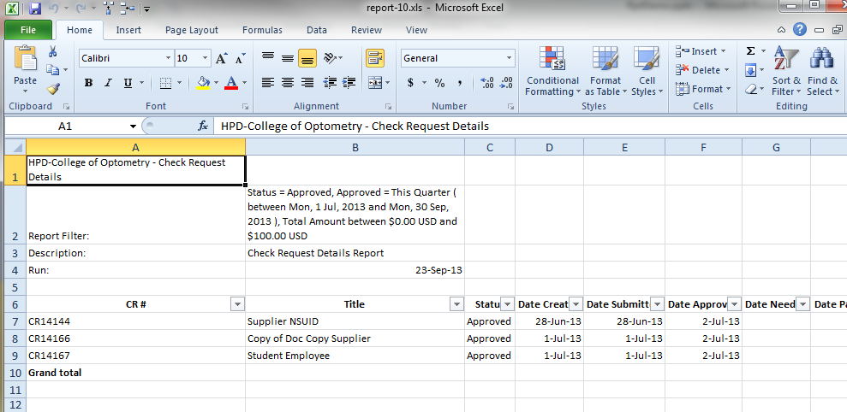
Example of Excel Format

Slide 10
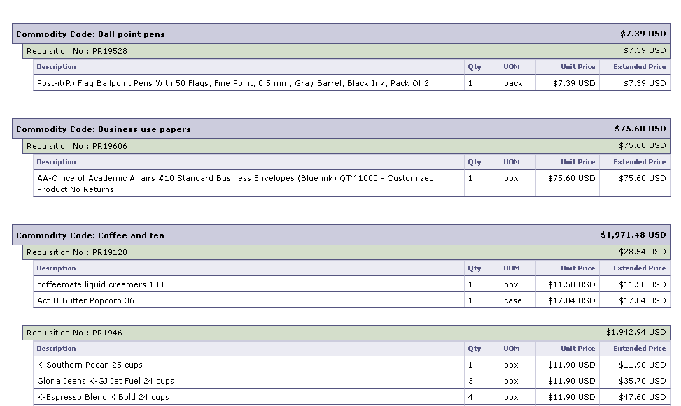
Example of HTML Format

Slide 11
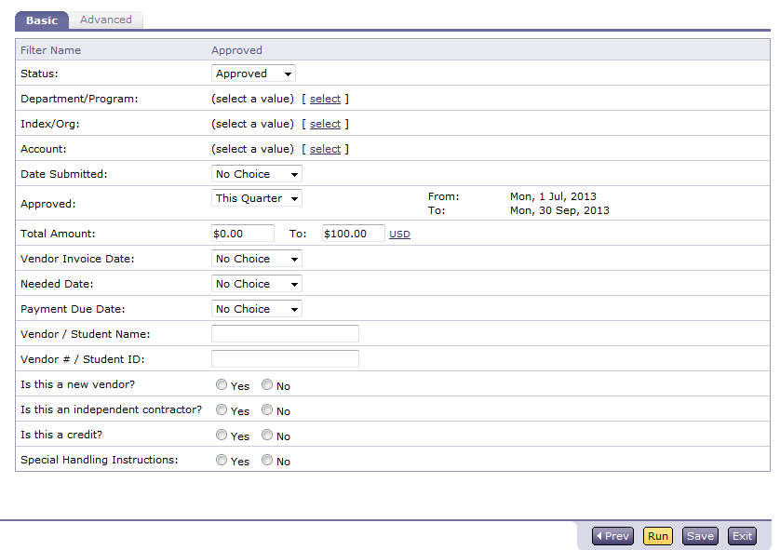
Report Execution (cont.)
Select the Filters

Slide 12
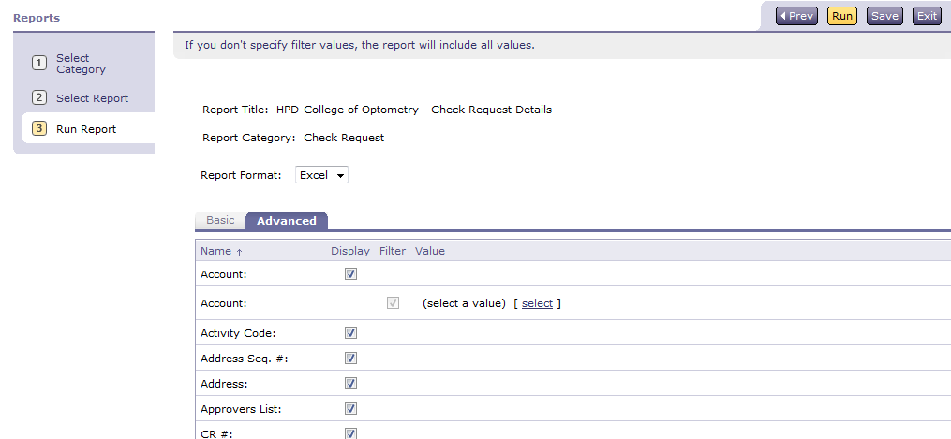
Report Execution (cont.)
Select the Display Fields and then click “Run”

Slide 13
Sample Reports
Check Request Details
Expense Report Details
Requisition Details

Slide 14
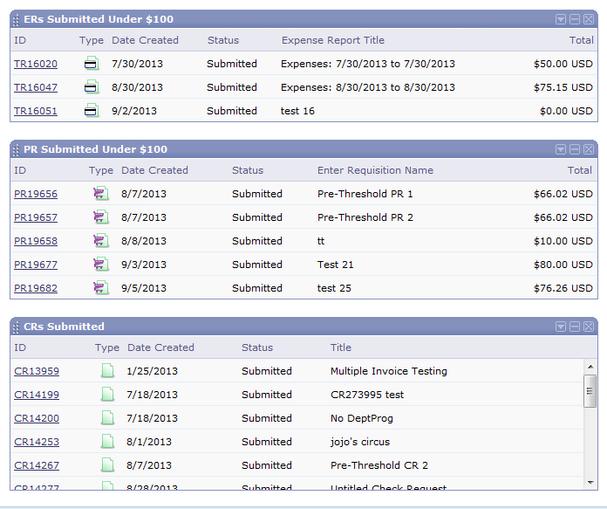
Saved Searches
Can save a search to see a running display of documents submitted under the threshold on your dashboard

Slide 15
Questions or Comments?
Email AribaHelp@nova.edu

