Slide 1
Standard Online OPT Guidelines
Disclaimer: Our office provides these instructions as a courtesy. Your answers may be different depending on your current circumstances. Please read through all of the steps carefully in the online application as you are ultimately responsible for the accuracy of the information provided.
Notes:
Photo credits: uscis.gov

Slide 2
STANDARD OPT FILING DEADLINES!
USCIS must receive your I-765 application:
No sooner than 90 days before you graduate and no later than 60 days after you graduate; and
No later than 30 days from the date the DSO recommended the OPT in SEVIS (on your I-20).
If you have any questions about the timing, please contact our office.

Slide 3
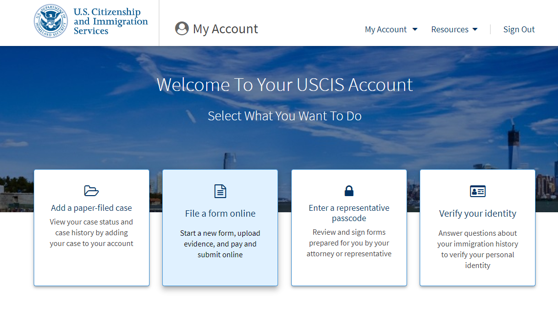
If you DO NOT have an account:
Create an account at my.uscis.gov until you reach this page.
Click on “File a form online”
If you already have an account:
Login at my.uscis.gov
Click on “File a form online”

Slide 4
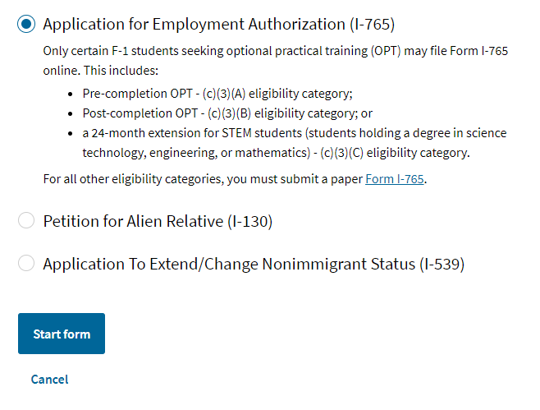
Select “Application for Employment Authorization (I-765)”
Select “Start form”

Slide 5
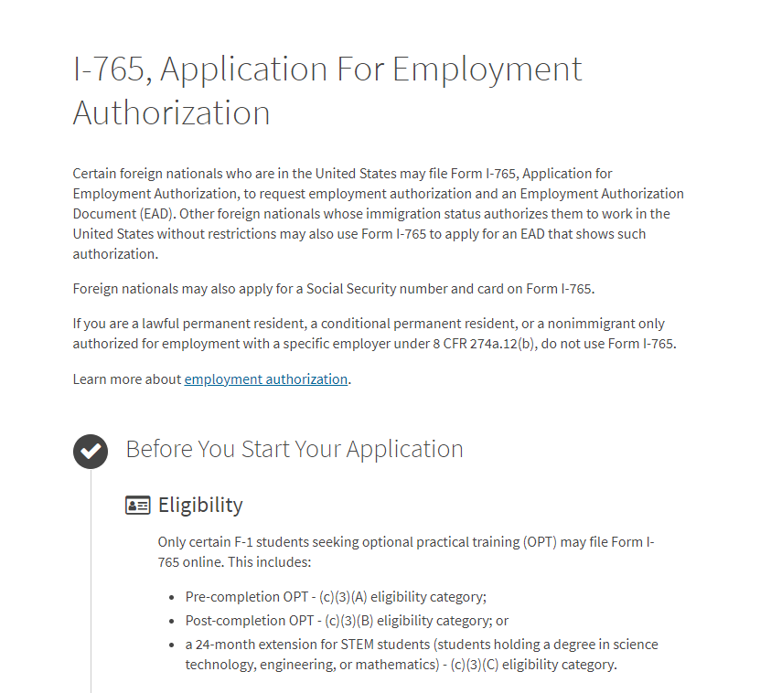
IMPORTANT!
Please read through ALL of the information listed on the page that comes up.
AFTER you have read through all of this information, click the “Next” button at the bottom of the page.

Slide 6
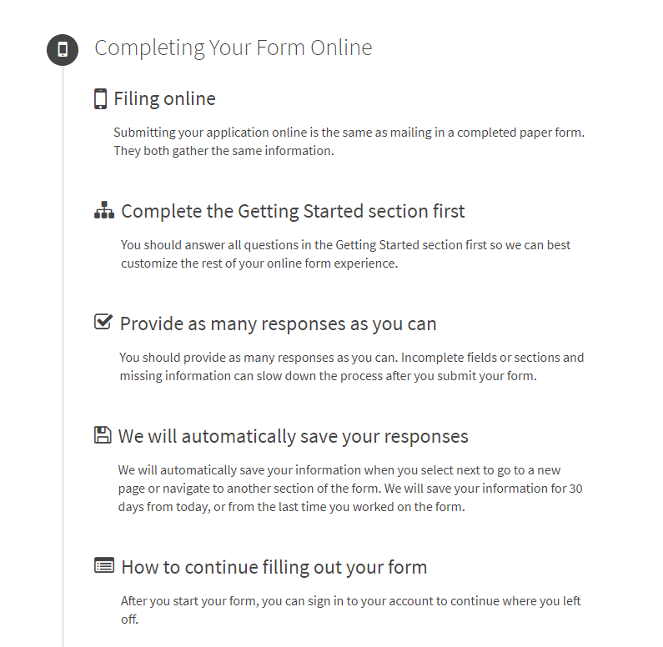
Please continue to read the information on this page as well. This will provide you with information related to filing an online form.
Once you have read through this information, please click the “Start” button at the bottom of the page.

Slide 7
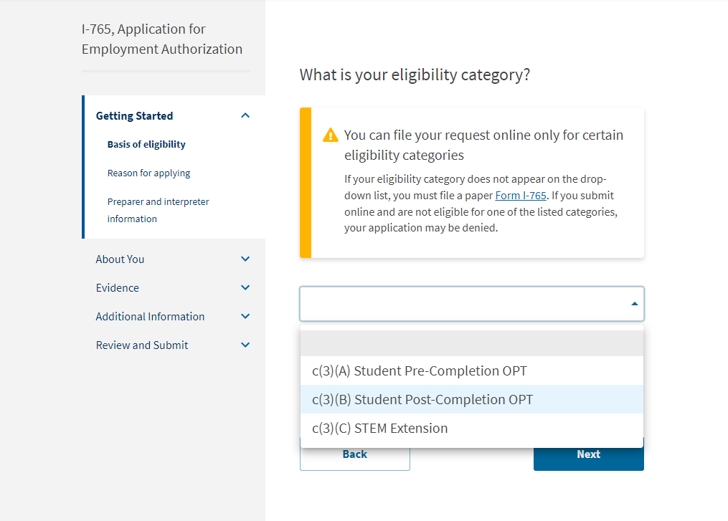
Basis of eligibility
For standard OPT, your eligibility category is c(3)(B) Student Post-Completion OPT
Getting Started
About You
Evidence
Additional Information
Review and Submit

Slide 8
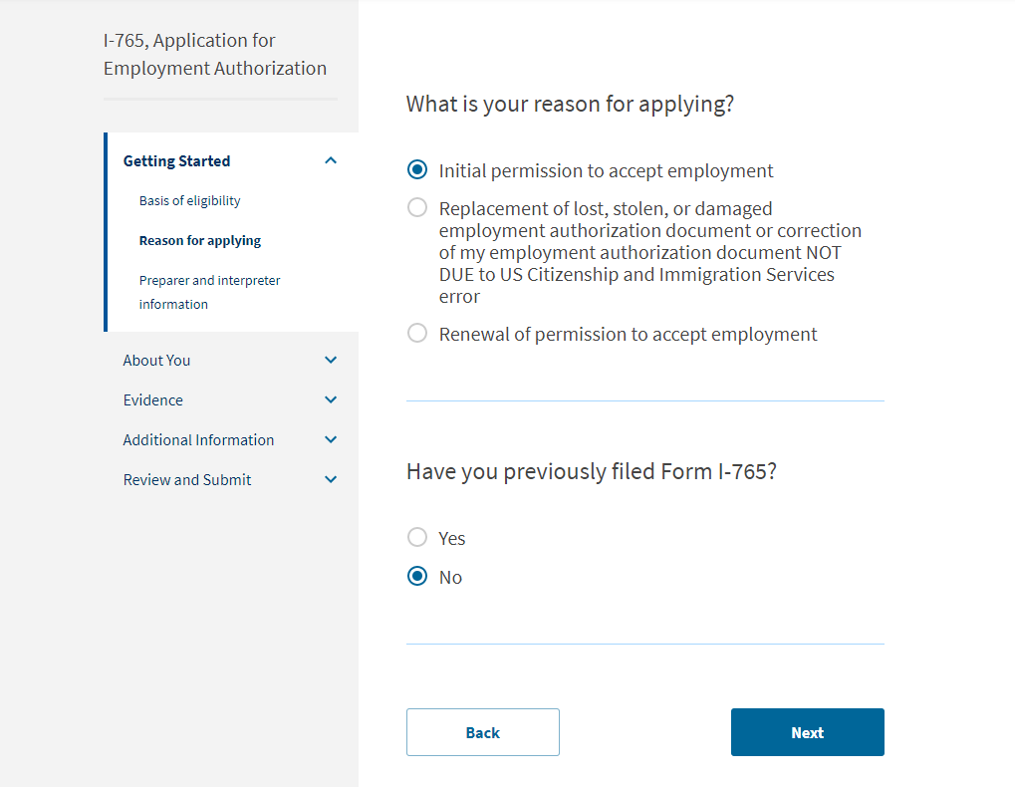
Reason for applying
You should choose “initial permission to accept employment.”
If this is your first time to use Form I-765, select “No.”
If you have filed Form I-765 for previous employment, please select “Yes.”
Getting Started
About You
Evidence
Additional Information
Review and Submit

Slide 9
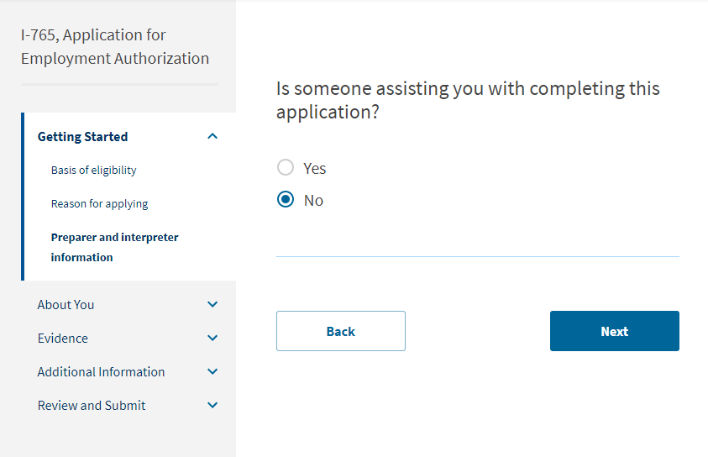
Preparer and interpreter information
You should select “No” unless you have hired someone to assist you in filling out the application.
Getting Started
About You
Evidence
Additional Information
Review and Submit

Slide 10
Your name
Use your legal name as listed in your passport
Be sure to list any other names you go by, such as your American name, nickname, maiden name if you are married.
If you do not have any other names, you can choose “No.”
Getting Started
About You
Evidence
Additional Information
Review and Submit

Slide 11
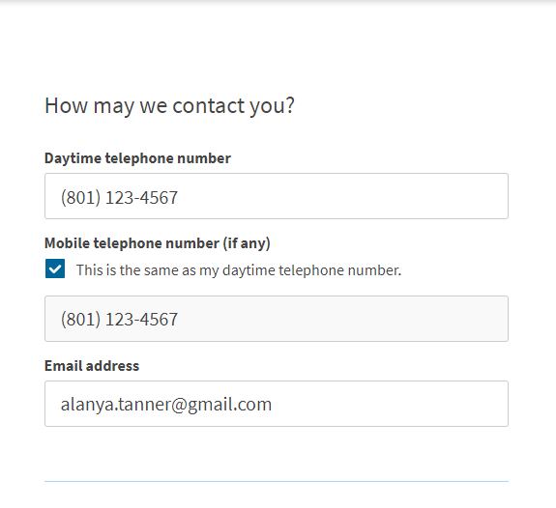
Your contact information
Getting Started
About You
Evidence
Additional Information
Review and Submit

Slide 12
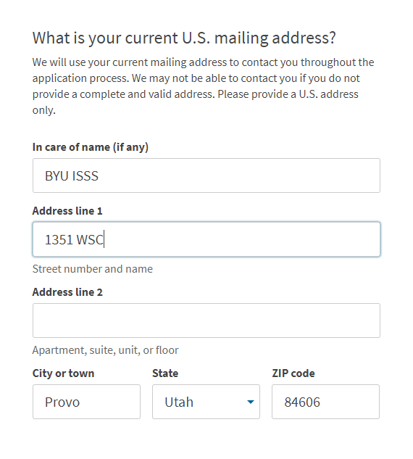
Your current mailing address
Getting Started
About You
Evidence
Additional Information
Review and Submit

Slide 13
Your current mailing address
If this box pops up on your screen, please choose the “Recommended address.”
Getting Started
About You
Evidence
Additional Information
Review and Submit

Slide 14
Your residential address
If it’s different from your mailing address:
Provide the address where you currently live
If it is not:
Select “Yes”
Getting Started
About You
Evidence
Additional Information
Review and Submit

Slide 15
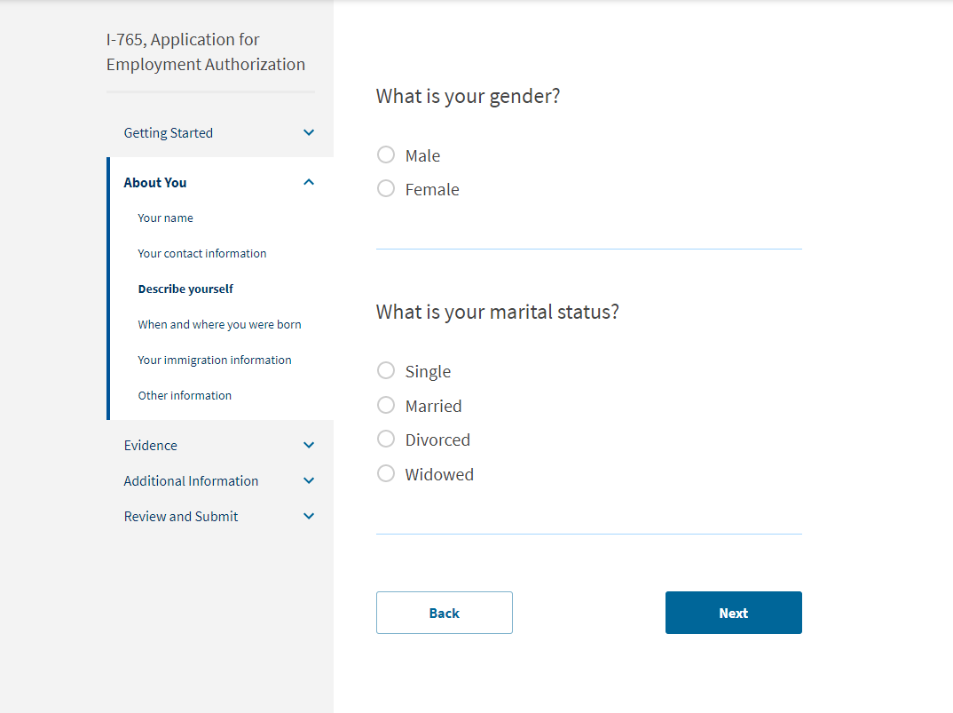
Describe yourself
Getting Started
About You
Evidence
Additional Information
Review and Submit

Slide 16
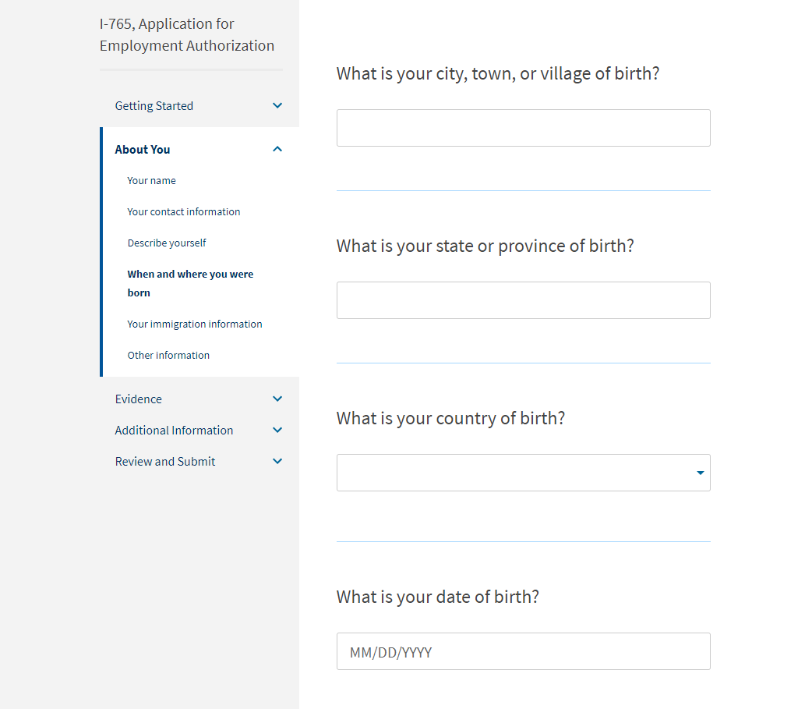
When and where you were born
Getting Started
About You
Evidence
Additional Information
Review and Submit

Slide 17
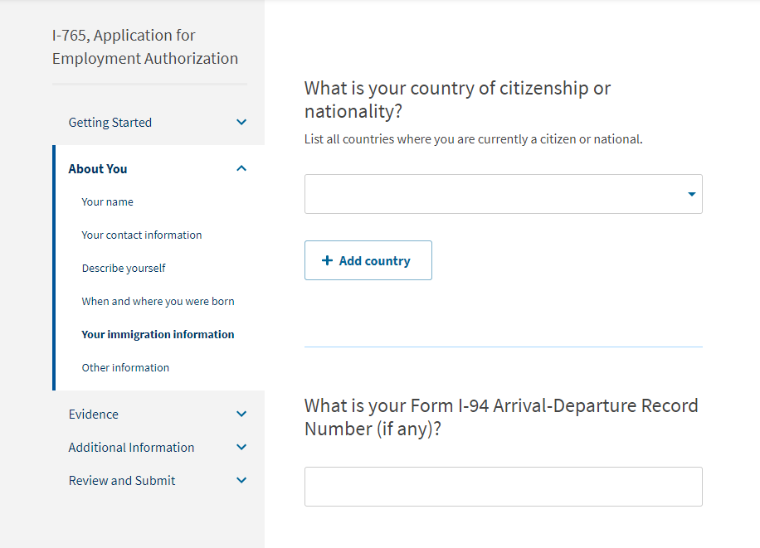
Your immigration information
Form I-94 can be found at i94.cbp.dhs.gov
Select “Get Most Recent I-94” and fill out the required information
The I-94 number can be found at the top of your I-94 record
Please save a copy of the I-94 record to your computer. You will need to upload this document later.
Getting Started
About You
Evidence
Additional Information
Review and Submit

Slide 18
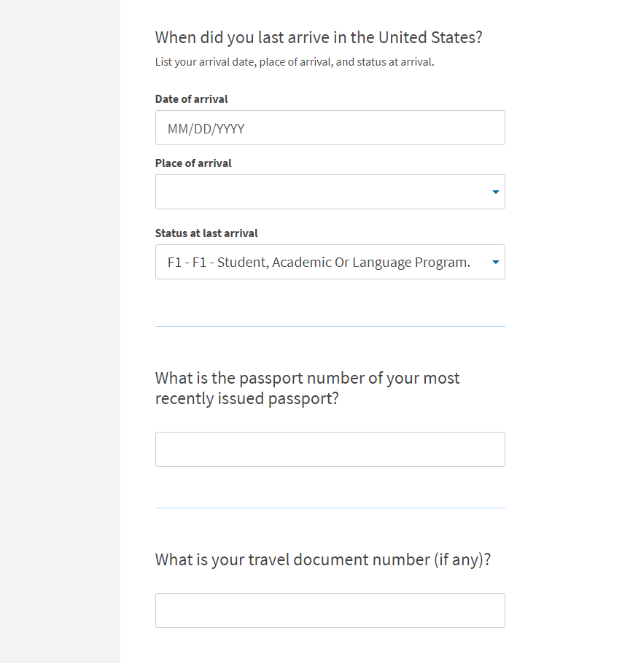
Your immigration information
Be sure to put the correct status of your last arrival. This may be different (i.e. F-2, J-2) than your current F-1 status.
It is uncommon for students to have a travel document number, but if you do, you would know that you have one.
Getting Started
About You
Evidence
Additional Information
Review and Submit

Slide 19
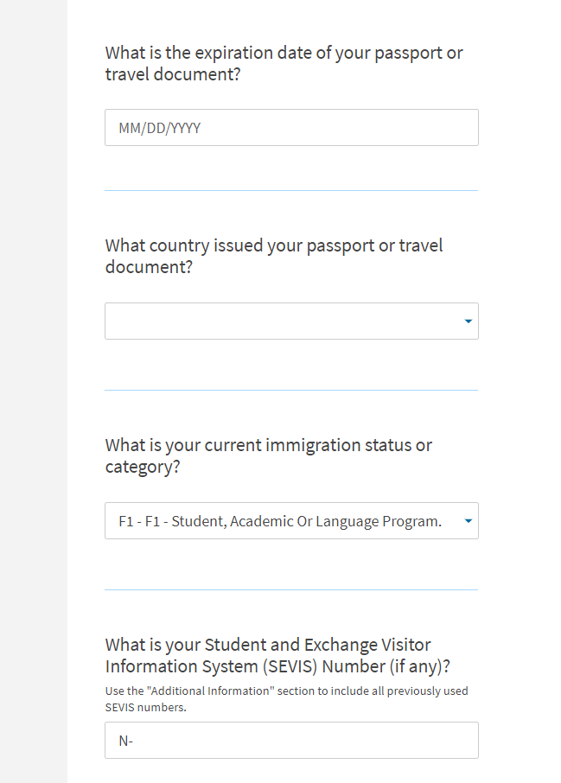
Your immigration information
The SEVIS Number can be found at the top of your Form I-20. It starts with the letter N.
Getting Started
About You
Evidence
Additional Information
Review and Submit

Slide 20
Other information
A-Number
If you have previously applied for OPT, the A-Number is listed on your EAD card as USCIS#
If you do not have an EAD card or do not know of an A-Number, check the box.
Getting Started
About You
Evidence
Additional Information
Review and Submit

Slide 21
Other information
You will only have a USCIS Online Account Number if you have previously filed a form online. Your number will then automatically appear here.
If you do not have or know your my USCIS Online Account Number, please check the box.
Getting Started
About You
Evidence
Additional Information
Review and Submit

Slide 22
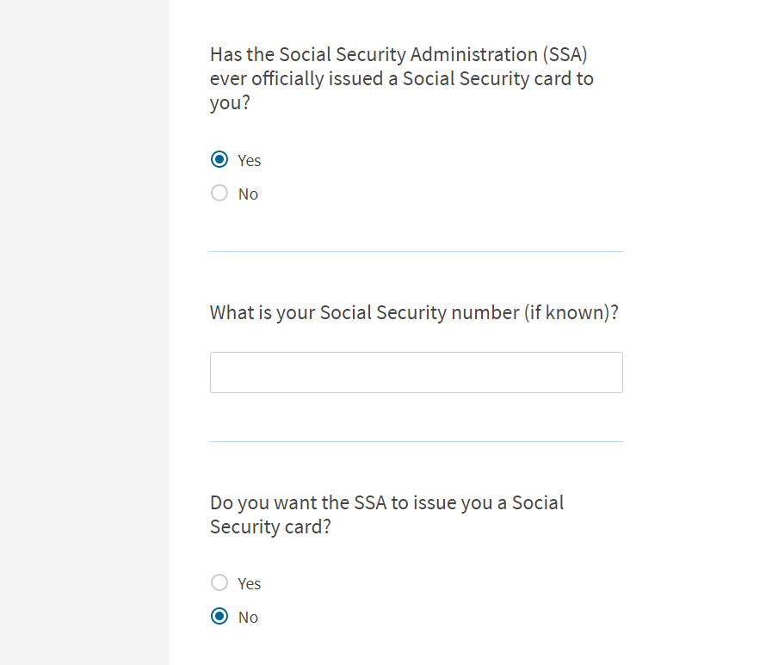
Other information
If you already have a Social Security Card:
Select “Yes” for being issued one
Enter your SSN
Select “No” for being issued a new one
Getting Started
About You
Evidence
Additional Information
Review and Submit

Slide 23
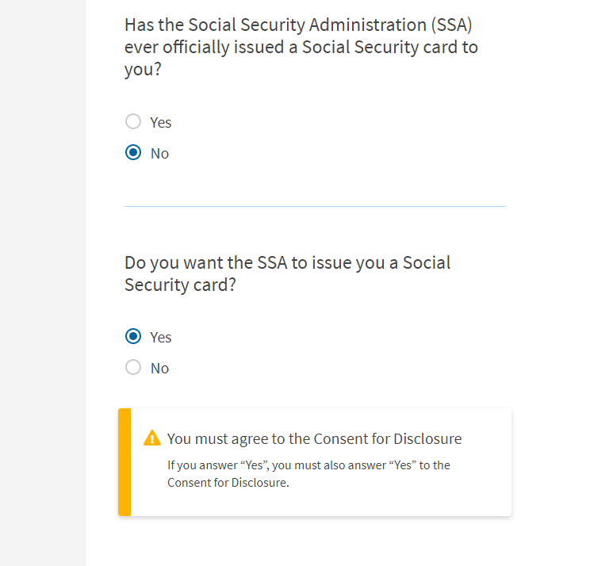
Other information
If you do not have a Social Security card:
Select “No” for having been issued one
Select “Yes” to be issued a Social Security card
Fill out the following boxes that show up
Getting Started
About You
Evidence
Additional Information
Review and Submit

Slide 24
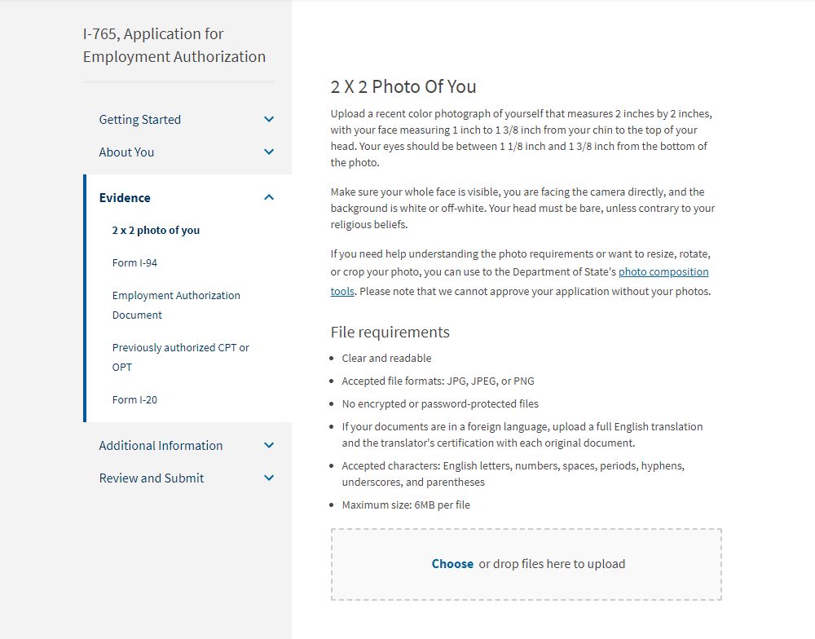
2 x 2 photo of you
Getting Started
About You
Evidence
Additional Information
Review and Submit

Slide 25
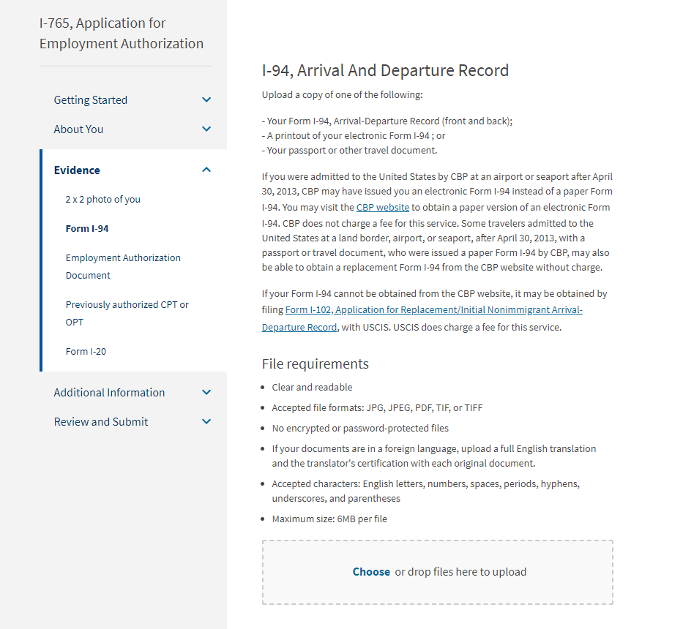
Form I-94
You will upload your I-94 record here.
Form I-94 can be found at i94.cbp.dhs.gov
Select “Get Most Recent I-94” and fill out the required information
Select print to save the I-94 and upload it.
If you have trouble finding your I-94, refer to the information on the USCIS website.
Getting Started
About You
Evidence
Additional Information
Review and Submit

Slide 26
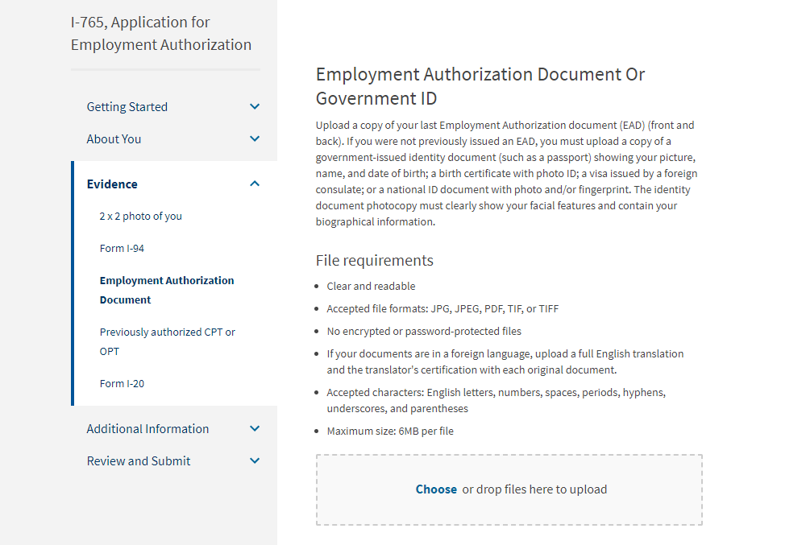
Employment Authorization Document
Please read the information provided to know what document to upload.
Getting Started
About You
Evidence
Additional Information
Review and Submit

Slide 27
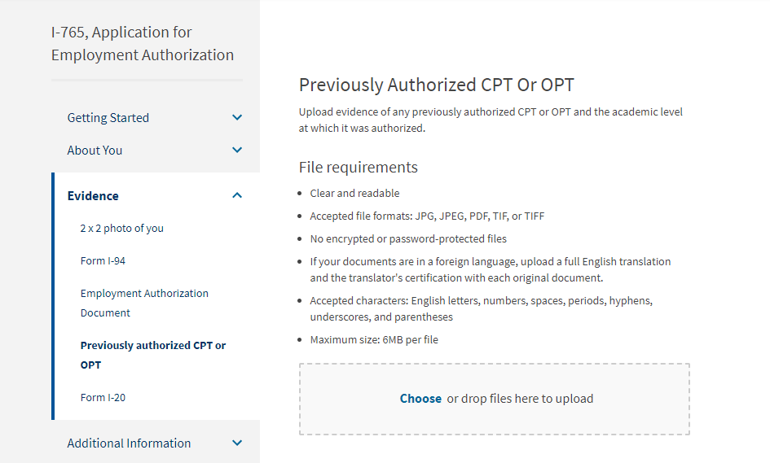
Previously authorized CPT
or OPT
Upload CPT I-20s here. Make sure they are all signed by you with a black ink pen.
Getting Started
About You
Evidence
Additional Information
Review and Submit

Slide 28
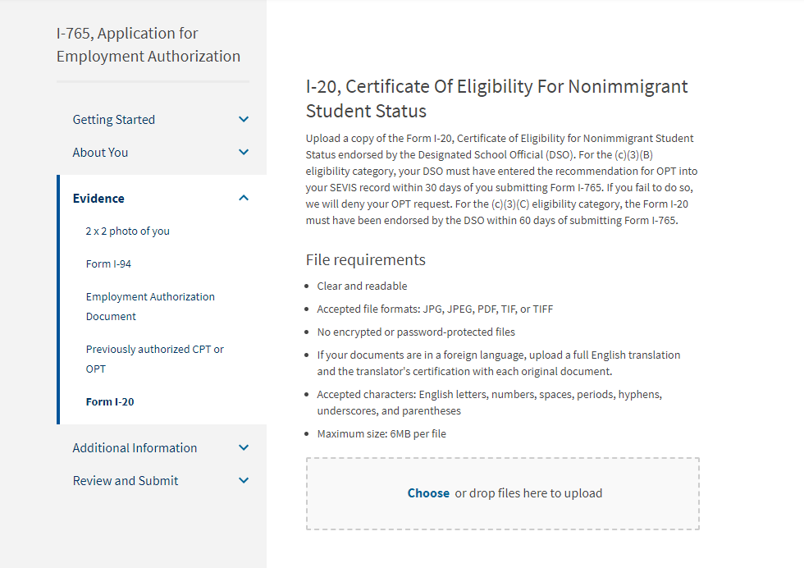
Form I-20
Continue in the application and come back to this page after you have received your OPT I-20 from the OIA office.
Getting Started
About You
Evidence
Additional Information
Review and Submit

Slide 29
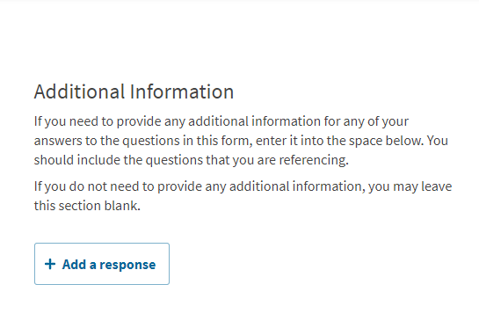
Additional information
Here you can add additional information for your application depending on your personal circumstances and anything that could affect your OPT.
For example, if you entered the U.S. on a previous passport or if your F-1 visa is in the previous passport, we recommend adding your previous passport here.
We recommend talking to the OIA office about the information you want to put here; however, most students do not need to put anything here.
Getting Started
About You
Evidence
Additional Information
Review and Submit

Slide 30
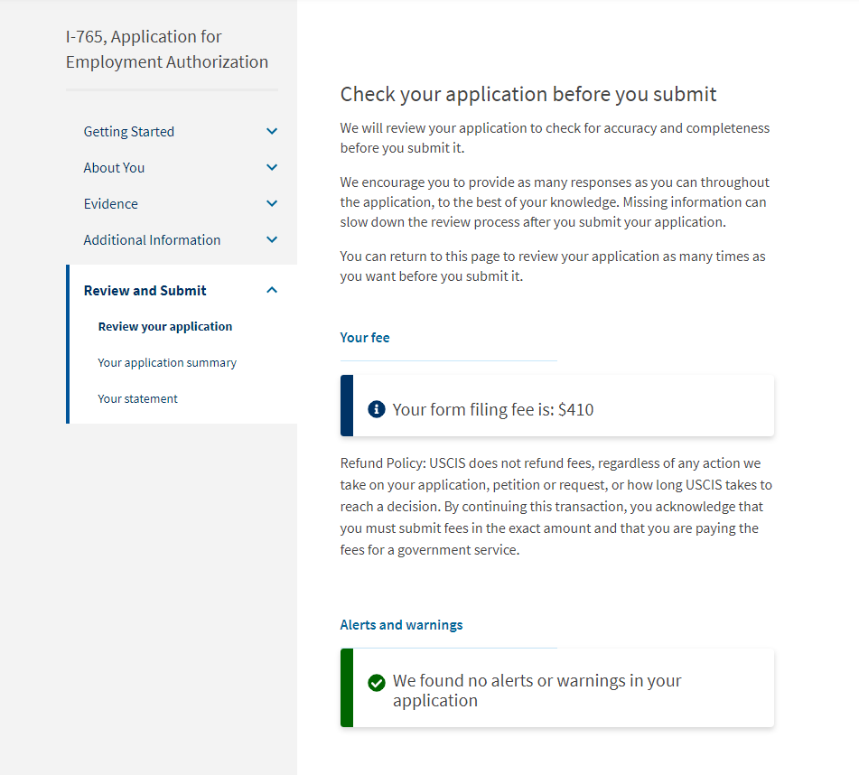
Review your application
Read over all of the information provided on this page of the application.
If there are alerts or warnings, be sure to go back and fix those.
Getting Started
About You
Evidence
Additional Information
Review and Submit

Slide 31
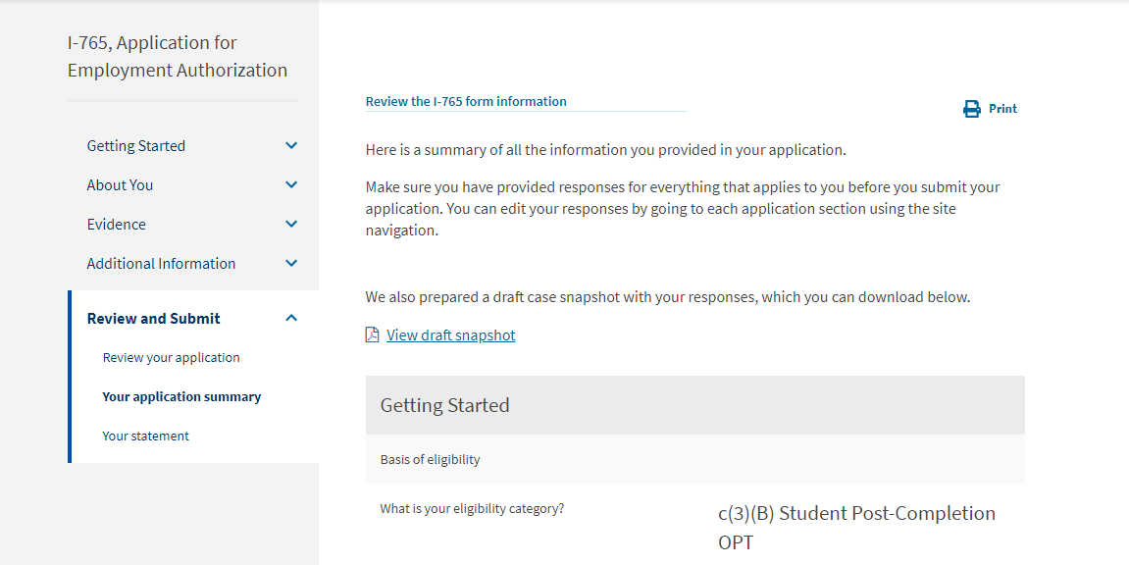
Your application summary
Please review your responses to your I-765
Once you have done so, click on “View draft snapshot”
This will download a version of the I-765 that you should submit with your NSU OPT Packet for your OPT I-20.
Getting Started
About You
Evidence
Additional Information
Review and Submit

Slide 32
Do NOT continue the online I-765 application until you have received your OPT I-20
Now email intl@nova.edu your completed NSU OPT Packet and the I-765 draft

Slide 33
IMPORTANT: Your I-765 application may be submitted up to 90 days before you graduate but must be received by USCIS no later than 60 days after you graduate.

Slide 34
After you receive your OPT I-20…
Submit your I-765 application soon so that USCIS receives your application within 30 days of your OPT I-20 being issued by your advisor.
Also, make sure to return to the following pages in your I-765 application BEFORE submitting...(next slides)

Slide 35
Form I-20
Return to this page!
Make sure the I-20 you upload has a REQUESTED Post-completion OPT on page 2 under the Employment Authorizations section (see image to the right).
Sign your OPT I-20 with a black ink pen.
Getting Started
About You
Evidence
Additional Information
Review and Submit

Slide 36
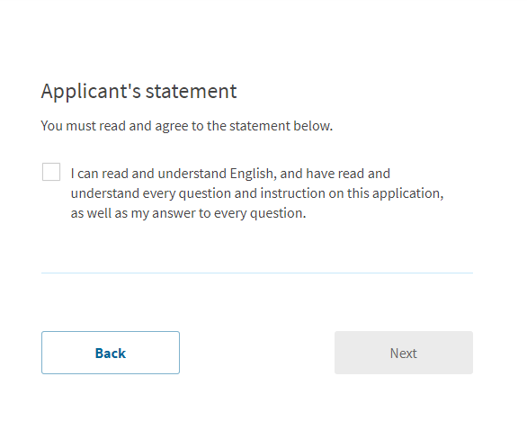
Your statement
Please read this statement and check the box if you agree with it.
Getting Started
About You
Evidence
Additional Information
Review and Submit

Slide 37
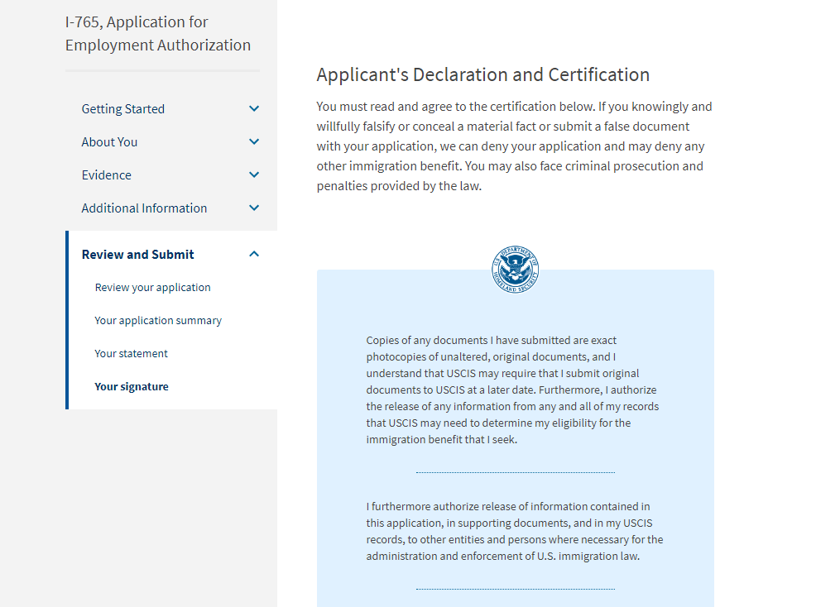
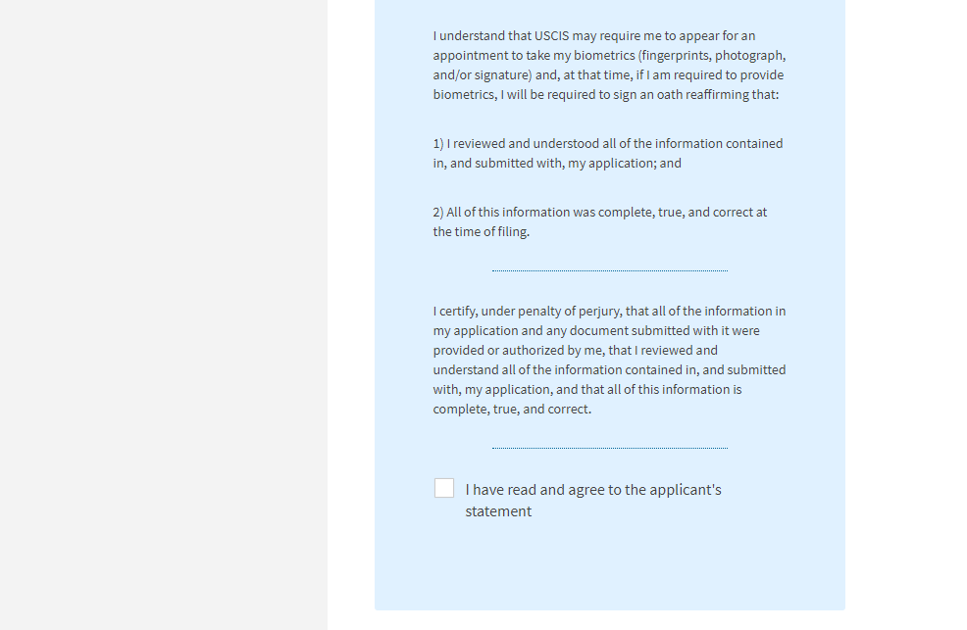
Your signature
Please read through all of this information before signing your application.
Getting Started
About You
Evidence
Additional Information
Review and Submit

Slide 38
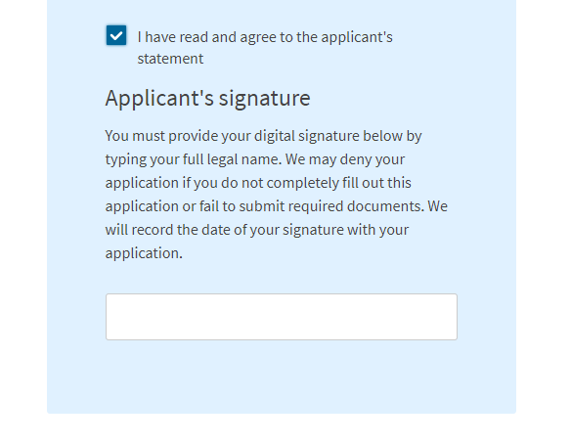
Your signature
Once you have agreed to the statement, be sure to type your full legal name as listed in your passport.
Getting Started
About You
Evidence
Additional Information
Review and Submit

Slide 39
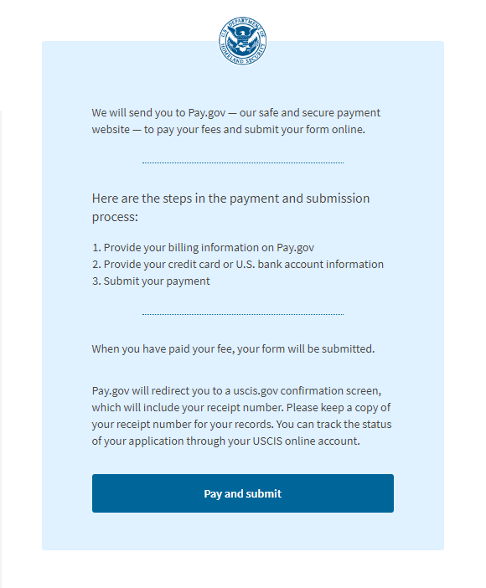
Pay and submit
Please read through all of this information to understand the payment process.
When you are ready to pay, click on the button at the bottom of the page.
Getting Started
About You
Evidence
Additional Information
Review and Submit

Slide 40
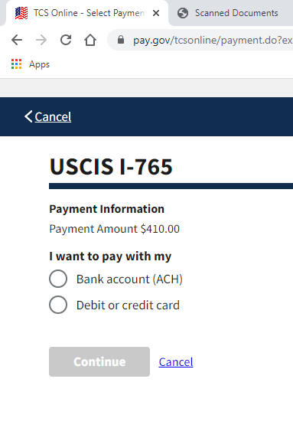
Pay and submit
After you click on "Pay and submit," you will be brought to a page that looks like this:
Choose the method you would like to use to pay for your I-765 application and follow the instructions.
The billing address should be your personal address.
Getting Started
About You
Evidence
Additional Information
Review and Submit

Slide 41
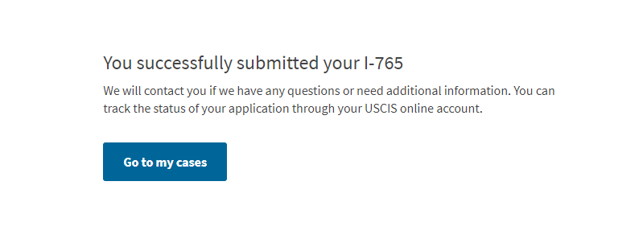
Congratulations!
Once you have paid, you will should be brought back to this page and have successfully submitted your I-765!

Slide 42
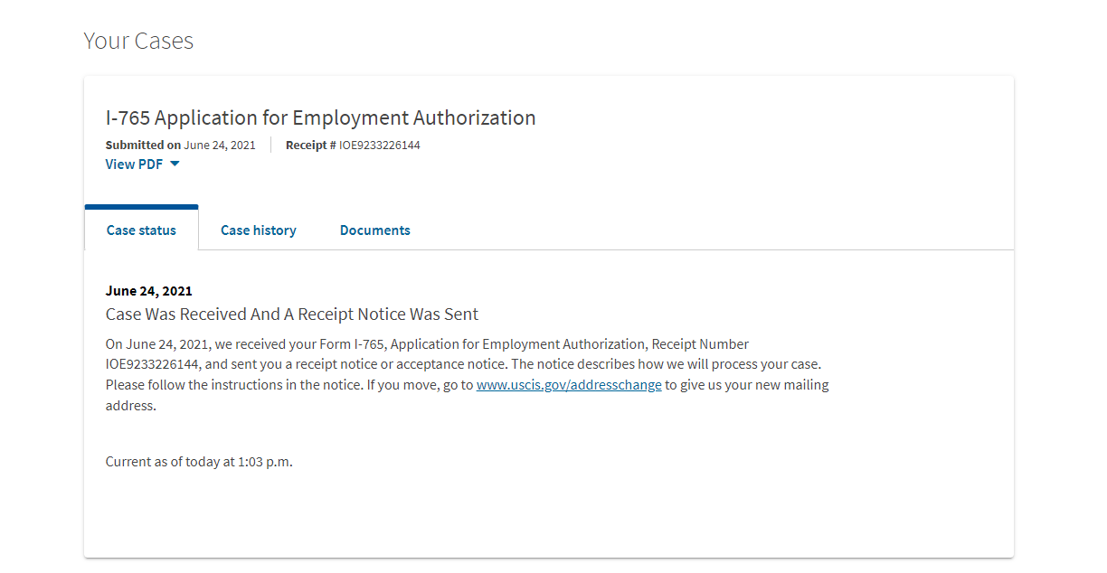
Your cases
You can view the status of your case on the homepage of your USCIS account.

Slide 43
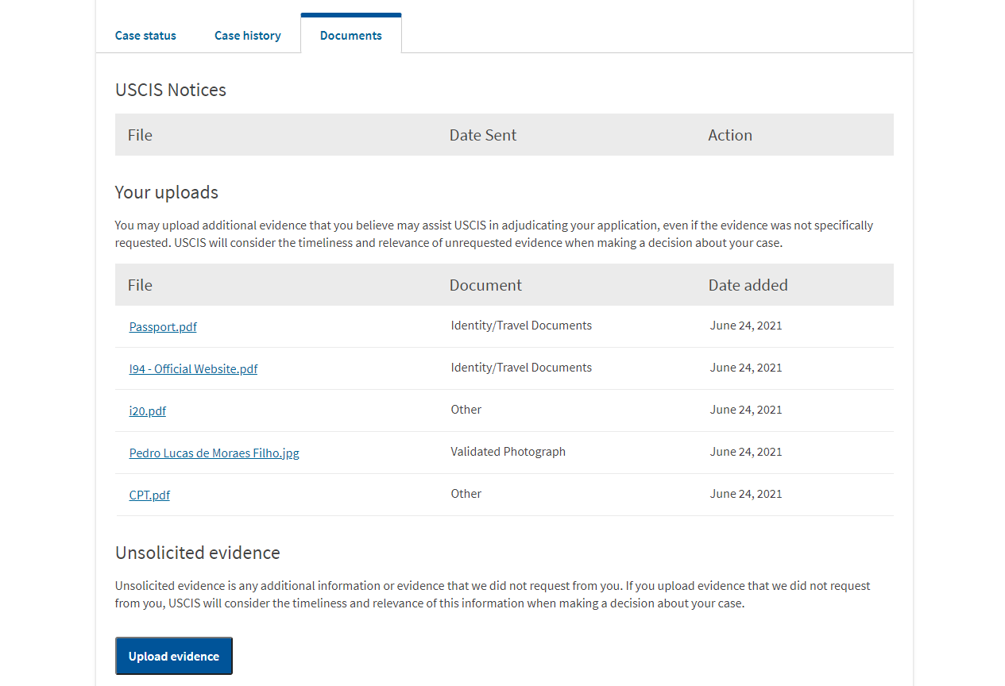
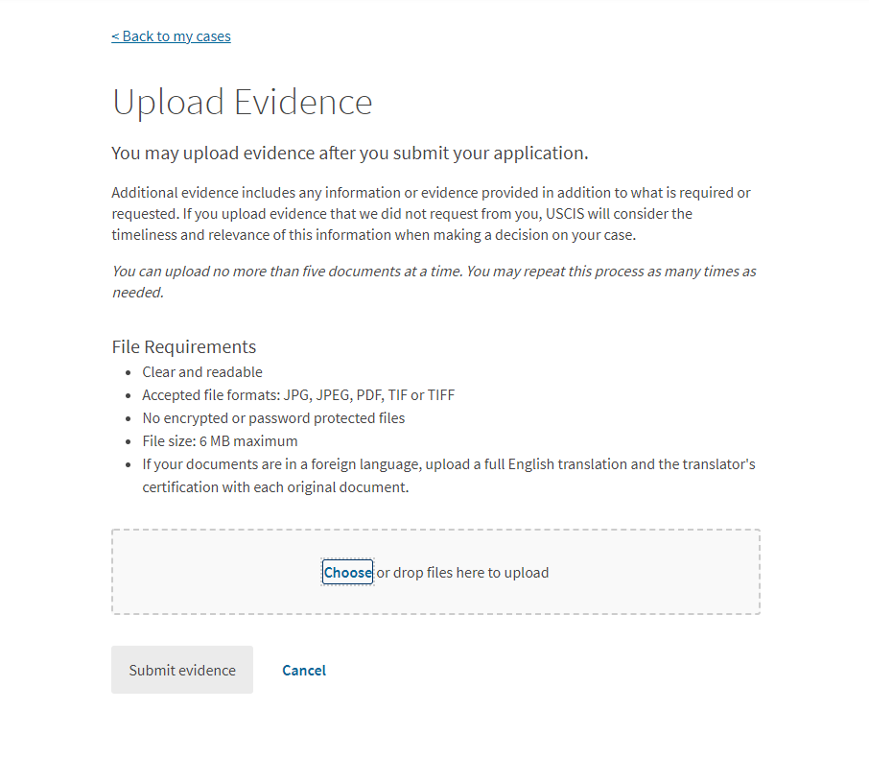
Upload Evidence
If USCIS requests additional evidence, you may upload those documents here.
If needed, please read and follow the instructions provided on their website.

