Slide 1



RETIREE VOLUNTARY BENEFIT PLAN OPTIONS
Notes:
ICUBA has also strategically paired the best in class voluntary benefit carriers for best in class service to our members.
EyeMed administers our vision benefits and Humana administers the dental benefits.

Slide 2

Welcome to Delta Dental PPO – We've got you covered
The Delta Dental Difference®
Visit a PPO dentist to save the most.
You can visit any licensed dentist.
You won’t be charged more than your expected share of the bill.
Delta Dental PPO
Delta Dental Premier®
Non–Delta Dental
Notes:
The Delta Dental Difference
The Delta Dental Difference is rooted in our vast network of PPO and Premier dentists. When you stay in-network and visit one of these dentists, you won’t get charged more than your expected share of the bill.
If you can’t find a PPO dentist, Delta Dental Premier dentists offer the next best opportunity to save. Premier dentists are usually cheaper than going to an out-of-network dentist because there is a limit to how much these dentists can charge.
You can find a PPO dentist at deltadentalins.com.

Slide 3
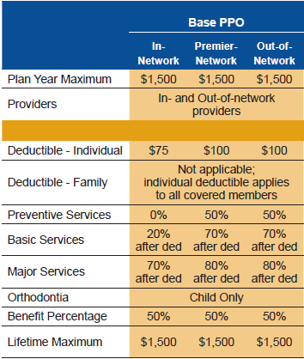
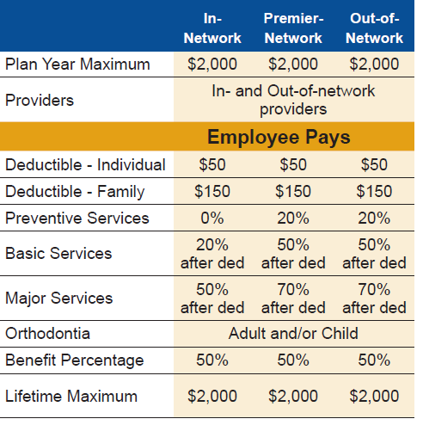
Your PPO coverage
BUY-UP PLAN
BASE PLAN

Slide 4


DeltaCare® USA DHMO
Notes:
Get to know your DeltaCare USA plan.

Slide 5

Coverage beyond Florida
DeltaCare USA DHMO: Coverage across the Unites States (limitations apply)*
The DHMO is available in the following states:
Alabama
Arizona
Arkansas
California
Colorado
Delaware
Florida
Georgia
Illinois
Indiana
Kansas
Maryland
Michigan
Mississippi
Missouri
Nevada
New Jersey
New York
North Carolina
Ohio
Oregon
Pennsylvania
South Carolina
Tennessee
Texas
Virginia
Washington DC
Wisconsin
*The Delta DHMO is only available in approved states!

Slide 6
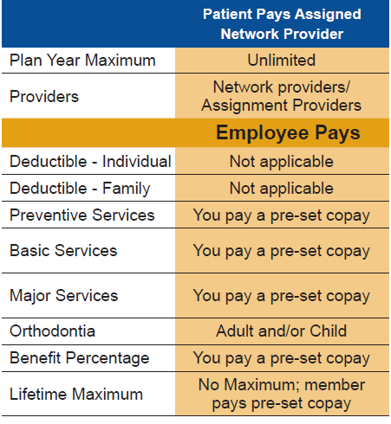
Your DeltaCare coverage
DeltaCare USA DHMO: a prepaid, fixed copayment plan
Once enrolled, select a primary dentist from the DeltaCare USA network to start enjoying:
Set copays
No annual maximums
No deductibles
No claim forms
Low premiums
DHMO benefit enhancements include:
178 more covered DHMO procedures; all-inclusive copays
Posterior composite fillings covered
No missing tooth exclusion
Implants covered
Tooth whitening covered
Notes:
We’ve got you covered
DeltaCare USA provides quality dental benefits at an affordable cost. This budget-friendly plan is easy to use and can help keep your smile healthy. Under this plan you’ll enjoy: More than 300 covered procedures. Benefits include:
General anesthesia/IV sedation
Extractions for orthodontics
Occlusal guards and adjustments
Fixed bridgework
Highly utilized cosmetic procedures: Bleaching; Additional cleanings at a set copayment; Posterior composites
Predictable costs. You’ll know your copayments for covered services, up front.
Receive many diagnostic and preventive services (including cleanings, x-rays and amalgam [silver] fillings) with no or low copayments.
Pay only your copayment (if any) at the time of treatment.
Receive covered services with no deductibles or maximums.*
No claim forms.
-----------------------------------------
Last updated: 7/19

Slide 7

OVER 65 RETIREE DELTA DENTAL PLAN COSTS
Notes:
Here are your 2021 dental plan rates

Slide 8

EyeMed Vision Plans
Frequency Limitations | Base Plan | Buy Up Plan
Examination | Once every 12 months | Once every 12 months
Frame | Once every 24 months | Once every 12 months
Lenses or Contact Lenses | Once every 12 months | Once every 12 months
Vision Care Services* | “In-Network Member Cost” | “In-Network Member Cost”
Exam With Dilation as Necessary | $5 Copay | $5 Copay
Frames | $0 Copay; $130 allowance; 20% off balance over $100 | $0 Copay; $160 allowance; 20% off balance over $130
Standard Plastic Lenses Single Vision, Bifocal, Trifocal | $15 Copay | $15 Copay
Standard Progressive Lens | $65 Copay | $65 Copay
Conventional Contacts | $0 Copay; $100 allowance; 15% off balance | $0 Copay; $130 allowance; 15% off balance
Disposable Contacts | $0 Copay; $100 allowance; plus balance | $0 Copay; $130 allowance; plus balance
Visit www.eyemed.com or call 1-866-804-0982 | ICUBA is on the INSIGHT Network!
* Please refer to EyeMed Plan Summary for more detailed information and out of network options.
Notes:
Vision coverage through EyeMed comes the availability of two plans the base and the buy-up, we will highlight for the the difference in the two plans….
REVIEW COVERAGE…

Slide 9
OVER 65 RETIREE EYEMED VISION PLAN COSTS
Notes:
Here are your 2021 Vision plan rates

Slide 10

FAQ’s & ADDITIONAL BENEFITS INFORMATION
This Photo by Unknown Author is licensed under CC BY-SA
Notes:
In this next section we will review vesting and other important plan reminders.

Slide 11
VESTING
A Participant will become fully vested in his or her HRA after:
he or she has remained an Eligible Employee for 36 consecutive months
AND
the Employer has made continuous contributions to such Participant’s
HRA for a consecutive 36-month period.
Being “vested” in your HRA allows you to continue using your remaining HRA balance and your ICUBA Benefits Master Card for eligible medical, dental, vision and prescription out-of-pocket expenses until your balance is exhausted.
As a RETIRED employee you will unfortunately, no longer have access to your ICUBA MasterCard portal via icubabnefits.org To view your current HRA balance please log-on to www.mywealthcareonline.com/icubamastercard
There is a $10.60 monthly administration fee that will be automatically deducted from your available vested HRA balance.
Notes:
REMINDER: Give retiree their schools Company Key during this slide

Slide 12
WHAT ABOUT DEPENDENTS?
May I add dependents when I retiree?
No, you can only elect retirement coverage for those eligible dependents currently enrolled on your medical plan at the time of retirement.
May I add a dependent to my retiree coverage once I am already on the retiree plan?
You are permitted to add a dependent acquired after the date your retiree coverage goes into effect if you acquire the dependent due to a life status change such as marriage, birth or adoption.
What if I am over 65 and my spouse is under 65 or vice versa?
The individual that is over 65 will have the option of choosing the: ICUBA Retiree Medical Plan (BCBS) or ICUBA Retiree Supplemental Medical Plan.
The individual that is under 65 may enroll in the ICUBA Retiree Medical Plan (BCBS)Note: when age 65 is attained, you will have the option of switching to the ICUBA Retiree Supplemental Medical Plan.

Slide 13
FREQUENTLY ASKED QUESTIONS
Can you provide me with a letter of credible coverage?
You can request a letter of credible coverage by emailing benefitsadministation@icuba.org
Does my retiree health insurance coverage change when I, or my covered dependent, reaches age 65?
Yes, when you and/or your covered dependent reach age 65, you must apply for Medicare A & B, which will become your primary health insurance coverage.
Your ICUBA medical plan insurance plan will be your secondary coverage. Note: an active election is required to continue medical coverage beyond the age of 64.

Slide 14
FREQUENTLY ASKED QUESTIONS
I will be turning 65 soon, what is the difference in the two plans offered to me?
The Medicare supplemental plan acts a supplemental coverage, the plan will usually cover all expenses not covered by Medicare after your deductible and OOP has been met. The ICUBA medical plan functions not as supplemental but secondary coverage; once the claim has been processed by Medicare it will be sent to BCBS and the claim will be processed in line with ICUBA plan benefits.
When and how do I apply for Medicare B?
Approximately three months before you and/or your covered dependent reach age 65 or, within 3 months of your retirement date at age 65 or older, contact your local Social Security Administration office to apply.

Slide 15
FREQUENTLY ASKED QUESTIONS
When and how do I apply for Medicare B?
Approximately three months before you and/or your covered dependent reach age 65 or, within 3 months of your retirement date at age 65 or older, contact your local Social Security Administration office to apply.
Is there a cost associated with Medicare B?
Yes, the monthly cost of Medicare B usually changes each year on January 1 and is automatically deducted each month from your social security check. Please contact the Social Security Administration to determine the current cost of Medicare B coverage.

Slide 16
FREQUENTLY ASKED QUESTIONS
I am a retiree. Will retiree coverage be extended to my eligible survivors when I die?
No, If you predecease your covered dependents, they will be offered 36 months of continuation coverage through COBRA. Notification of passing must be received by ICUBA within 60 days of your death.
Can I make changes to my coverage at any time?
You can cancel coverage for yourself or a dependent at any time but if you cancel your medical coverage, you will not be allowed to re-enroll in the program at a later date; otherwise, you must experience a Qualifying Life event and make changes within the 30-day life event window.
Will I receive a new health insurance identification card after I retire?
For your Medical, Vision and Behavioral Health coverage, No new cards will be issued
Prescription and Dental- New ID cards will be issued.

Slide 17
PAYMENT OPTIONS
Once your enrollment form is received and processed (2-3 business days), you will be sent billing coupons and information about your payment options such as:
Vested HRA funds (ICUBA MasterCard)
Credit Card
Check
Electronic Funds Transfer
Payments are due on the first of each month. Coverage will be cancelled, and reinstatement not allowed, if the first premium payment is not made within 60 days of the date of the original election of retiree coverage.
Notes:
Review slide directly…

Slide 18

RETIREE BRAND PARTNER CONTACT INFORMATION
ICUBA RETIREE ADMINISTRATION
(Wex, formerly Discovery Benefits)
1-866-377-5102 Option 3
E-mail: cobraadmin@discoverybenefits.com
Escalations: retireeadministration@icuba.org
BCBS CARE CONNECTED TEAM
Customer Service: 1-855-258-9029
24/7 Essential Advocate: 1-888-521-2583
Teladoc ($5): 1-800-TELADOC
OPTUMRX
Optum Healthcare Advisor: 1-855-811-2213
ICUBACares Pharmacist: 1-877-286-3967
AETNA Mental Health and Substance Abuse
Customer Service: 1-877-398-5816
Option 1: Employee Assistance Program
Option 2: Behavioral Health
DELTA DENTAL
Customer Service: 800-521-2651
Website: www.deltadentalins.com
EYEMED
Customer Service: 1-866-800-5457
Provider Network: Insight
AMWINS
1.888.883.3757
This Photo by Unknown Author is licensed under CC BY-NC-ND

Slide 19
ICUBA RETIREE DROPBOX
EARLY RETIREE PLAN INFORMATION
https://www.dropbox.com/home/Early%20Retiree%20Plan%20Information
65+RETIREE PLAN INFORMATION
https://www.dropbox.com/sh/31bozaxxhr88f0m/AADpRk1Q2RQtRXFMqKxy7sYpa?dl=0

Slide 20
THANK YOU, AND HAPPY RETIREMENT! Additional Plan information can be found in the ICUBA Retiree Dropbox

