Slide 1

UNDERSTANDING YOUR RETIREMENT BENEFIT PLAN OPTIONS
2021 ICUBA OVER 65 RETIREE BENEFITS PRESENTATON
PART I
Notes:
Hello and Welcome to ICUBA’s “Understanding your retirement benefits plan options” presentation for the plan year beginning April 1st 2021.

Slide 2

TOPICS OF DISCUSSION
Qualifying for retiree benefits
Your Enrollment Options
ICUBA Retiree Plans vs. COBRA
Enrolling as a Retiree
AmWINS-Medicare Supplemental Plan offering
AmWINS Costs
ICUBA Retiree Medical (BCBS) Plan Offerings
Schedule of Medical Benefits
Prescription Drug Plan
Aetna BH Benefits
Additional Benefits Information
ICUBA (BCBS) Medical Plan Costs
Humana Dental Plan Option(s)
Humana Dental Plan Costs
EyeMed Vision Plan Option(s)
EyeMed Vision Plan Costs
FAQ’s & Additional Benefits Information
ICUBA Retiree Dropbox
ICUBA (BCBS) Early Retiree Plan Costs
Notes:
Read Quote
So that is our goal today, to help you fully learn your retiree benefit options
We will be reviewing…..
(Read topic of discussion)

Slide 3
QUALIFYING FOR RETIREE BENEFITS through ICUBA
DO I QUALIFY FOR RETIREE BENEFITS?
Retirees must meet the “Member Institution’s” definition of Eligible Retiree in order to be covered under the ICUBA Retiree Plan.
ICUBA ELIGIBLE RETIREE DEFINITION
Eligible Retiree shall mean each Employee who (1) is a Participant in the Plan during the 3-month period immediately prior to retirement from a Member Institution; (2) was Actively at work on the day prior to retirement; and (3):
is at least 55 years of age and has 10 years of continuous service with a Member Institution;
is at least 56 years of age and has 9 years of continuous service with a Member Institution;
is at least 57 years of age and has 8 years of continuous service with a Member Institution;
is at least 58 years of age and has 7 years of continuous service with a Member Institution;
is at least 59 years of age and has 6 years of continuous service with a Member Institution; or
is at least 60 years of age and has at least 5 years of continuous service with a Member Institution.
Retirees and their Dependents MUST enroll in coverage within 30 days of retirement unless the Eligible Retiree or Dependent chooses COBRA Continuation Coverage in lieu
of the Retiree Plan.
This Photo by Unknown Author is licensed under CC BY-SA
Notes:
So let’s get started.
Qualifying for retiree benefits through ICUBA
To be an eligible retiree you must meet your member institutions definition of “eligible retiree:” which is listed below and states you must be:
A participant of the plan during the 3-months immediately prior to retirement
You must be actively at work on the day prior to retirement and
Your age and years of service must equal at least 65. (May change by school)

Slide 4
RETIREE ENROLLMENT OPTIONS
EARLY RETIREES
Retirees under the age of 65 will be offered, during their initial retiree enrollment to continue the same benefits, he/she was enrolled in directly proceeding their retirement.
OVER 65 RETIREES
Retirees who are age 65 and over will be offered, during their initial retiree enrollment a choice between the Retiree Medicare Supplemental plan or to continue to be enrolled in the same benefits, he/she was enrolled in directly proceeding their retirement.
Notes:
If you are not yet 65 years of age, you will be considered an early retiree. Upon retirement you will be given the option to enroll in the ICUBA retiree plan or COBRA. No matter what tier you choose you will be given the option continue the same benefits you were enrolled in directly preceding retirement.
If you are at least 65 years of age, you will be considered an Over 65 Retiree. Upon retirement you will have three options: enroll in COBRA, enroll in the Medicare supplemental plan or continue on the ICUBA retiree benefit plans.

Slide 5
ICUBA RETIREE PLANS vs. COBRA
ICUBA RETIREE MEDICAL PLANS
You do not pay an administration fee
Your coverage will continue until you cancel it (or your coverage is cancelled for non-payment of premiums
You will have the option of enrolling in the Medicare Supplemental plan when you turn 65
No payment fee for monthly premiums paid by credit card or EFT.
COBRA
A 2% administration fee is added to you COBRA premium each month.
Your coverage ends after 18 months
You will not have the option to enroll in any other plans once you are enrolled in COBRA you forfeited the right to any of your retiree benefits.
There is a payment fee if you make COBRA payments by credit card or EFT.
Notes:
What is the difference between the retiree tier and the COBRA tier of continuation?
As a retiree you do not have to pay additional premium for the 2% COBRA administration fee
As a retiree you are allowed to continue on the coverage for as long as you choose
When you turn 65 you will have the option to continue on with either the ICUBA or AmWINS 65 plus plans
And lastly
If you choose to make payment by EFT or credit card there is no transaction fee.

Slide 6
ENROLLING AS A RETIREE
To enroll in benefits as a Retiree, you must complete and return an enrollment form or make your benefit elections:
Within 30 days of retirement and becoming eligible for Retiree benefits. If you do not enroll within the 30-day enrollment period, you will permanently forfeit your eligibility for all Retiree insurance coverage.
During annual enrollment by the stated deadline. If you do not make any benefit changes, you will automatically be enrolled in your current benefit elections or to the stated default coverage if your existing plan(s) is/are changing.
When you have a mid-year qualifying event (marriage, birth or adoption of a child, loss or gain of eligibility for other health insurance coverage - voluntarily canceling other health insurance does not constitute loss of eligibility) and want to make an allowed mid-year change in benefit elections. This change must be made within 30 days of the event. Documentation to support the change will be required. No Exceptions
Notes:
Enrolling as a retiree:
Once your active employment is terminated you will receive your retiree enrollment paperwork in the mail, you will have 30 days from the date of your retirement or from the postmark date on your paperwork, whichever is greater; to complete and return your signed enrollment forms.
You will also be given the opportunity, each year to participate in the retiree open enrollment, at that time you will be given the opportunity to make changes to your current retiree benefits based on the plans currently being offered by your former school or university, for the next plan year
And Lastly,
You are given the option to make mid year enrollment changes if you or one of your eligible dependents experience a qualifying life event.

Slide 7

MEDICARE SUPPLEMENTAL PLAN INFORMATION
We are pleased to provide you with information regarding your 2021 Retiree Medical Plan and Prescription Drug Plan sponsored by ICUBA.
ICUBA’s group healthcare program includes the comprehensive Manage My Health benefit. This program offers greater assistance to our retirees and spouses by giving them easy, confidential access to an extensive suite of programs and services aimed at improving your physical and mental wellbeing.
In 2021, you will have access to 24-hour access to doctors on call, counseling services for stress, depression, mental health, grief and bereavement. Manage My Health also includes programs for nutrition, assistance finding doctors and specialists near you, and resources for individuals who are at high-risk of falling victim to scams or identity theft, or who believe that their identity may have already been compromised. New program enhancements will become available as of January 1, 2021.
If you have any questions, please call the AmWINS Group Benefits Customer Care Center toll-free at 1-888-883-3757, Monday through Friday, 8:00 AM to 8:00 PM (EST).
Notes:
So now we can transition into your retiree enrollment plan options, as an individual over the age of 65 your first retiree plan option is the Retiree Medicare Supplemental Plan, which is brought ICUBA by AmWINS and is underwritten by TransAmerica.
This particular health plan includes the…. (begin reading at second paragraph)
All of these benefits are in effect effective January 2021 and now we will move into the plans medical benefits summary..
Next slide

Slide 8


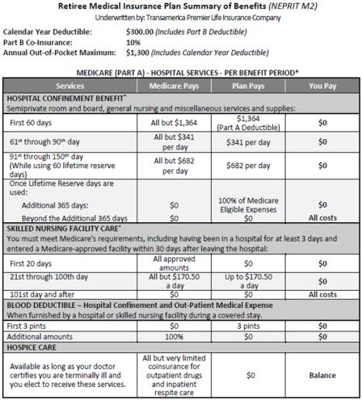
AmWINS 2021 Plan Benefits-Hospital Services
This Photo by Unknown Author is licensed under CC BY-ND
Notes:
Please keep in mind that if you choose this plan your plan year will switch to a calendar plan year.
As you can see here this plan has:
A $300 calendar year deductible (this is set by Medicare each year)
A co-insurance of 10%
And an annual out-of-pocket max of $1300
We’ll fist review the Medicare Part A Hospital Services Benefit
REVIEW PAGE

Slide 9
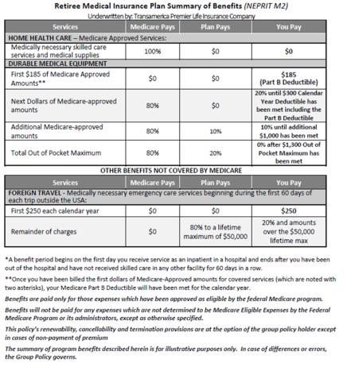
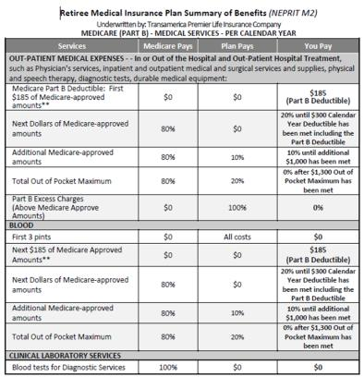
AmWINS 2021 Plan Benefits-Medical
Notes:
Next, is the Medicare Part B Medical Services benefits
REVIEW PAGE….

Slide 10
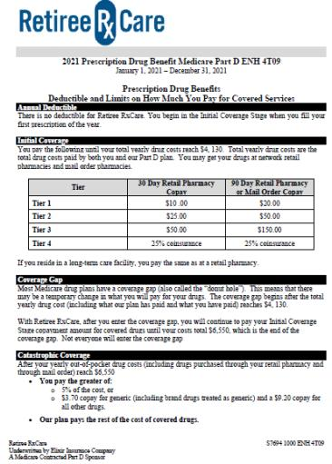

AmWINS 2021 Plan Benefits-Prescription Drug
Notes:
And lastly, this is the Medicare Supplemental plans prescription drug benefits…
Based on the tier your drug would fall in the schedule is listed there, we have also included this plans prescription drug formulary at the end of the presentation for reference.
So this basics of this plan..
You pay the listed amounts until your yearly drug costs reach $4020
With Retiree Rx Care, there is not “donut hole” after you enter the coverage gap you will continue to pay your initial co-payment amount until your costs total $6350, which is the end of the coverage gap.
After your yearly out-of-pocket total reaches $6350 you will pay the greater of:
5% of the cost, or
$3.60 copay for generics and $8.95 for all other drugs, the plan pays the rest of the cost for the covered drug.

Slide 11
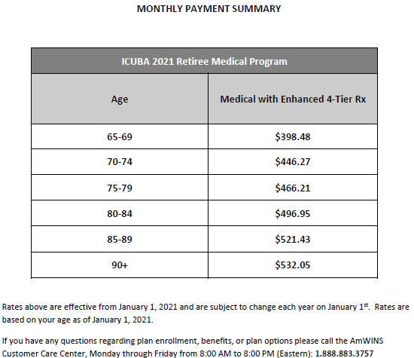
AmWINS OVER 65 MEDICAL PLAN COSTS
Notes:
Here are the rates for the Retiree Medicare Supplemental plan.

Slide 12



RETIREE Medical, Prescription Drug & Behavioral Health Plans
Notes:
Your second retiree plan option is the ICUBA(BCBS) medical plans as most of your are aware,
ICUBA strategically pairs the best in class carriers for best in class service to our members.
Blue Cross Blue Shield administers our medical benefits
Optum Rx administers our prescription drug benefits and
Aetna Resources for Living handles our behavioral health, substance abuse benefits

Slide 13
ICUBA Medical Plan Highlights (In-Network Only)
In-Network Benefit Summary Comparison | Preferred PPO | $4,000/$8,000 Deductible | Premier CoPay
 | In-Network | In-Network | In-Network
 | Employee Pays | Employee Pays | Employee Pays
Deductible (Individual/Family) | $2,500/$5,000 | $4,000/$8,000 | $2,500/$5,000
Coinsurance | 20% | 30% | 20%
Out-of-Pocket Maximum (Individual/Family) Includes all medical copays, deductibles & coinsurance | $4,000/$8,000 | $5,350/$10,700 | $4,000/$8,000
Physician Office Visits | $25 copay | $25 copay | $25 copay
Total Care (BDTC) (Family Practice, Internal Medicine, Pediatrics) | $0 | $0 | $0
Specialist Office Visits | $50 copay | $50 copay | $50 copay
Convenient Care Clinics | $10 copay | $10 copay | $10 copay
Independent Clinical Labs* (free standing facilities & office visits) | 0%* | 0%* | 0%*
Preventive Care | 0% | 0% | 0%
Teladoc Visit | $5 copay | $5 copay | $5 copay
Urgent Care Center | $50 copay | $50 copay | $50 copay
Emergency Room Services | 0% after $300 copay (waived if admitted) | 0% after $300 copay (waived if admitted) | 0% after $300 copay (waived if admitted)
Ambulance | $250 copay | $250 copay | $250 copay
Hospital Inpatient | 20% after deductible | 30% after deductible | 20% after deductible
* After Deductible ** After Limited Deductible: $2,000 of the $4,000 Individual Deductible
Notes:
First are the ICUBA medical plans, (please remember your only option at your initial retirement is to continue with the plan you are currently enrolled in) please also remember that the 4K/8K plans is not offered to 65+ retirees during OE.
REVIEW PLAN DETAILS…

Slide 14

ICUBA Prescription Drug Plan
 |  | 90-Day saves $$$!
Tier | 30-day (Retail Only) | 90-day (Retail & Mail) | 90-Day (Mail Only)
Preferred Generics at NSU Pharmacy | $0 | $0 | N/A
Preferred Generics | $5 | $10 | $10
Non-Preferred Generics | $10 | $20 | $20
Preferred Brands | $40 | $80 | $80
Non-Preferred Brands | $75 | $150 | $150
Specialty (Briova Rx)* | $75 | N/A | N/A
Prescription Drug Out of Pocket Maximum
In-network Rx copays will be applied toward an individual maximum out-of-pocket of $2,000 and $4,000 for family.
Prescribed diabetic supplies including meters, lancing devices, lancets, test strips, control solution, needles, and syringes; prescribed Aspirin for adults, prescribed generic folic acid and generic prenatal vitamins for pregnancy, prescribed generic statins (if eligible)
* Specialty medications are limited to a 30-day supply. Copay Assistance Cards are acceptable to Preferred Specialty products. Please refer to Summary or contact Optum/ICUBAcares for more information.
Prescription Drug FREEBIES! Prescribed diabetic supplies including meters, lancing devices, lancets, test strips, control solution, needles, and syringes; prescribed Aspirin for adults, prescribed generic folic acid and generic prenatal vitamins for pregnancy and prescribed generic statins (if eligible) | Prescription Drug Out of Pocket Maximum In-network Rx copays will be applied toward an individual maximum out-of-pocket of $2,000 and $4,000 for family.
$
Notes:
No changes have been made to ICUBA’s Prescription Drug Plan, it is still broken out into preferred / non-preferred generic and brand tiers. ICUBA does have a separate OOP max for prescription drugs as an added layer of protection. Remember – 90-day supplies and mail order save you Money! You can get a 3 month supply of generic and brand drugs for the cost of 2 months.

Slide 15





Behavioral Health & Substance Abuse Benefits
Professional Counseling Speak with a licensed clinician to manage a diagnosed behavioral health condition over the phone, televideo or in the office | Psychiatric Medication Evaluation Medication management for diagnosed behavioral health conditions | Applied Behavioral Analysis Therapy* Behavioral health services related to Autism Spectrum Disorder (ASD) diagnosis | Intensive Services* Hospitalization Detoxification Residential treatment
* Prior Authorization required
Notes:
The Behavioral Health Program supplements the medical plan and includes professional counseling, psychiatric treatments for behavioral health conditions, Behavioral health services related to Autism Spectrum Disorder and intensive services for substance abuse.

Slide 16


Free visits @ BDTC Providers |  | Care Connected in your corner!
Primary Care Blue Distinction Total Care Providers are always $0 (Medically necessary services from Family Practice, Internal Medicine and Pediatrician BDTC are always FREE) |  | Help with claim questions Concierge assistance for billing Assistance finding a BDTC Provider Lifestyle coaching Chronic condition coaching 1-855-258-9029 (Also listed on the back of your BCBS ID Card)
Notes:
These next few slides are just reminders of some of the great benefits that are still available to you as an ICUBA BCBS retiree.
First up the is BDTC…
Next is Care Connected…

Slide 17

ICUBAcares Pharmacist Advocate Program
Do you have side effects from a new medication?
Were you denied at the pharmacy for a prior authorization and misplaced your letter from Optum?
Were you told you need to try step-therapy before you can take a certain drug?
Want to learn how you can save money by switching to a generic?
These are all great reasons to call
1-877-286-3967
Monday through Friday 9AM – 5PM
Real Pharmacists -- Real Advocates -- Real Solutions
ICUBAcares Rally Incentive: If you are a candidate for a qualified medication change, the ICUBAcares team will assist with your transition to a medication less costly to the plan and reward once complete. Call for a prescription check-up to find out more!
Notes:
The ICUBAcares Pharmacist Advocate Program is also a great prescription drug resource. Call them for a prescription drug check-up where they can review your current medications, discuss side effects, make sure the drug interactions are appropriate, help you navigate the Preferred Brand vs. Non-Preferred tier confusion, and help you coordinate with your doctor and the insurance company for things like Prior Authorization, Step Therapy, Quantity Limits.
ICUBAcares has real pharmacists who are real advocates with real solutions.

Slide 18

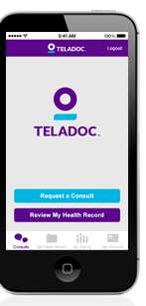
Take a doctor with you: 1-800-
TELADOC!
$5 Copay!
Single Sign-On available through MyHealthToolkit!
Telemedicine and Video Consultations available anytime – If your doctor is unavailable, no time, vacation/business trip, etc.!
Members must establish an account prior to seeking treatment; Company: ICUBA
Teladoc physicians are a national group of NCQA qualified physicians, contracted with Teladoc.
This benefit is meant to supplement an ongoing relationship with a PCP and be used as an alternative to Urgent Care. Please make sure you share your Teladoc records with your PCP!
TOP DIAGNOSES
PRESCRIPTIONS AS NEEDED
Sinus problems
Pink eye
Bronchitis
Allergies
Flu
Cough
Ear infection
Urinary tract infection
Upper respiratory infection
Nasal congestion
No controlled substances, psychiatric or lifestyle drugs
Member convenience through e-prescribing
Appropriate prescribing following CDC guidelines
Please note: Restrictions apply as it relates to number of consults during the year and severity of condition for consultation. This benefit provides national coverage, excluding Arkansas.
Notes:
This benefit is meant to supplement an ongoing relationship with a PCP and be used as an alternative to Urgent Care but is great for simple ailments like sinius infections, sore throat, ear infections, nasal congestion and other mild illnesses.
Please make sure you share your Teladoc records with your PCP so they have the full picture of your medical journey!

Slide 19

OVER 65 RETIREE MEDICAL PLAN COSTS
2021-2022 POST 65 RETIREE Monthly Premiums
Preferred PPO Plan
Employee Only | $ 943.60
Employee + Spouse | $ 2,010.40
Employee + Children | $ 1,701.00
Employee + Family | $ 2,648.80
Premier Copay PPO Plan
Employee Only | $ 1,097.60
Employee + Spouse | $ 2,336.60
Employee + Children | $ 1,979.60
Employee + Family | $ 3,078.60
$4,000/$8,000 Deductible PPO Plan
Employee Only | $ 936.60
Employee + Spouse | $ 2,000.60
Employee + Children | $ 1,352.40
Employee + Family | $ 2,265.20
*Note: the 4K/8K plan is not available to 65+ retirees during open enrollment
Notes:
Here are the 2021 ICUBA medical plan rates

