Slide 1
Community Engagement at Nova Southeastern University Barbara Packer-Muti, EdD Associate Vice President

Slide 2
Core Values Adopted by Board
– March 28, 2011
Academic Excellence
Student Centered
Integrity
Innovation
Opportunity
Scholarship/Research
Diversity
Community

Slide 3
Carnegie Elective Classification Carnegie Foundation for the Advancement of Teaching
“Community Engaged”
Community Outreach and Partnership
Curricular Engagement (Aka Service Learning)
Self Study
Extensive Submission

Slide 4
Our Carnegie Disappointment in 2008
GREAT community outreach, partnerships, curricular activities…BUT
No Centralized Office
No Centralized Repository
No Consistent, Centralized Assessment
No University-wide Recognition

Slide 5
Success in 2010!
Re-organized
Centralized
Revitalized Community Culture
Learned from 2008
BECAME ONE OF ONLY 311 Recognized Institutions Nation-wide with the Elective Carnegie Classification as Community Engaged!!!

Slide 6
What We Did: Timeline of Events
CCD Committee (University-wide)
Applied for 2008 Carnegie Elective Classification
Applied for 2010 Carnegie Elective Classification
Annual Report
Awarded 2010 Carnegie Elective Classification
Third Year of Implementation
Community Collaboration Database (CCD) Task Force Committee Formed
CCD Trainings
Annual Report
Second Annual Community Affiliates Survey
Collaboration on the CCD
Annual Report
1st Community Affiliates Survey
Celebration of Excellence Community Recognition Award
' 08
Sep 2008
Mar 2009
Sep
Mar 2010
Sep
Mar 2011
Sep
Mar 2012
Sep
' 13

Slide 7
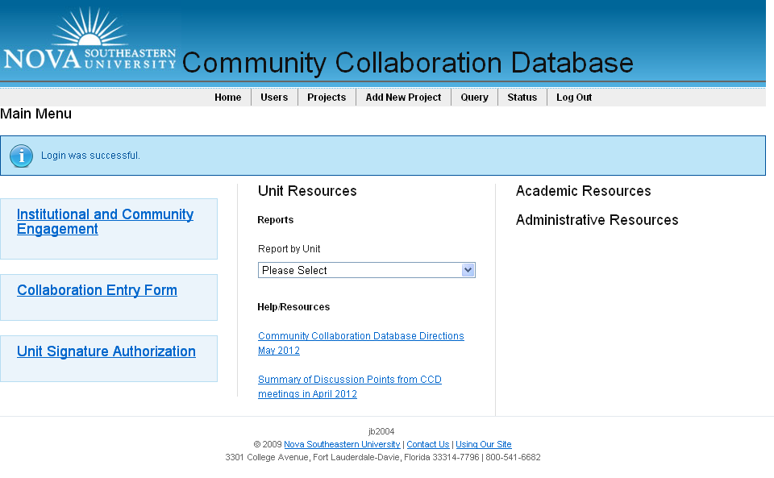
Home page CCD

Slide 8
Academic Unit | Total Collaborations | Types of Collaborations/June 2012
 |  | Academic | Social | Service | Clinical | Research | Professional | Grants | Special Events/ Projects | Development | Other
CPS | 235 | 19 | 1 | 6 | 220 | 4 | 0 | 3 | 1 | 0 | 0
CAHN | 75 | 14 | 4 | 7 | 66 | 0 | 0 | 1 | 2 | 0 | 0
CDM | 11 | 4 | 0 | 7 | 0 | 0 | 1 | 3 | 2 | 0 | 0
COO | 107 | 5 | 3 | 30 | 63 | 3 | 18 | 3 | 9 | 1 | 0
COM | 494 | 104 | 17 | 109 | 355 | 11 | 35 | 16 | 20 | 1 | 16
COP | 27 | 3 | 0 | 4 | 24 | 0 | 2 | 0 | 26 | 0 | 0
FCAS | 64 | 59 | 1 | 5 | 1 | 1 | 10 | 1 | 8 | 0 | 3
FSEHS | 72 | 24 | 9 | 27 | 9 | 4 | 24 | 4 | 8 | 6 | 7
GSCIS | 5 | 1 | 0 | 3 | 0 | 2 | 4 | 0 | 0 | 0 | 0
HSHJ | 1 | 1 | 0 | 0 | 0 | 1 | 0 | 1 | 1 | 1 | 0
SBE | 5 | 4 | 0 | 1 | 0 | 1 | 5 | 0 | 2 | 0 | 0
SHSS | 45 | 3 | 1 | 2 | 35 | 5 | 1 | 1 | 9 | 0 | 1
MSC | 27 | 3 | 2 | 11 | 0 | 5 | 11 | 9 | 5 | 1 | 2
OSC | 1 | 1 | 0 | 0 | 0 | 0 | 0 | 0 | 0 | 0 | 0
LAW | 32 | 27 | 1 | 30 | 0 | 0 | 0 | 1 | 4 | 0 | 0
USC | 51 | 10 | 12 | 29 | 0 | 3 | 0 | 0 | 1 | 0 | 0
TOTALS: | 1252 | 282 | 51 | 271 | 773 | 40 | 111 | 43 | 98 | 10 | 29
1252

Slide 9
Administrative | Total Collaborations | Types of Collaborations/June 2012
 |  | Academic | Social | Service | Clinical | Research | Professional | Grants | Special Events/ Projects | Development | Other
Admissions | 1 | 1 | 0 | 0 | 0 | 0 | 1 | 0 | 1 | 0 | 0
Athletics | 17 | 2 | 2 | 14 | 0 | 2 | 1 | 0 | 1 | 1 | 0
Business Services | 1 | 0 | 0 | 0 | 0 | 0 | 0 | 0 | 1 | 0 | 0
Clinical Operations | 2 | 1 | 0 | 0 | 1 | 0 | 0 | 0 | 1 | 0 | 0
Community & Governmental Affairs | 0 | 0 | 0 | 0 | 0 | 0 | 0 | 0 | 0 | 0 | 0
ESS | 5 | 5 | 0 | 0 | 0 | 0 | 1 | 0 | 0 | 0 | 0
Finance | 3 | 0 | 0 | 0 | 0 | 0 | 0 | 0 | 3 | 0 | 0
Institutional Advancement | 106 | 0 | 7 | 6 | 0 | 0 | 0 | 0 | 97 | 1 | 0
Museum of Art | 73 | 4 | 8 | 0 | 0 | 0 | 1 | 0 | 73 | 2 | 0
Quality of Life | 0 | 0 | 0 | 0 | 0 | 0 | 0 | 0 | 0 | 0 | 0
Research & Tech Transfer | 11 | 1 | 0 | 1 | 0 | 10 | 10 | 0 | 1 | 11 | 0
Sherman Library | 21 | 9 | 5 | 7 | 0 | 1 | 0 | 1 | 3 | 0 | 3
Student Affairs | 142 | 4 | 10 | 136 | 2 | 2 | 1 | 0 | 20 | 0 | 1
SEC | 28 | 6 | 11 | 18 | 1 | 1 | 8 | 0 | 5 | 4 | 1
University Relations | 2 | 0 | 0 | 0 | 0 | 0 | 0 | 0 | 1 | 0 | 1
TOTALS: | 417 | 34 | 44 | 186 | 4 | 16 | 25 | 3 | 208 | 21 | 8
417
417

Slide 10
DASHBOARDS!

Slide 11
Geriatric Blood Pressure Screening

Slide 12
Jacksonville SEC’s PA Second Harvest Food Drive

Slide 13
Students from NSU’s Oceanographic Center helped the FL Department of Environmental Protection officials save dozens of sea turtles who were dying in the cold waters of central and north FL during a cold snap!

Slide 14
Autism Walk

Slide 15
Epilepsy Foundation Event in Hyde Park

Slide 16
Habitat for Humanity
Paint Your Heart Out!

Slide 17
Relay for Life!

Slide 18
Science Alive!
Nova Southeastern University
NSU Students and Alumni bring science to life at a local elementary school with an evening of interactive experiments and scientific demonstrations

Slide 19
NSU Health Fair

Slide 20
Coastal Cleanup

Slide 21
Give Kids a Smile Day

Slide 22
Special Olympics

Slide 23
A Day for Children Health Fair

