Slide 1



New Employee Benefit Orientation
Plan Year
April 1, 2015 - March 31, 2016
Celebrating 13 Years of
“Better Benefits Through Collaboration”
Notes:
Our Plan Year is a Bit Different as it not calendar year

Slide 2
Meeting Overview
Introduction to ICUBA
Eligibility
Online Enrollment
Wellness/Preventative Benefits
Employee Assistance Program
Medical Insurance
Pharmacy Benefits
Flexible Spending Accounts and Health Reimbursement Accounts
ICUBA Benefits Card TM
Dental and Vision Plans
Life Insurance
Optional Life Insurance
Short Term Disability
Long Term Disability
Emergency Travel Benefit
Identity Theft Protection
Retirement Plans
Voluntary benefits and Legal Plan
Notes:
We have lots of information to cover however feel free to ask questions as we go along

Slide 3

























ICUBA Member Schools
Notes:
Independent Colleges and Universities Benefits Association, Inc.
Better Benefits through Collaboration
A State Approved IRC 501c Corporation
Multiple Employer Welfare Association [MEWA]
Executive Director-Mark S. Weinstein, CPA,Esq.,LLM,MPH
NSU is the largest member

Slide 4

Health Care Reform
Enrollment in an ICUBA Medical Plan satisfies the requirement for having coverage.
ICUBA Medical Plans are equivalent to Gold Plans offered on the Public Marketplace Exchanges.
ICUBA has lower out-of-pocket costs, broader networks of providers, pre-tax benefits, employer contributions into HRA’s, and more generous FREE wellness benefits.
All other requirements of Health Care Reform are in place.
Notes:
We will talk a bit more about how the requirements of Health Care Reform impact our premiums when we discuss details of the health plans on a later slide

Slide 5
NSU Wellness Services
NSU WELLNESS SERVICES
The NSU Pharmacy provides free health screenings monthly call 954-262-4550 or log in to http://pharmacy.nova.edu/home.html
NSU Center for Psychological Studies Guided Self Change Programs can help you Lose Weight, Stop Smoking, Stop Gambling, and Stop Procrastinating! Call 954-262-5969, fees based on a sliding scale
NSU Employee Sick Call Clinic open every morning from 8:15 am until 11:00 am, walk in or call 954-262-2181, health plan billed for services
Your NSU Primary/Family Care / Internal Medicine and Pediatric Physicians are participating providers in the Blue Physician Recognition Provider; therefore you will receive 100% coverage for services received from your NSU BPR physician. Call the NSU Health Care Centers at 954-262-4100 to schedule an appointment
Notes:
Samples of Services Provided
Alcohol Awareness
Blood Glucose Screening
Cholesterol Awareness
GERD Awareness Education & Counseling
HIV?AIDS Awareness
Immunization Awareness
Men’s and Women's’ Health Awareness
National Pharmacy Month
Osteoporosis Screening & Awareness
Skin damage Screening
Also the NSU Caregivers Alliance Program visit www.nova.edu/wellness/caregiver

Slide 6



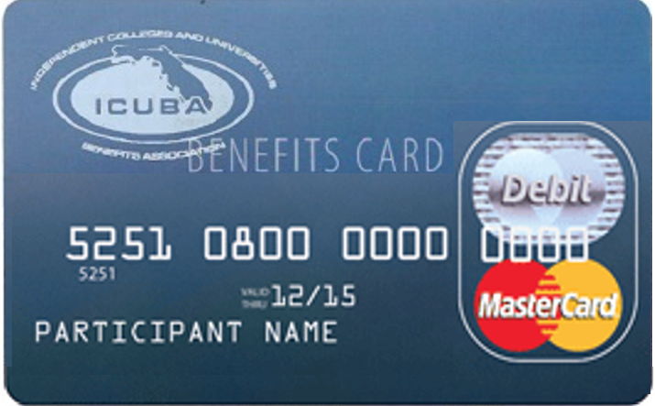






Same Great Benefits in 2015

Slide 7




Plan Enhancements Effective 4/1/15
Points for colonoscopy (100), Mammogram (100) and
MyHealthy Turnaround™ Pre-Diabetes Prevention (400).
New maternity flyer
Emergency Transportation Services
$250 co-pay
FREE
Ultrasounds of the Breast

Slide 8



FREE ICUBA Cares™ In-Network Benefits
All of the following benefits are always FREE to Members regardless of your health condition, age, gender or number of times you receive the medically necessary service:
Lab Tests Pap Tests Urinalysis Colorectal Screenings Prostate Cancer Screenings | Electrocardiograms Echocardiograms Mammograms Colonoscopies and Sigmoidoscopies Immunizations Allergy Injections Bone Mineral Density Tests Ultrasounds of the Breast | Employee Assistance Program is for available to all employees and household members. Call Resources for Living™, your EAP 24-hours a day at 1.877.398.5816 Receive up to six free face-to-face counseling sessions per presenting issue per plan year. | Prescribed diabetic supplies including meters, lancing devices, lancets, test strips, control solution, needles, and syringes Aspirin for adults with a physician prescription Prescribed generic folic acid and generic pre-natal vitamins for pregnancy
ALL VISITS TO A BLUE PHYSICIAN RECOGNITION
PROVIDER ARE ALWAYS FREE!
Notes:
Do you know your basic numbers”
Weight, BP, cholesterol, blood sugar
Do you know how these numbers impact your well being?

Slide 9
PPO Medical Plan Comparisons
ICUBA offers two Blue Options PPO Plans: PPO 70 and Preferred PPO
Plan Similarities
Plan Differences
All Free ICUBA Cares™ Wellness Benefits
Free Blue Physician Recognition™ office visits
24/7 Toll free Health Dialog® line
Catamaran Prescription Drug Benefit (Same low co-pays for 90-day at mail or retail)
Behavioral Health and EAP Benefits
Plan Rules
Same $20 copay for initial Maternity Visit
ER & Urgent Care Benefits
Premiums
Deductibles
Coinsurance
Co-pays (except maternity visits)
Annual Out-of-Pocket Maximums
HRA Contributions

Slide 10
2015-16 Medical Plan Comparison Chart
2015-2016 Plan Year | PPO 70 Blue Options |  | Preferred PPO Blue Options
 | Network | Non Network | Network | Non Network
Deductible Individual/Family | $1,000/$2,500 | $1,500/$4,000 | $2,000/$4,000 | $3,500/$9,750
Coinsurance | 30% after deductible | 50% after deductible | 20% after deductible | 40% after deductible
Out of Pocket Maximum (includes all medical co-pays, deductibles, and coinsurance) | $3,000/$6,000 | $6,000/$12,000 | $3,500/$7,000 | $7,000/$14,000
Blue Recognition Office Visits (includes Family Practice, Internal Medicine, and Pediatrics) | $0 | N/A | $0 | N/A
Physicians Office Visit (includes General Practice, Internal Medicine, Family Practice, Pediatrics, and OB/GYN) | $20 co-pay; no deductible | 50% after deductible | 20% no deductible | 40% after deductible
Maternity Office Visits $20 co-pay for initial office visit to confirm pregnancy. Please refer to the maternity flyer. | $20 co-pay per plan year; not subject to deductible | 50% after deductible | $20 co-pay per plan year; not subject to deductible | 40% after deductible

Slide 11
2015-16 Medical Plan Comparison Chart
2015-2016 Plan Year | PPO 70 Blue Options |  | Preferred PPO Blue Options
 | Network | Non Network | Network | Non Network
Specialist Office Visit, including Chiropractors and Therapists | $30 co-pay; no deductible | 50% after deductible | 20% no deductible | 40% after deductible
Wellness Exam | $0 | Not Covered | $0 | Not Covered
Outpatient Diagnostic Imaging | $100 co-pay and 30% after deductible | 50% after deductible | 20% after deductible | 40% after deductible
Urgent Care | $30 co-pay; no deductible | $30 co-pay; no deductible | 20% no deductible | 20% no deductible
Emergency Room Services | $100 co-pay (waived if admitted) no deductible | $100 co-pay (waived if admitted) no deductible | $100 co-pay (waived if admitted) no deductible | $100 co-pay (waived if admitted) no deductible
Medically Necessary Emergency Transportation | $250 co-pay; no deductible | $250 co-pay; no deductible | $250 co-pay; no deductible | $250 co-pay; no deductible
Hospital Inpatient | $250 co-pay and 30% after deductible | $500 co-pay and 50% after deductible | 20% after deductible | 40% after deductible

Slide 12
Pay Only the Proper Amount of Your
Out-of-Pocket Expenses
If you are going in for your wellness visit, make sure you have a discussion with your doctor/office staff to have the visit filed as a wellness claim.
If you are using a Blue Physician Recognition™ provider, All office visits are FREE and your doctor should not collect a payment.
All In-Network Maternity office visits are free after the initial office visit co-payment per plan year for a normal pregnancy. Care Consultants will advocate on your behalf. Remember to enroll with Healthy Additions and review the maternity flyer.
If you are billed for a facility fee for an office visit or are billed for an annual physical or annual gynecological exam, please advocate on your behalf and contact Florida Blue™ Customer Service at 1 (800) 664-5295 and have your claims properly adjusted.
Always pay your provider based on the Member Health Statements available to you as a registered member at www.floridablue.com.

Slide 13
Definitions
Blue Physician Recognition™ (BPR): Personal physician (Family Practice, Internal Medicine, and Pediatrics) who coordinates all aspects of patient care and who meets The National Committee for Quality Assurance (NCQA) quality measures and is designated as a participating Blue Physician Recognition™ provider by Florida Blue.
Deductibles: The cumulative amount that you must pay in the Plan Year before benefits will be paid by the Plan. Physician office visits, Therapy office visits, Urgent Care visits, Emergency Room visits, Emergency Transportation Services. And Prescription Drugs DO NOT apply to the deductible.
Coinsurance: The percentage of a covered expense that you pay after the satisfaction of any applicable deductible. For example, the plan may pay for 70% of covered services and you pay 30%.
Copays (Co-payments): The fixed dollar amount you are required to pay each time a particular service is used. The copay does apply to out-of-pocket but does not reduce amounts applied to the deductible or co-insurance.
Plan Year: The plan year runs from April 1, 2015 through March 31, 2016.
Annual Out-of-Pocket Maximum: The maximum amount of deductible, co-insurance and co-payments during any Plan Year that you pay before the Plan begins to pay 100% of Covered Expenses for the balance of the Plan Year.
Flexible Spending Account: A Health Care or Dependent Care Spending Account in which you put aside pre-tax dollars to pay for eligible expenses.
Member Health Statement (MHS): Comprehensive monthly statement of claim activity in last 28 days, explanation of benefits (EOB) paid sent by insurance companies to enrollees. MHS provides necessary information about claim payment information and patient responsibility amounts, deductible and out-of-pocket accumulation, and tips to live healthier
.

Slide 14
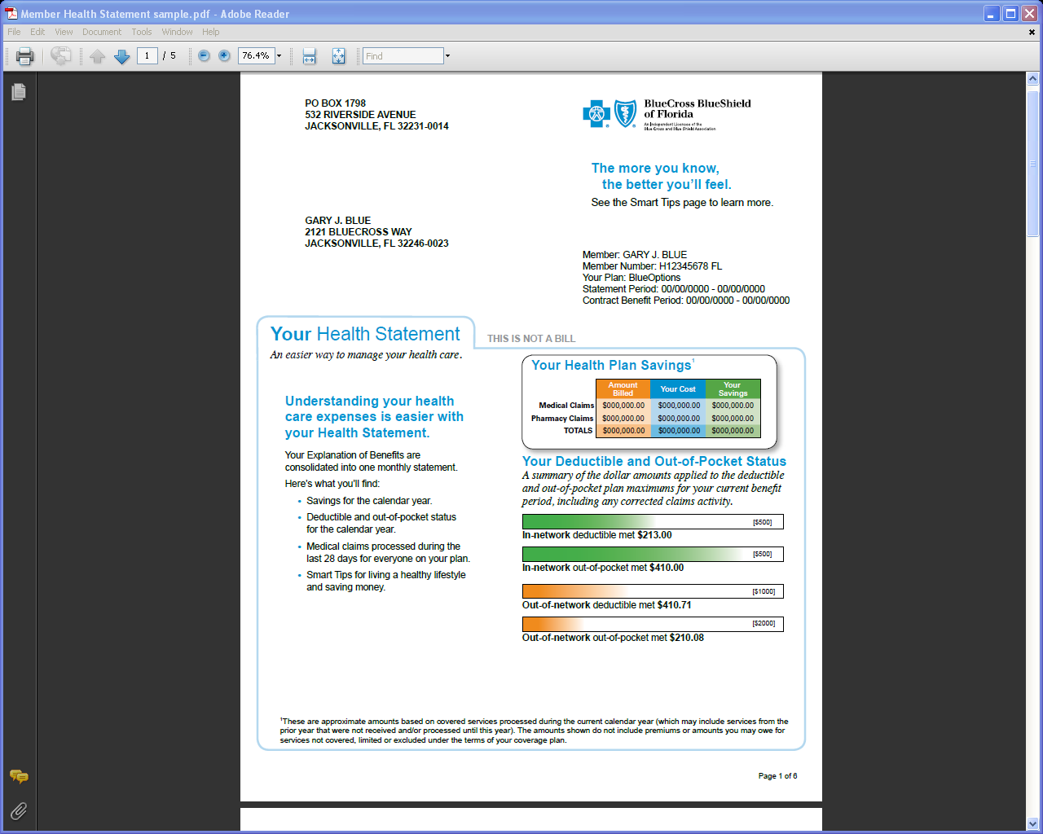
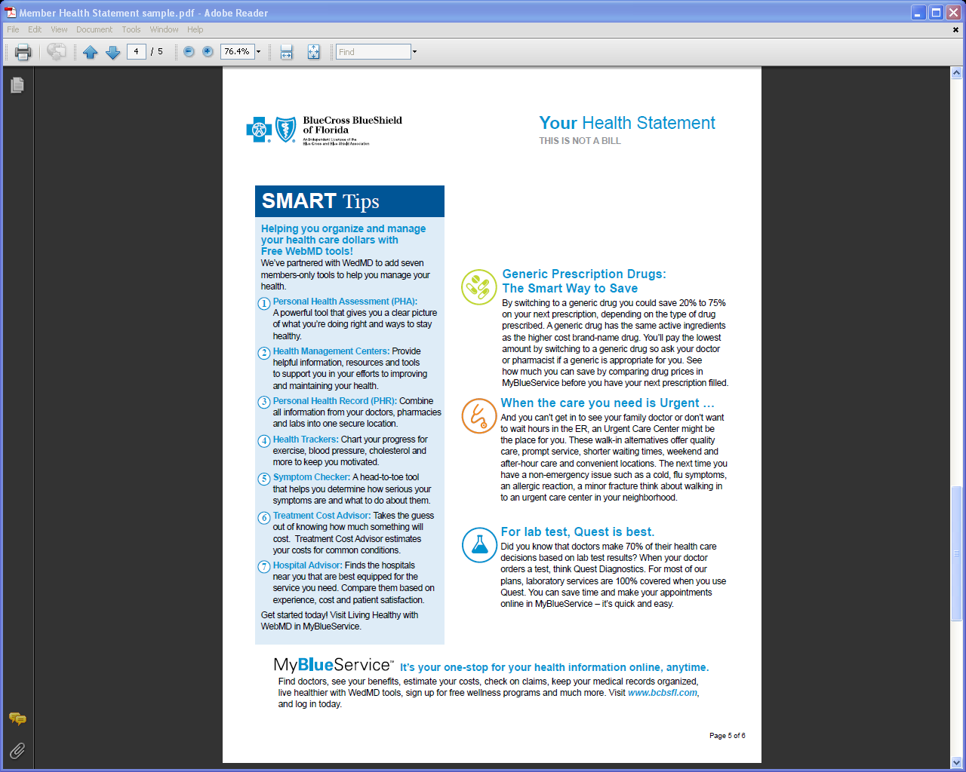
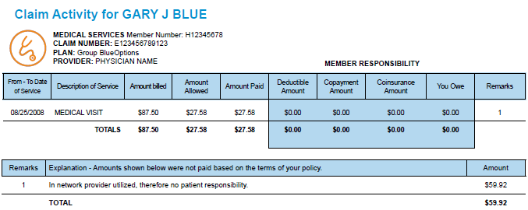
Member Health Statement
Member Health Statement
Notes:
Every month you will receive one of these statements consisting of approximately six (6) pages containing health tips, definition of terms, right to appeal information, deductible accumulation status, and coupons for healthy products and claim activity.
A representation of 3 of these pages is condensed on this slide. The claim activity portion indicates date(s) of service a description of the service [lab, x-ray, surgery, hospital stay, etc., the amount billed and the Amount Allowed.
I referred to the Allowed or contracted rate for in-network providers on the prior slide. The reason this is so important to you is because it is tied directly to the Member Responsibility or the ‘You Owe’ amount. This is where your wallet is impacted. Never pay an in-network provider more than the ‘You Owe’ amount. Should you encounter an in-network provider who balance bills please contact the Florida Blue customer service and allow their Provider Relations folks to intercede on your behalf.
The other information on the MHS slide will include Smart Tips such as new tools on WebMD including personal health assessment, health trackers, symptom checker, treatment cost advisor, hospital advisor, creating your own medical expense record and much more. Please review your MHS each month when you receive it.
If your are interested in saving paper you can opt out of receiving the paper copy and receive the statement electronically
instead.

Slide 15
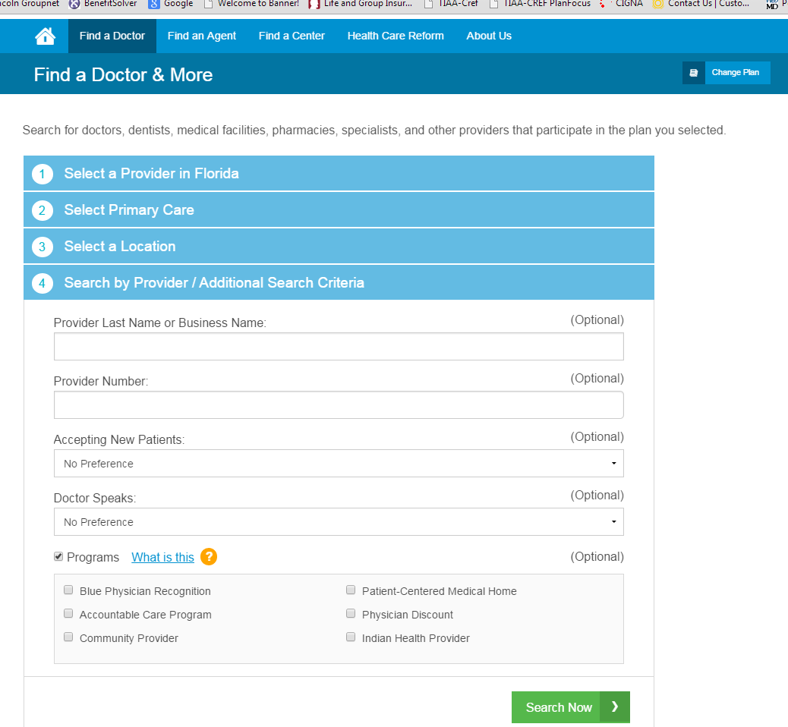
Blue Physician Recognition Program
FREE OFFICE VISITS FOR ALL TYPES OF CARE
Free Office Visits
When you are using a Blue Physician Recognition™ provider, all office visits are FREE. Your doctor should not collect a co-payment
How to find BPR doctors
Visit www.FloridaBlue.com and select
Find a Doctor or log in.
Enter your plan name
When you log in, this step is done for you.
Enter the type of doctor your looking for.
Enter location.
Under Search Criteria select Programs and then Blue Physician Recognition.
When Blue Physician Recognition is shown under Programs, you’ll know that this doctor is participating.
Try It For Yourself:
www.floridablue.com
Notes:
NSU Family Practice, Internal Medicine and Pediatrics participate

Slide 16



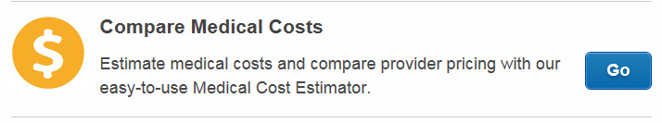


A convenient way to verify the cost of an office visit or procedure.
Members have a choice when accessing the tool:
Call: The Care Consultant Team at 1 (888) 476-2227
Click: Visit www.floridablue.com and click on Members, login with your user name and password, then select compare medical costs
Visit: A Florida Blue Center
Call 1 (877) 352-5830 for a location near you
Notes:
There is one of these facilities in Pembroke Lakes Mall and another one at the
Saw Grass Mills Mall

Slide 17
Monthly Medical Plan Premiums
The ICUBA Employee Member premium increase is 4% (+ 1.5% tax increase) for the
Blue Options Plans as compared to 9% in the Florida market for April 1, 2015.
Preferred PPO Blue Options Premium
 | Total Premium | Employer Contribution | Employee Contribution | HRA
Employee | $539 | $454 | $85 | $50
Employee + Spouse | $1,109 | $554 | $555 | $100
Employee + Child(ren) | $971 | $602 | $369 | $100
Family | $1,510 | $770 | $740 | $100
Dual Enroll | $1,510 | $1,039 | $471 | $150
PPO 70 Blue Options Premium
 | Total Premium | Employer Contribution | Employee Contribution | HRA
Employee | $692 | $441 | $251 | $25
Employee + Spouse | $1,424 | $483 | $941 | $50
Employee + Child(ren) | $1,247 | $530 | $717 | $50
Family | $1,939 | $696 | $1,243 | $50
Dual Enroll | $1,939 | $972 | $967 | $75
Notes:
As mentioned earlier the 1.5% tax increase related to ACA
PICORI [Patient Centered Outcomes Research Institute
Pay or Play Rule- if ER doesn’t offer health coverage to 95% of its EEs and offer a plan that pays at least 60%of costs and is affordable-$2000 fine for any EE who gets subsidy
Temporary Reinsurance Program Fee($63 per covered life) sunset in 2016
Additional reporting and tracking costs

Slide 18
Making a Choice
Estimating Your Financial Risk
Coverage/Tier | Annual Premium | Out of pocket maximum (OOP) Medical | Out of pocket maximum pharmacy | Premium + OOP | NSU HRA contribution | Estimated in-network financial risk
EMPLOYEE ONLY
PPO 70 Blue Options | $3,012.00 | $3,000.00 | $2,000.00 | $8,012.00 | $300.00 | $7,712.00
Preferred PPO Blue Options | $1,020.00 | $3,500.00 | $2,000.00 | $6,520.00 | $600.00 | $5,920.00
EMPLOYEE & SPOUSE
PPO 70 Blue Options | $11,292.00 | $6,000.00 | $4,000.00 | $21,292.00 | $ 600.00 | $20,692.00
Preferred PPO Blue Options | $6,660.00 | $7,000.00 | $4,000.00 | $17,660.00 | $1,200.00 | $16,460.00
EMPLOYEE & CHILD(REN)
PPO 70 Blue Options | $8,604.00 | $6,000.00 | $4,000.00 | $18,604.00 | $ 600.00 | $18,004.00
Preferred PPO Blue Options | $4,428.00 | $7,000.00 | $4,000.00 | $15,428.00 | $1,200.00 | $14,228.00
EMPLOYEE & FAMILY
PPO 70 Blue Options | $14,916.00 | $6,000.00 | $4,000.00 | $24,916.00 | $ 600.00 | $24,316.00
Preferred PPO Blue Options | $8,880.00 | $7,000.00 | $4,000.00 | $19,880.00 | $1,200.00 | $18,680.00
Notes:
The plan cost comparison details the financial difference of the plans.
We prepared this slide to illustrate both of our plans provide excellent coverage.
Some EEs feel more comfortable paying the higher premiums that come with a lower deductible while others prefer a lower premium with a higher deductible.

Slide 19
Did you know?
$20.365 Million Annual NSU Contribution
Tier | Annual Amount Paid by NSU
 | Premium | HRA | Total Annual Contribution
PPO 70 Employee | $5,292.00 | $300.00 | $5,592.00
PPO 70 Employee / Spouse | $5,796.00 | $600.00 | $6,396.00
PPO 70 Employee / Child(ren) | $6,360.00 | $600.00 | $6,960.00
PPO 70 Family | $8,352.00 | $600.00 | $8,952.00
Preferred PPO Employee | $5,448.00 | $600.00 | $6,048.00
Preferred PPO Employee / Spouse | $6,648.00 | $1,200.00 | $7,848.00
Preferred PPO Employee / Child(ren) | $7,224.00 | $1,200.00 | $8,424.00
Preferred PPO Family | $9,240.00 | $1,200.00 | $10,440.00
NSU will contribute approximately 20.3 65 million dollars to employee healthcare coverage costs in the 2015-2016 plan year!
Annual premium for 2015-2016 plan year: $18,058,152.00
Annual HRA for 2015-2016 plan year: $2,307,600.00
Total NSU Contributions 2015-2016 plan year:
$20,365,752.00
Notes:
The numbers for this chart are obtained by taking the headcount by plan and calculating the annual ER premium and HRA contribution.

Slide 20

Pharmacy Benefits
Understanding Your Tiered Copays
Your Catamaran™ pharmacy benefit plan offers three categories or tiers of drugs that determine your cost share or copay.
Whenever possible, have your doctor consult your Preferred Medication List for the lowest cost generic or brand medications available for your therapy.
You may visit www.mycatamaranRx.com or call member services at 1-800-207-2568.
Tier | Co-pay 30 day Retail/90 day Retail or Mail Order | Definition
1 – Generic | $5/10 | Generics contain the same active ingredient as their brand-name equivalents and offer the same effectiveness and safety. Some generics use a brand name instead of a chemical name. Both have the lowest co-pay.
2 – Preferred | $27/50 | Medications in this tier have been selected by your pharmacy benefit plan as preferred brand drugs. These drugs have higher co-pays than generics but are less costly than non-preferred medications on the third tier.
3 – Nonpreferred | $60/120 | Because a generic version or a second-tier alternative is available, non-preferred medications have the highest co-pays and are not listed on the Preferred Medication List.
Maximum annual plan year out-of-pocket for prescription drug co-pay is $2,000 per individual; $4,000 for family.
90-day prescriptions are available at the same co-pay at retail and mail order.
Remember 90 day prescriptions save you money!
Notes:
Local Area pharmacies- Albertson’s, CVS, K-Mart, NSU, Walmart, Walgreens
Other areas of the country
A&P
Brooks
Dillon’s
Kroger
Longs
Meijer
Ralph’s
Vons
You can find a complete listing in the Plan Document

Slide 21
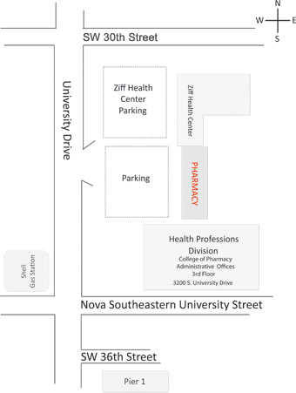
Catamaran™ Pharmacy Benefits
Free Generic Drugs at NSU Pharmacy
Full service pharmacy
Accepts NSU/ICUBA prescription plan
FREE generic drugs for NSU/ICUBA healthcare subscribers
Open:
  Monday – Friday
  9:00 AM – 6:00 PM
  Saturday
  9:00 AM – 1:00 PM
Notes:
If you take a Specialty RX such as Enbrel, forteo, Humira, Lupron or Zoladex you need to call the Specialty Pharmacy at 1-866-823-2712
Our plan also utilizes Step- Care for
Actia, Brand Proton Pump Inhibitors [Nexium] Fentora, Advair, Foradil, Serevent, Oxycontin, Ranexa, Statins [Lipitor} Symlin- call 1-877-665-6609

Slide 22


Employee Assistance Program (EAP) Benefits
Free Employee Assistance Program (EAP) (up to six counseling sessions per issue per plan year) is available to ALL EMPLOYEES AND HOUSEHOLD MEMBERS. You do not need to be enrolled in any ICUBA benefit plan in order for you and/or a household member to access EAP services.
Client Connect® Provider Matching Service assists members in locating an appropriate provider for their current situation.
The Resources for Living EAP website has many helpful resources including informative articles, interactive health and wellness instruments, health assessments and videos, family, personal, and mental health information, on-line seminars, discounts to vendors and community resources.
Resources For Living services are available to you, all members of your household and your adult children up to the age of 26, regardless of your medical insurance coverage. Services are confidential and are available 24 hours a day, 7 days a week.
To access services, simply call 1-877-398-5816
or login online at www.mylifevalues.com
Username: ICUBA
Password: 8773985816
Notes:
There is a flyer in your packet that outlines all of the services available along with the phone number and online Username [ICUBA] and
8773985816 Password information

Slide 23

Behavioral Health &
Substance Abuse Benefits
  Behavioral Health/Substance Abuse Benefits are provided by MHNet Behavioral Health.
  Members must be on the Medical Health Plan.
  Provider Search: www.mhnet.com or call 877-398-5816 and press option for Behavioral Health Benefits.
  MHNet contact information can be located on the back of the Florida Blue ID card.
Deductible and out of pocket maximum is combined with medical.
In-network services must be rendered by a MHNet provider.
Services rendered by an out of network provider may be subject to balance billing by the out of network provider for the difference between the allowed amount and the provider billed charges.

Slide 24

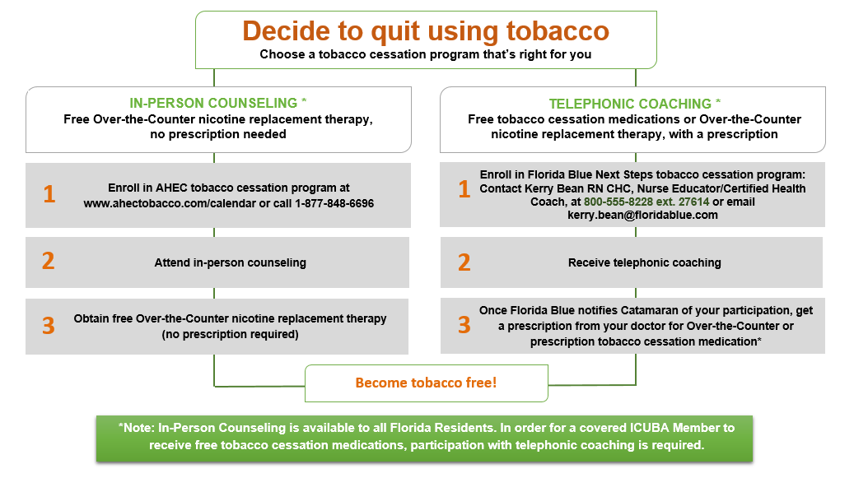
Tobacco Cessation Program
It’s okay to be a quitter—
it’s time to stop using tobacco
Once you make the decision to quit tobacco, you may enroll with the Next Steps program or a counseling program with the Area Health Education Center (AHEC). Once you initiate the counseling session and obtain a prescription from a physician, you will be eligible for free tobacco cessation medications. Call 877-848-6696 or access www.ahectobacco.com/calendar.
Both prescription and over-the-counter (OTC) tobacco cessation products are available through this program with up to two twelve-week cycles each plan year at no cost to you.
Products that can help you quit include:
■ Nicotine replacement products (NRP): These products provide small doses of nicotine and are considered tobacco substitutes. Some nicotine replacement product options are: nicotine skin patches, gum, lozenges, or nasal sprays.
■ Prescription medications like Chantix or Zyban. Since medication isn’t for everyone, you should meet with your doctor and discuss which product is right for you.
■ Take your prescription, Catamaran ID card, and over the counter product (if applicable) to the pharmacy counter, they will process your claim at no cost to you as long as you actively participate in the tobacco cessation program.
Notes:
TWO ways to QUIT

Slide 25
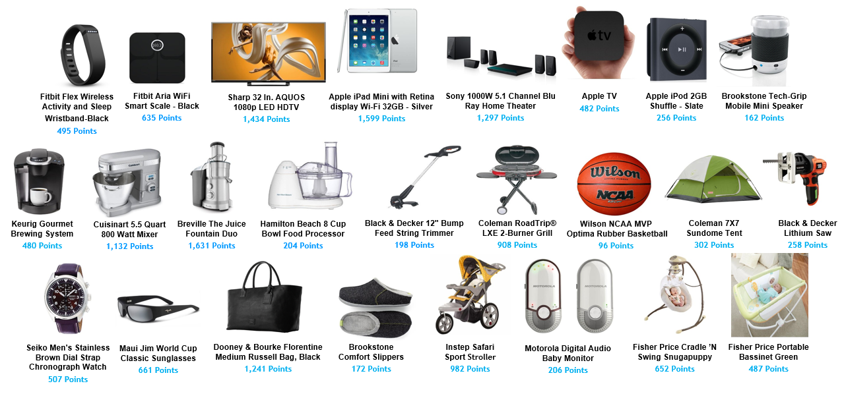
Have you heard about
BlueRewards
The Wellness Incentive Program developed in partnership with Florida Blue to help you achieve your wellness goals and get rewarded for it.
BlueRewards is a positive way to help you improve your health through a variety of activities, tools and resources, including a Personal Health Assessment (PHA). As you work toward your wellness goals, you’ll earn points redeemable online. You can earn up to 1,800 points* for Plan Year April 1, 2015—March 31, 2016!
Choose from thousands of Great Rewards!
*Earned Points may be rolled over for up to one additional year.
Notes:
Get fit and healthy and reward yourself at the same time with great prizes

Slide 26
BlueRewards
Know Your Numbers! | Points | Date Completed
Complete BYFB Health Screening and Personal Health Assessment with health coaching | 200
─ Normal body mass index (27 or less) | 25
─ Healthy cholesterol (4.0 or less) | 25
─ Ideal blood pressure (less than 120/80) | 25
─ Non-tobacco user (2+ years) | 25
Complete preventive care screening (annual/physical exams only) | 200
Complete WebMD personal health assessment | 25
Enroll in Healthy Addition Prenatal Program | 200
Participate in BYFB Next Steps Coaching Program | 50 per call/max 150
Mammogram | 100
Colonoscopy | 100
Get Informed! | Points | Date Completed
My Healthy Turnaround™ Pre-Diabetes Program | 400*
Attend a campus-sponsored wellness event | 50 each/200 max
Get informed through MyHealth Assistant on Floridablue.com for the following Activities…
Select and achieve an Exercise Goal | 10 select/15 achieve
Select and achieve a Maintain Positive Mood Goal (and maintain that goal) | 10 select/15 achieve
Select and achieve a Nutrition Goal | 10 select/15 achieve
Select and achieve a Quit Tobacco Goal | 10 select/15 achieve
Select and achieve a Stress Goal | 10 select/15 achieve
Select and achieve a Weight Loss Goal | 10 select/15 achieve
Get Moving! | Points | Date Completed
Utilize Exercise Tracker in WebMD | 5 each/75 max
Utilize Weight Tracker in WebMD | 5 each/25 max
Utilize Stress Tracker in WebMD | 5 each/25 max
Utilize Cholesterol Tracker in WebMD | 5 each/25 max
Utilize Blood Pressure Tracker in WebMD | 5 each/25 max
*My Healthy Turnaround™ Pre-Diabetes Program - 200 points awarded at week 9 and 200 points awarded at completion.
How would you like to… get in shape, eat better, quit tobacco, or lose weight … and be rewarded for it?
Employees and eligible spouses who are enrolled in an ICUBA medical plan are eligible to receive up to 1,800 points for participating in healthy activities.
As you work toward your wellness goals, you can earn the points for the activities outlined in the chart to the right!
The points may then be used to buy items through an online marketplace, where you can choose from thousands of name brand rewards.
Notes:
Three ways to earn points

Slide 27
Health Reimbursement Account (HRA) and
Health Care Spending Account (HSCA) Differences
Health Reimbursement
Account
Health Care
Flexible Spending Account
HRA
HCSA
FSA
  Funded monthly by NSU
  Available for PPO 70 and Preferred
  PPO Plans
  Can only be used for eligible medical expenses incurred by the employee and dependent(s)
  Funds rollover at the end of each plan year as long as you are on the ICUBA Medical Plan or vested
  Portable after 36 months of continuous participation in an ICUBA Medical Plan
  Can have an HRA without electing an FSA
  Funded by employee pre-tax dollars
  Can be used for employee and eligible dependent medical expenses
  No carry-over of funds from year
  to year (by law)
    Subject to Use-it-or-lose-it
  HCSA funds expended before tapping into HRA funds
  HCSA maximum annual limit is $2,550 under Health Care Reform
Entire election amount will be available as of 4/1/15
Notes:
HRA is provided to employees enrolled in either the PPO 70 or Preferred Plan. Funds are added tot eh account near the end of each month.
If you are vested in the HRA and leave the university you have access to those funds until they are exhausted. There is a monthly service fee charged to the account each month.
FSA is Funded UPFRONT by NSU

Slide 28
Dependent Care Spending Account (DCSA)
Dependent Care Spending Account
DCSA
Funded by employee with pre-tax contributions and used to pay for eligible dependent care expenses
Maximum annual limit of $5,000 per household (Married filing jointly)
Can only be used for the care of dependent(s) under age 13 and physically or mentally challenged adults who are unable to care for themselves when employee (and spouse) are either working or looking for work
Funds can be accessed by using the ICUBA Benefits MasterCard™
File your claims online at http://icubabenefits.org
Subject to use-it-or-lose-it rule
Funds are available as they are deducted from payroll
You do not need to elect an HCSA or have an HRA to elect a DCSA
Notes:
Dependents are defined as being under the age of 13 but also could be a physically or mentally challenged adult who is your dependent and does not earn more than $3,200 a year.
These DCFFA can be accessed by using the ICUBA MasterCard debit card which is issued by MBI bank and administered by Alegeus or by filing an on-line or a paper claim
Funded Per PAY- the money is not available until it has been deducted fromlyour bi-weekly pay!

Slide 29
ICUBA Benefits MasterCard™
Always save your
receipts and EOB forms
If additional documentation is required, you will need to provide itemized documentation that displays the patient’s name, provider name, date of service (not date of payment) was rendered, the amount owed after all credits and payments have been applied, and a description of services rendered. You may also use the Explanation of Benefits (EOB) form as itemized receipt.
You can use your ICUBA Benefits card at any eligible provider that accepts MasterCard™
There is no need for a Personal Identification Number (PIN); all
you need to do is select the credit option at the point of payment.
Some card transactions may require you to submit additional documentation to verify/substantiate the transaction.
If additional documentation
is required, you will receive notification by mail or email to
the address on file for you.
If you are requested to verify/substantiate a card transaction, do so promptly to avoid card suspension.
Additional cards may be ordered for eligible dependents that are 18 and over.
To request a card you may contact an ICUBA Benefits Administrator at 866.377.5102 or via email at benefitsadministration@icuba.org

Slide 30

Vision and Dental Providers
Dental Provider
Vision Provider
Humana Dental plans
are exactly the same and the prices are not changing from last year.
Advantica Vision plans benefits and costs remain the same as last year.

Slide 31
High Option PPO Dental Plan
High Option PPO Plan | In-Network | Out-of-Network
Plan Year Deductible – Single / Family | $50 / $150 | $50 / $150
Deductible Waived for Preventive | Yes | Yes
Plan Year Maximum (excludes orthodontia services) | $2,000 | $2,000
Preventive Services | 100% | 80%
Basic Services | 80% after deductible | 50% after deductible
Major Services | 50% after deductible | 30% after deductible
Orthodontia – Adult & Child | 50% | 50%
Orthodontia Lifetime Maximum | $2,000 | $2,000
Two additional preventive cleanings for a total of four cleanings per year.
Two periodontal cleanings per year to be covered at preventive levels of benefits.
Coverage for composite fillings on all teeth.
Addition of an Extended Annual Maximum Benefit paying 30% coinsurance after the annual maximum benefit is met.
High Option PPO Dental Plan 2015-2016 Monthly Dental Rates
Employee | $36.68
Employee + 1 | $73.04
Family | $122.84
the NSU Dental Faculty Practice PPO Plans Accepted Only
Refer to your Dental Summary Plan Description (SPD) for full benefit description.

Slide 32
Low Option
“Preventive Plus” Plan
* Services include amalgam/resin restorations and simple extractions.
** Receive a discount on these services if you see participating dentists.
Low Option PPO Plan | In-Network | Out-of-Network
Plan Year Deductible – Single / Family | $50 / $150 | $50 / $150
Deductible Waived for Preventive | Yes | Yes
Plan Year Maximum (excludes orthodontia services) | $1,000 | $1,000
Preventive Services | 100% | 100%
*Basic Services | 80% after deductible | 80% after deductible
**Major Services | Discount available | Not Covered
Orthodontia – Adult & Child | Discount available | Not Covered
Low Option “Preventive Plus” Plan 2015-2016 Monthly Dental Rates
Employee | $19.48
Employee + 1 | $45.28
Family | $74.96
**Major Services are not covered under this plan, however you can receive a
discount for services if you see participating dentists.
Benefits can be obtained at the NSU Dental Faculty Practice
PPO Plans Accepted Only
Refer to your Dental Summary Plan Description (SPD) for full benefit description.

Slide 33
DMO CS250 Dental Plan
DMO CS250 Plan | In-Network Only
Calendar Year Deductible | No deductible
Out of Pocket Maximum | No maximum
Office Visit Copays (during normal business hours) | $5 copay per visit
Preventive Services | Please refer to dental schedule for copay amounts
Basic Services | Please refer to dental schedule for copay amounts
Major Services | Please refer to dental schedule for copay amounts
Orthodontics – Adult & Child | $2,000 Adult; $1,800 Child fixed copay
DMO CS250 Dental Plan 2015-2016 Monthly Dental Rates
Employee | $10.98
Employee + 1 | $22.02
Family | $34.20
Refer to your Dental Summary Plan Description (SPD) for full benefit description.
Notes:
The NSU Dental Faculty Practice and Dental Clinic DO NOT Participate in this plan.

Slide 34
Advantica Base Vision Plan
The NSU Eye Care Institute participates in this plan | In-Network | Out-of-Network
Vision Exam | $5 Co-Pay | Up to $40 Reimbursement (less applicable Co-Pay)
Standard Frames | $15 Co-Pay; $100 allowance | Reimbursed up to $40 (no Co-pay if included with eyeglass lenses)
Single Vision, Bifocal, Trifocal, and Lenticular Lenses | Covered After $15 Co-Pay | Up to $20 for Single Vision, $40 for Bifocal, $60 for Trifocal, $100 for Lenticular Reimbursement less Co-Pay
Standard Progressive Lens | $50 Co-Pay | Up to $45 reimbursement less Co-pay
Single Vision (SV) Polycarbonate | Included with Lens Co-Pay up to age 19; over age 19, $30 Co-Pay | Up to $10 reimbursement less Co-pay under age 19
UV Coating Lens | $12 Co-Pay | Up to $5 reimbursement less Co-pay
Contact Lenses - Medically Necessary (in lieu of eyeglasses and elective contact lenses) | $15 Co-pay; $250 materials allowance; $30 fitting fee allowance | Up to $250 reimbursement (less applicable Co-pay)
Contact Lenses – Elective (in lieu of eyeglasses) | $15 Co-pay; $100 materials allowance; $30 fitting fee allowance | Up to $60 reimbursement (less applicable Co-pay)
Frequency Limitations - Vision Exams | Once every 12 months
Frequency Limitations - Eyeglass Lenses | Once every 12 months
Frequency Limitations - Frames | Once every 24 months
Frequency Limitations - Contact Lenses | Once every 12 months
April 1, 2015 – March 31, 2016 Monthly Base Vision Plan Premiums
Employee | $3.98
Family | $10.18

Slide 35
Advantica Buy-Up Vision Plan
The NSU Eye Care Institute participates in this plan | In-Network | Out-of-Network
Vision Exam | $5 Co-Pay | Up to $40 Reimbursement (less applicable Co-Pay)
Standard Frames | $15 Co-Pay; $100 allowance | Reimbursed up to $40 (no Co-pay if included with eyeglass lenses)
Single Vision, Bifocal, Trifocal, and Lenticular Lenses | Covered After $15 Co-Pay | Up to $20 for Single Vision, $40 for Bifocal, $60 for Trifocal, $100 for Lenticular Reimbursement less Co-Pay
Standard Progressive Lens | $50 Co-Pay | Up to $45 reimbursement less Co-pay
Single Vision (SV) Polycarbonate | Included with Lens Co-Pay up to age 19; over age 19, $30 Co-Pay | Up to $10 reimbursement less Co-pay under age 19
UV Coating Lens | $12 Co-Pay | Up to $5 reimbursement less Co-pay
Contact Lenses - Medically Necessary (in lieu of eyeglasses and elective contact lenses) | $15 Co-pay; $250 materials allowance; $30 fitting fee allowance | Up to $250 reimbursement (less applicable Co-pay)
Contact Lenses – Elective (in lieu of eyeglasses) | $15 Co-pay; $100 materials allowance; $30 fitting fee allowance | Up to $60 reimbursement (less applicable Co-pay)
Frequency Limitations - Vision Exams | Once every 12 months
Frequency Limitations - Eyeglass Lenses | Once every 12 months
Frequency Limitations - Frames | Once every 12 months
Frequency Limitations - Contact Lenses | Once every 12 months
April 1, 2015 – March 31, 2016 Monthly Buy Up Vision Plan Premiums
Employee | $4.78 ($9.60 in additional annual premium for frames once every 12 months)
Family | $12.22 ($24.48 in additional annual premium for frames every 12 months)

Slide 36
RELIANCE STANDARD
Reliance Standard Life
LIFE AND DISABILITY BENEFITS
Basic Employer Provided Life Insurance
Optional Life Insurance
Short Term Disability
Long Term Disability
Identity Theft Protection
Emergency Travel Assistance

Slide 37
BASIC AND OPTIONAL TERM LIFE INSURANCE
BASIC AND OPTIONAL
TERM LIFE INSURANCE
Basic – Employer | Optional - Employee
Benefits-eligible employees must work at least 19.2 hours weekly and are U.S. citizens or U.S. residents and foreign nationals
Eligible after 3-months of employment | Eligible after a 3-month waiting period
Benefit is one times annual salary up to a maximum of $350,000 | Elect amounts between $10,000 and $300,000 in $10,000 increments
Term life insurance | Convertible at age 65 /portable up to age 65 and younger
Benefit reduces to 65% at age 65 and to 50% at age 70
No medical exam for this period only (Optional Life Insurance)
Complete a beneficiary form at http://icubabenefits.org and update as needed
Notes:
You can enroll in this optional life benefit now and when your 90 day waiting period is up you will be automatically enrolled and the premium deduction will begin.
Keep in mind this is the only time you can enroll in this plan without evidence of insurability.
If you decide to enroll in the future you will need to complete a health questionnaire and be subject to medical underwriting.
Remember to update your beneficiary on a regular basis- annually, when your marital status changes when you have children, etc.

Slide 38
Reliance Standard Optional Term Life Insurance
Enroll now-coverage will begin after 90 days of employment
Elect coverage amount between $10,000 and $300,000 in $10,000 increments
Your application will be subject to Evidence of Insurability (EOI), access this form through http://www.reliancestandard.com/eoi/hom/nova/nsueoi.pdf
Reliance Standard will notify you when your application is approved, denied or pending additional information
First monthly premium deduction will occur in the first pay of the month following the approval of your coverage
If you do not send an EOI to Reliance Standard by 4/30/2015 your enrollment request will expire
The value of the policy reduces to 65% at age 65, and 50% at age 70

Slide 39
OPTIONAL TERM LIFE INSURANCE
Rate Chart (1)
Age
Amount of coverage
 | 10,000 | 20,000 | 30,000 | 40,000 | 50,000 | 60,000 | 70,000 | 80,000 | 90,000 | 100,000
00-24 | 0.47 | 0.94 | 1.41 | 1.88 | 2.35 | 2.82 | 3.29 | 3.76 | 4.23 | 4.70
25-29 | 0.57 | 1.14 | 1.71 | 2.28 | 2.85 | 3.42 | 3.99 | 4.56 | 5.13 | 5.70
30-34 | 0.76 | 1.52 | 2.28 | 3.04 | 3.80 | 4.56 | 5.32 | 6.08 | 6.84 | 7.60
35-39 | 0.85 | 1.70 | 2.55 | 3.40 | 4.25 | 5.10 | 5.95 | 6.80 | 7.65 | 8.50
40-44 | 0.95 | 1.90 | 2.85 | 3.80 | 4.75 | 5.70 | 6.65 | 7.60 | 8.55 | 9.50
45-49 | 1.42 | 2.84 | 4.26 | 5.68 | 7.10 | 8.52 | 9.94 | 11.36 | 12.78 | 14.20
50-54 | 2.18 | 4.36 | 6.54 | 8.72 | 10.90 | 13.08 | 15.26 | 17.44 | 19.62 | 21.80
55-59 | 4.08 | 8.16 | 12.24 | 16.32 | 20.40 | 24.48 | 28.56 | 32.64 | 36.72 | 40.80
60-64 | 6.26 | 12.52 | 18.78 | 25.04 | 31.30 | 37.56 | 43.82 | 50.08 | 56.34 | 62.60
65-69 | 12.50 | 25.00 | 37.50 | 50.00 | 62.50 | 75.00 | 87.50 | 100.00 | 112.50 | 125.00
70-74 | 25.00 | 50.00 | 75.00 | 100.00 | 125.00 | 150.00 | 175.00 | 200.00 | 225.00 | 250.00
75+ | 25.00 | 50.00 | 75.00 | 100.00 | 125.00 | 150.00 | 175.00 | 200.00 | 225.00 | 250.00

Slide 40
OPTIONAL TERM LIFE INSURANCE
Rate Chart (2)
Age
Amount of coverage
00-24
25-29
30-34
35-39
40-44
45-49
50-54
55-59
60-64
65-69
70-74
75+
110,000 | 120,000 | 130,000 | 140,000 | 150,000 | 160,000 | 170,000 | 180,000 | 190,000 | 200,000
5.17 | 5.64 | 6.11 | 6.58 | 7.05 | 7.52 | 7.99 | 8.46 | 8.93 | 9.40
6.27 | 6.84 | 7.41 | 7.98 | 8.55 | 9.12 | 9.69 | 10.26 | 10.83 | 11.14
8.36 | 9.12 | 9.88 | 10.64 | 11.40 | 12.16 | 12.92 | 13.68 | 14.44 | 15.20
9.35 | 10.20 | 11.05 | 11.90 | 12.75 | 13.60 | 14.45 | 15.30 | 16.15 | 17.00
10.45 | 11.40 | 12.35 | 13.30 | 14.25 | 15.20 | 16.15 | 17.10 | 18.05 | 19.00
15.62 | 17.04 | 18.46 | 19.88 | 21.30 | 22.72 | 24.14 | 25.56 | 26.98 | 28.40
23.98 | 26.16 | 28.34 | 30.52 | 32.70 | 34.88 | 37.06 | 39.24 | 41.42 | 43.60
44.88 | 48.96 | 53.04 | 57.12 | 61.20 | 65.28 | 69.36 | 73.44 | 77.52 | 81.60
68.86 | 75.12 | 81.38 | 87.64 | 93.90 | 100.16 | 106.42 | 112.68 | 118.94 | 125.20
137.50 | 150.00 | 162.50 | 175.00 | 187.50 | 200.00 | 212.50 | 225.00 | 237.50 | 250.00
275.00 | 300.00 | 325.00 | 350.00 | 375.00 | 400.00 | 425.00 | 450.00 | 475.00 | 500.00
275.00 | 300.00 | 325.00 | 350.00 | 375.00 | 400.00 | 425.00 | 450.00 | 475.00 | 500.00

Slide 41
OPTIONAL TERM LIFE INSURANCE
Rate Chart (3)
Age
Amount of coverage
00-24
25-29
30-34
35-39
40-44
45-49
50-54
55-59
60-64
65-69
70-74
75+
210,000 | 220,000 | 230,000 | 240,000 | 250,000 | 260,000 | 270,000 | 280,000 | 290,000 | 300,000
9.87 | 10.34 | 10.81 | 11.28 | 11.75 | 12.22 | 12.69 | 13.16 | 13.63 | 14.10
11.97 | 12.54 | 13.11 | 13.68 | 14.25 | 14.82 | 15.39 | 15.96 | 16.53 | 17.10
15.96 | 16.72 | 17.48 | 18.24 | 19.00 | 19.76 | 20.52 | 21.28 | 22.04 | 22.80
17.85 | 18.70 | 19.55 | 20.40 | 21.25 | 22.10 | 22.95 | 23.8- | 24.65 | 25.50
19.95 | 20.90- | 21.85 | 22.80 | 23.75 | 24.70 | 25.65 | 26.60 | 27.55 | 28.50
29.82 | 31.24 | 32.66 | 24.08 | 35.50 | 36.92 | 38.34 | 39.76 | 41.18 | 42.60
45.78 | 47.96 | 50.14 | 52.32 | 54.50 | 56.68 | 58.86 | 61.04 | 63.22 | 65.40
85.68 | 89.76 | 93.84 | 97.92 | 102.00 | 106.08 | 110.16 | 114.24 | 118.32 | 122.40
131.46 | 137.72 | 143.98 | 150.24 | 156.50 | 162.76 | 169.02 | 175.28 | 181.54 | 187.80
262.50 | 275.00 | 287.50 | 300.00 | 312.50 | 325.00 | 337.50 | 350.00 | 362.50 | 375.00
430.50 | 451.00 | 471.50 | 492.00 | 512.50 | 533.00 | 553.50 | 574.00 | 594.50 | 615.00
430.50 | 451.00 | 471.50 | 492.00 | 512.50 | 533.00 | 553.50 | 574.00 | 594.50 | 615.00
Notes:
Rates are in 5 year age brackets and each time you cross over to a new age bracket your premium will increase.

Slide 42
SHORT-TERM AND LONG-TERM DISABILITY
Short-Term and Long Term Disability
Short-Term | Long-Term
Benefits-eligible employees must work at least 19.2 hours weekly and are U.S. citizens or U.S. residents and foreign nationals
Eligible after 3-month waiting period and benefits paid at 60% of employee’s salary | Eligible after 6-month waiting period and benefits paid up to 60% of employee’s salary
7 calendar-day elimination period (amount of time the employee must be disabled before benefits become payable) | 180-day elimination period (amount of time the employee must be disabled before benefits become payable)
180 day benefit period – followed by Long Term Disability | Pre-existing limitations may apply and conversion available on termination
This is an overview of benefits available under the University STD Program & LTD Plan. It is not intended to modify, in any way, the plan documents or Summary Plan Description that, in the case of any difference, will govern.
Notes:
Short-term disability is a university payroll program-i.e., this money comes right out of university funds. It is not an insurance plan.
Long term disability is an insured product.

Slide 43

24 – Hour Travel Assistance Services
Emergency Medical Transportation
Emergency Personal Services
Pre – Trip Assistance
Medical Services Include:
Emergency evacuation
Passport/ Visa requirements
Currency exchange rates
Consulate/ embassy referral
Medical referrals for local physician/dentist
Prescription assistance
Medical case monitoring
Medically necessary repatriation
Visit by family member of friend
Urgent message relay
Interpretation/ translation services
Emergency travel arrangements
Weather information
In the US 800-456-3893
Worldwide, collect 603-328-1966
https://www.oncallinternational.com/login/?returnurl=/partners/

Slide 44

IDENTITY THEFT PROTECTION
Your Life Insurance carrier provides this service if you become a victim of identity theft
24/7 telephone support and step-by-step guidance by anti-fraud experts
Expert case worker assigned to you to perform the recovery process for you.
Call InfoArmor at 1-855-246-7347
http://www.myprivacyarmor.com/

Slide 45


formerly PrePaid Legal
Aflac
Offers various insurance plans, accident insurance, hospital indemnity, short-term disability and cancer indemnity
Voluntary employee benefit - no employer contribution
View PowerPoint presentation on benefits webpage
Clicking enroll button means you have an interest in enrolling
Contact AFLAC representative Joe Evans at (954) 560-6000 for more information.
  “Safeguard for Minors” identity theft protection for dependents for an extra $1.00 a month
  Real Estate, Family Law, Estate Planning, Traffic Issues
  Legal Shield premium deductions once a month. Deductions will be taken in the second pay period of each month
  Voluntary employee benefit - no employer contribution
  Contact Kelley Kaupas-Rheault at (954)-214-0327 or John Broadbent at (954)-881-1296
  View additional information on benefits webpage www.LegalForNova.com
  Free Mobile App
Notes:
Nova Southeastern University also offers a legal plan through pre-paid legal services.
Again, this is a voluntary employee benefit with no employer contributions.
For additional information view the Pre-Paid Legal presentation on the benefits webpage or contact Pre-Paid Legal Representatives, Kelly Kaupas-Rheault at (954) 214-0327 or John Broadbent at (954) 881-1296.
Cost is about 15.75 / month for basic legal services and 25.00 per month with identity theft protection
Some help with legal issues such as speeding tickets, identity theft, divorce, landlord disputes and simple wills.
When you are enrolling in the benefits portal the AFLAC election is an interest only button. This means you must contact the agent-Joe Evans for more information and actual enrollment. The coverage is age and income based and has pre-ex conditions.

Slide 46


NSU 401(k) RETIREMENT PLAN
NSU 401(k) RETIREMENT PLAN
www.tiaa-cref.org
www.valic.com/nova
Notes:
Teachers Insurance Annuity Association-College Retirement Equities Fund
Variable Annuity Life Insurance Company

Slide 47
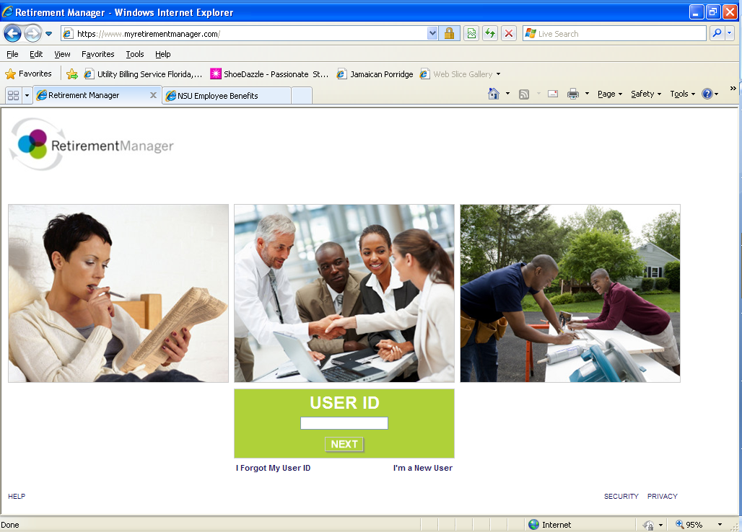
NSU RETIREMETN PLAN
(RETIREMENT MANAGER)
A secure way to enroll and make changes to the NSU Retirement accounts at https://www.myretirementmanager.com
Comprehensive source for financial planning and determine if your financial plan is on track
Notes:
Both vendors send representatives to campus on a regular basis either for individual consultations [you can bring your spouse, significant other or a financial planner to individual appointments]
OR participate in one of the retirement plan seminars on various topics such as:
Women in Finance
Debt management
How to Invest in Tough Economic Times
TIAA-CREF call 1-800-732-8353 to make an appointment
VALIC
Nicholas Brown 850-322-8240
Steve Proffitt 954-684-6306

Slide 48
NSU 401(k) RETIREMENT PLAN
NSU 401(k) RETIREMENT PLAN
Must be 21 years of age, full time employee and not be in an excluded class (e.g. Temporary, Part-Timer, Cluster, Union, Non Resident Aliens, etc.) to be eligible for NSU Retirement Savings Plan
Full-time employees eligible to receive matching contributions in the NSU 401(k) Retirement Savings Plan after one year of service
  Eligible to make voluntary contribution into the NSU 401(k) Plan on the first of the month following your hire date
  NSU Safe Harbor matching contribution immediately vested
  NSU Basic 2% and matching contribution (above basic 2%) is vested after 3 years of service
Employees who attain the age of 50 can defer additional amounts (“catch-up” contributions) up to the annual limit of $24,000 ($18,000 under age 50)
Notes:
Although you are not eligible to join the matching plan until your 1 year anniversary you can start your own supplemental account immediately and put money aside on a pre-tax basis by visiting www.myretirementmanager.com

Slide 49
401(k) CONTRIBUTIONS
University matching contributions begin after one year of service
EMPLOYEE | EMPLOYER BASIC | EMPLOYER SAFE HARBOR MATCHING | EMPLOYER MATCHING | EMPLOYER TOTAL | EMPLOYER & EMPLOYEE TOTAL
0% | 2% | 0% | 0% | 2% | 2%
1% | 2% | 1% | 1% | 4% | 5%
2% | 2% | 2% | 2% | 6% | 8%
3% | 2% | 3% | 3% | 8% | 11%
4% | 2% | 4% | 4% | 10% | 14%
100% Vested Immediately | 3 yr. Vesting from Date of Hire | 100% Vested Immediately | 3 yr. Vesting from Date of Hire
Enroll and make changes to the NSU Retirement accounts by visiting https://www.myretirementmanager.com

Slide 50
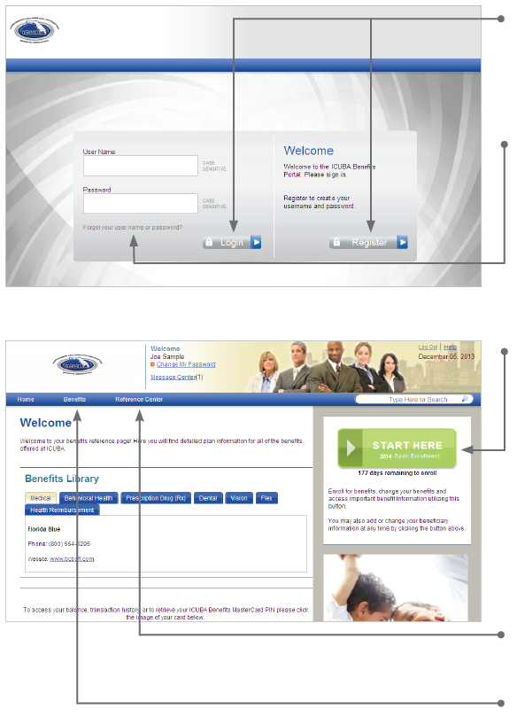
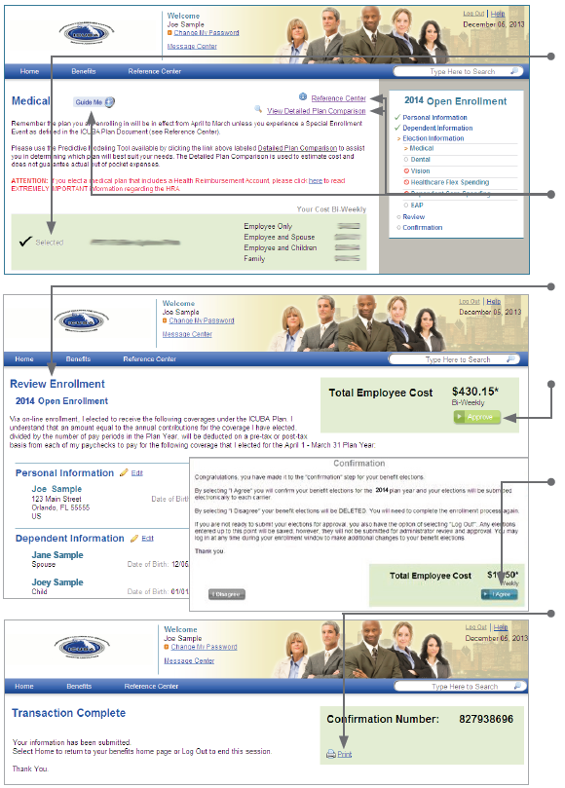
Get started
Visit http://icubabenefits.org and login by entering your user name and password. If you are a first-time user, click on “Register” to set up your user name, password and security questions. Your “Company Key” is ICUBA (note: it’s case sensitive).
Forgot your username or password?
1. Visit http://icubabenefits.org and click on the “Forgot your username or password?” link.
2. Enter your social security number, company key and date of birth.
3. Answer your security phrase.
4. Enter and confirm your new password, then click “Continue”
to return to this page and login.
Begin enrollment
Click “Start Here” and follow the instructions to enroll in your benefits or waive coverage.
You must make your elections by the deadline under the “Start Here” button. If you miss the deadline your current benefit plan elections will be continued. However if you are currently enrolled in a Blue Choice plan, you will be moved to the corresponding Blue Options beginning on April 1, 2014.
*Note: If you elected a Flexible Spending Account (FSA) for the current plan year, please be aware that your elections will not automatically rollover to the upcoming plan year and you will need to make an active election.
Wondering what something means?
View the online glossary in the “Reference Center.”
Want to review your current plan?
You have year-round access to your benefit summary and
specific benefit elections at http://icubabenefits.org.
1. Click “Benefits Summary” in the “Benefits” tab.
2. Review your current plan.
http:/
Benefits Enrollment Instructions
icubabenefits.org
Get started
Visit icubabenefits.org and login by entering your user name and password. If you are a first-time user, click on “Register” to set up your user name, password and security questions. Your “Company Key” is ICUBA (note: it’s case sensitive).
Forgot your username or password?
1. Visit icubabenefits.org and click on the “Forgot your username or password?” link.
2. Enter your social security number, company key and date of birth.
3. Answer your security phrase.
4. Enter and confirm your new password, then click “Continue”
to return to this page and login.
Begin enrollment
Click “Start Here” and follow the instructions to enroll in your benefits or waive coverage.
You must make your elections by the deadline under the “Start Here” button. If you miss the deadline your current benefit plan elections will be continued.
*Note: If you elected a Flexible Spending Account (FSA) for the current plan year, please be aware that your elections will not automatically rollover to the upcoming plan year and you will need to make an active election.
Wondering what something means?
View the online glossary in the “Reference Center.”
Want to review your current plan?
You have year-round access to your benefit summary and
specific benefit elections at icubabenefits.org.
1. Click “Benefits Summary” in the “Benefits” tab.
2. Review your current plan.
Make your elections
Review your options as you walk through the enrollment process. Click “Select” on the plan(s) you choose. Track your choices along the enrollment bar which updates with your total cost.
If you have any questions as you go through enrollment, call the ICUBA Benefits Center at 1-866-377-5102.
Use the “Reference Center”, “View Detailed Plan Comparison” or “Guide Me” tools to help you make elections.
Review your elections
Review, edit and approve your personal information, elections, dependents and total cost.
Approve
Once you have reviewed your elections and they are accurate, click “Approve”.
Confirm your choices
Your enrollment isn’t complete until you confirm your benefit elections.
Print
Print your election information and confirmation number for future reference.
You must complete your enrollment within 30 days of your date of hire.

Slide 51
ENROLLMENT REMINDER
Employees have thirty days (30) from their date of hire or eligibility to enroll in ICUBA benefits
Enrollment is made online at http://icubabenefits.org
Premiums are charged from the date of hire
Enrollment instructions are posted on the benefits web page
If you do not enroll during this period you may enroll during the next annual enrollment or qualifying status change
Employees working at least 19.2 hours per week are eligible to enroll in dental and vision plans
Employees working 28 hours or more per week are eligible for *retirement matching, medical, dental, and vision plans
*Employee must be classified as full-time to be eligible for the retirement matching plan
Notes:
If you are past your 30 calendar days enrollment window, then you may not be eligible to enroll for benefits until the next open enrollment period. Contact the Benefits department at 954-262-4748 to discuss your options, if available.

Slide 52
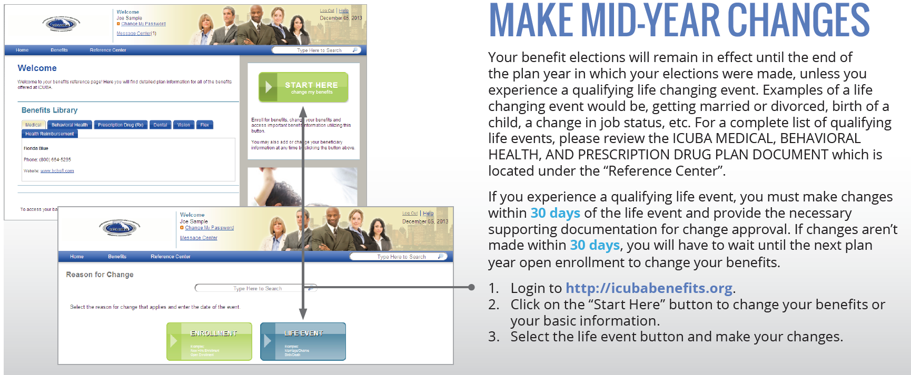
Benefits Enrollment Instructions
http://icubabenefits.org

Slide 53
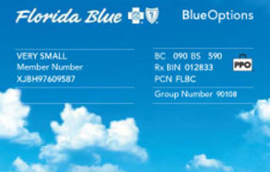
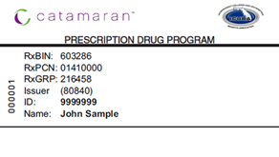
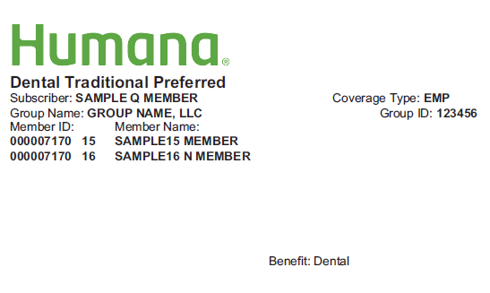
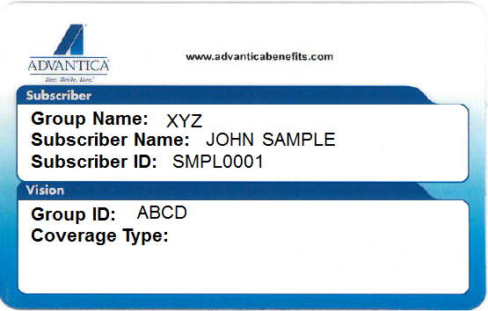


ICUBA Benefits Insurance Providers

Slide 54

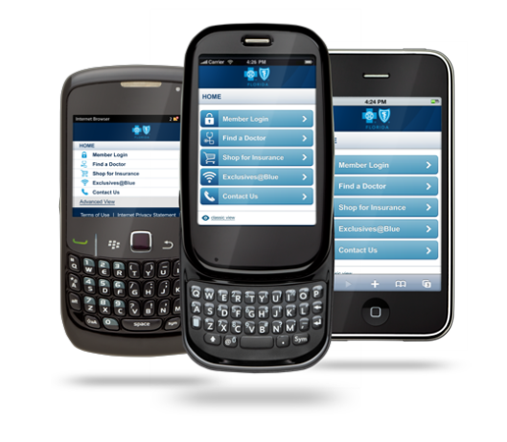
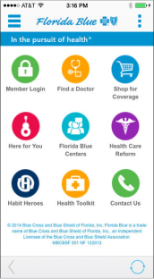
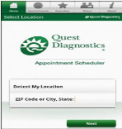









Mobile Apps
Good health is in your hands.
Access personalized health information and tools while on the go! Mobile Apps provide you with easy access to your personalized health information.
Once you receive your ID card, download the app to take advantage of the benefits your plan offers.
The Florida Blue mobile app provides quick and easy access to your plan coverages and details such as deductibles, claims, an electronic copy of your Member ID card and a search feature to help you locate doctors in the network from wherever you are.
Catamaran gives you instant, secure access to your personal prescription information and trusted pharmacy resources. Check your prescription history, compare prescription prices and locate nearby pharmacies.
MyHumana Mobile app gives you quick access to view your dental plan and coverage details as well as a search feature to help you easily locate an in-network provider in your area.
Resources for Living allows you to access information, support and resources to help you manage the issues that impact your work, life and well-being.
The WebMD app provides 24/7 mobile access to mobile-optimized health information and decision support tools, including Symptom Checker, Drugs & Treatments, First Aid Information and Local Health Listings.
MyQuest™ allows you to conveniently access your health information, request and receive lab results, schedule your next lab appointment or find the nearest Quest Diagnostics Patient Service Center location.

Slide 55

We are available to discuss plan details and
problem solve with members after the presentation.

