Slide 1
Community Engagement at Nova Southeastern University: A Case Study Barbara Packer-Muti, EdD Executive Director, Institutional & Community Engagement

Slide 2
Nova Southeastern University
With more than 28,000 students, NSU ranks 8th in enrollment among 1,500 private, non-profit colleges and universities across the nation .

Slide 3
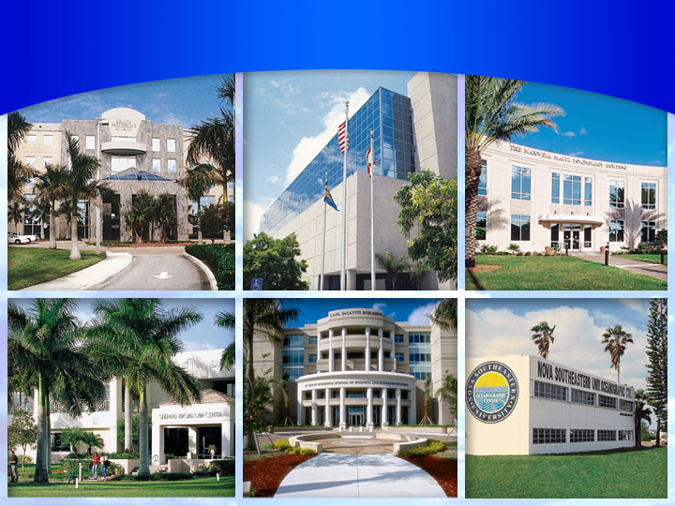
NOVA SOUTHEASTERN UNIVERSITY
18 centers, colleges and schools

Slide 4
18 Centers, Colleges and Schools
Nova Southeastern University
Farquhar College of Arts and Science
H. Wayne Huizenga School of Business and Entrepreneurship
Graduate School of Computer and Information Sciences
Oceanographic Center
Shepard Broad Law Center
College of Osteopathic Medicine
College of Pharmacy
College of Optometry
College of Nursing
College of Health Care Sciences
College of Medical Sciences
College of Dental Medicine
Abraham S. Fischler School of Education
Center for Psychological Studies
Graduate School of Humanities and Social Sciences
Mailman Segal Center for Human Development
Institute for the Study of Human Service, Health and Justice
University School

Slide 5
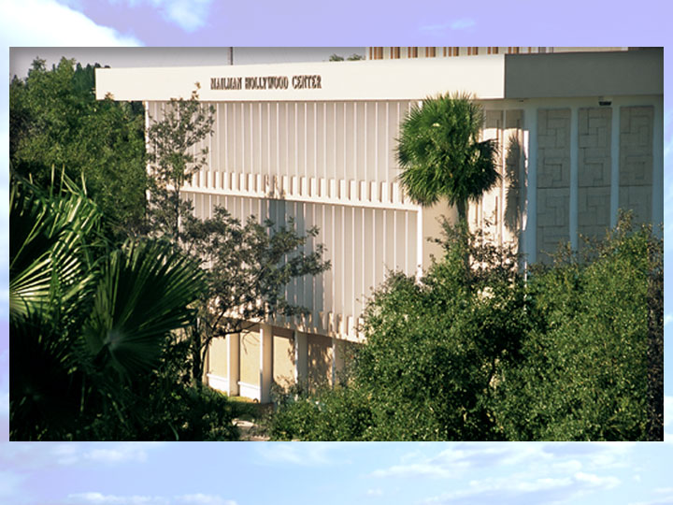
Nova Southeastern University
Main Campus
Mailman Hollywood Building
Farquhar College of Arts and Sciences

Slide 6
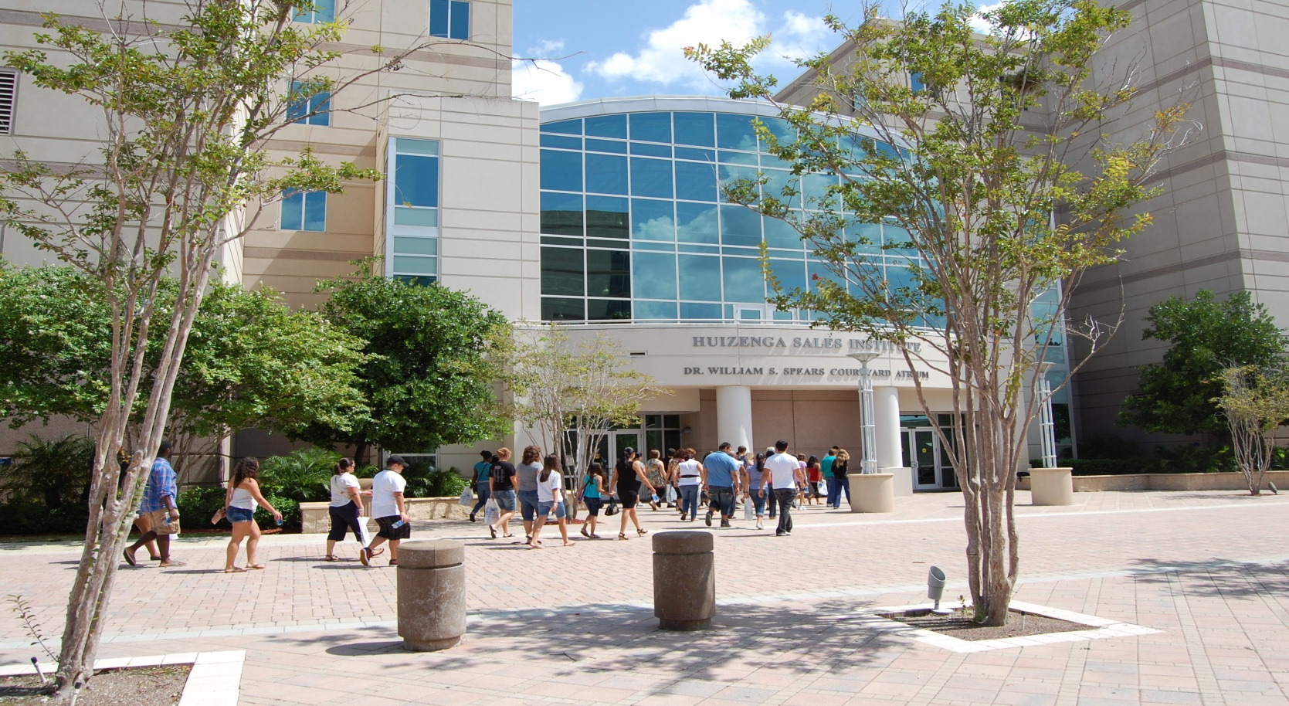
Nova Southeastern University
Main Campus
Carl DeSantis Building
H. Wayne Huizenga School of Business and Entrepreneurship
and the Graduate School of Computer and Information Sciences

Slide 7
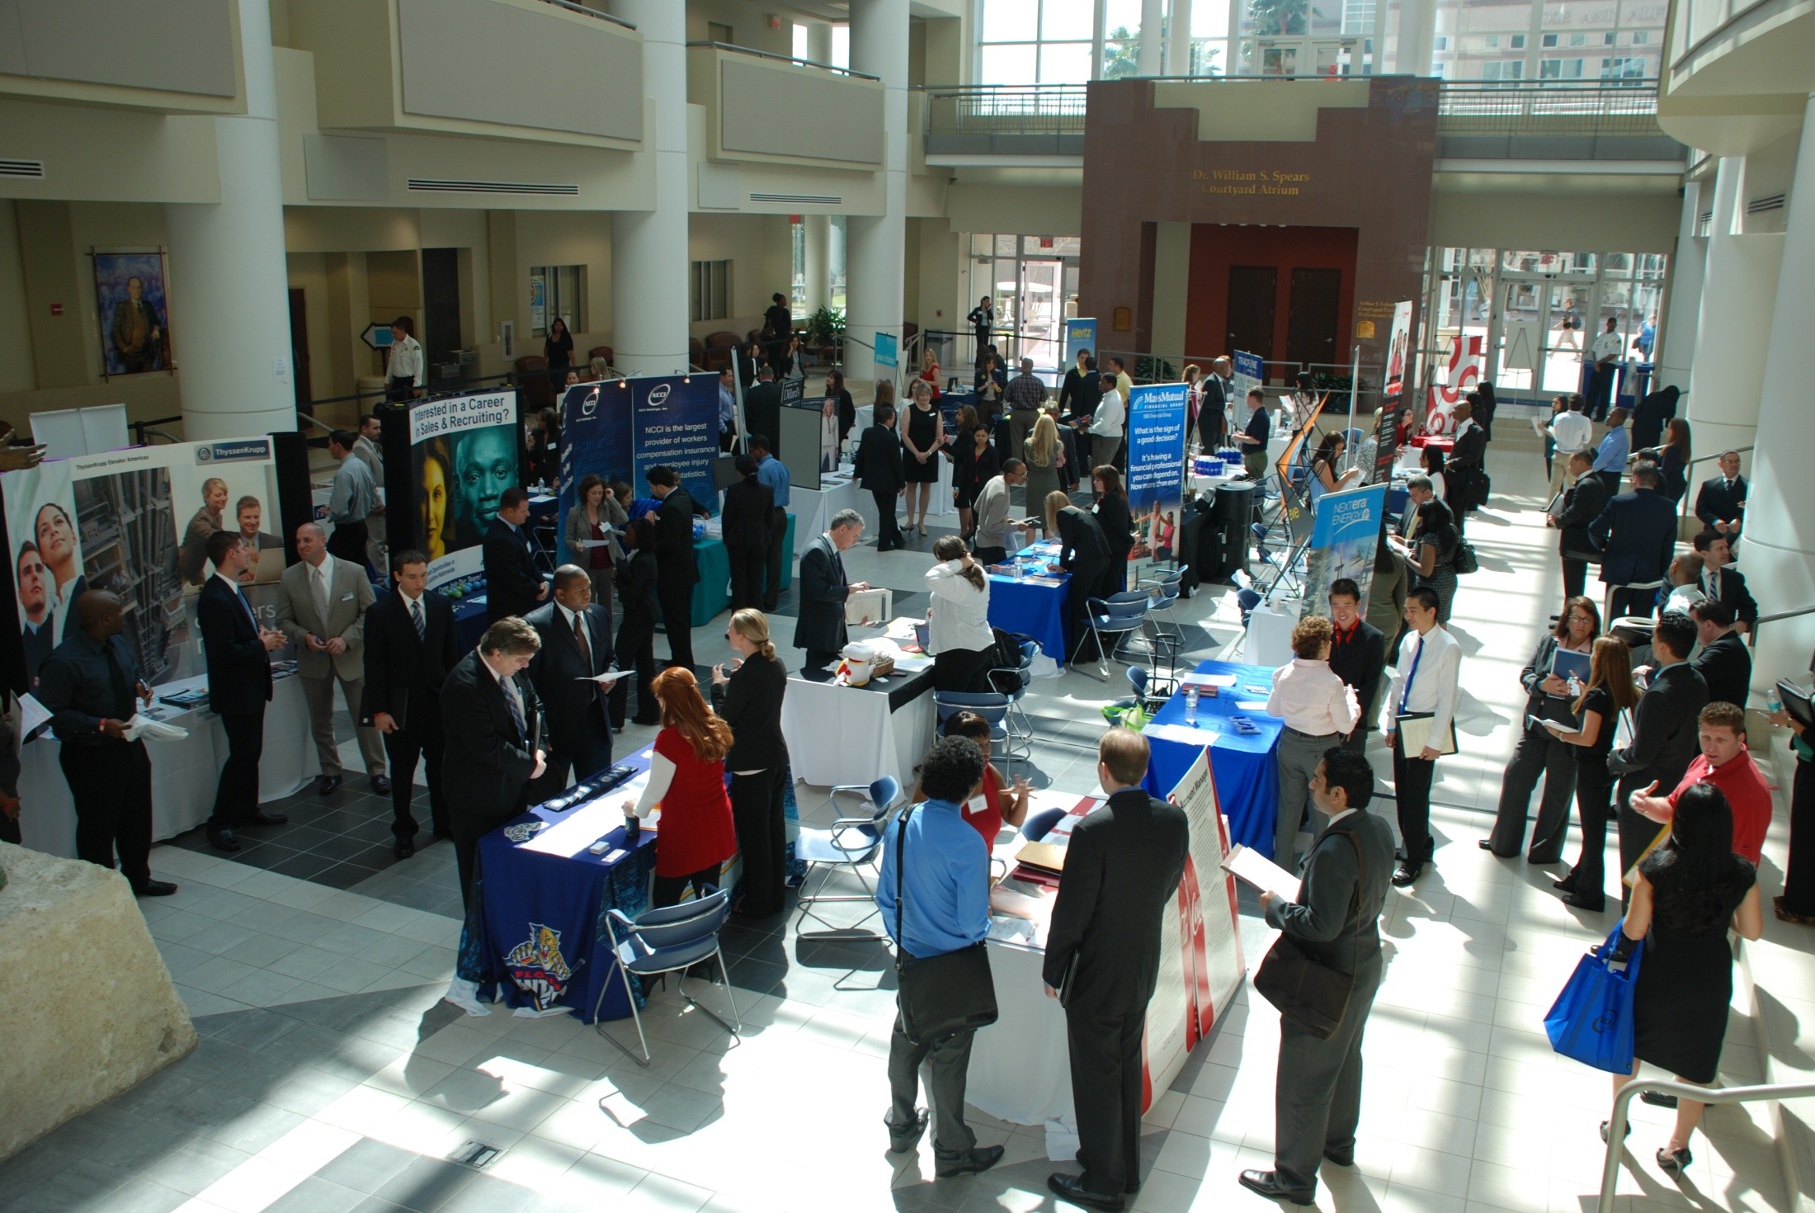
Nova Southeastern University
Carl DeSantis Building
Atrium

Slide 8
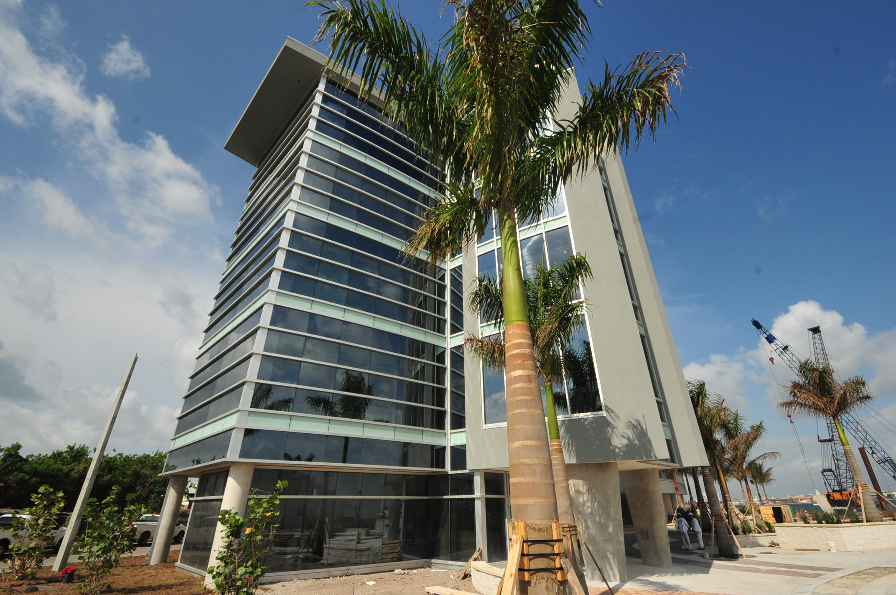
Nova Southeastern University
NSU Oceanographic Center
Coral Reef Ecosystem Research Facility

Slide 9
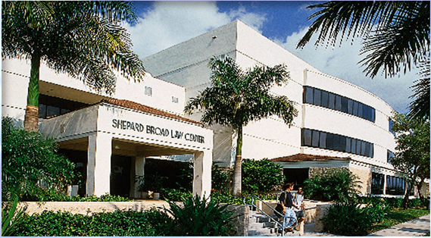
Nova Southeastern University
Main Campus
Leo Goodwin Sr. Hall
Shepard Broad Law Center

Slide 10
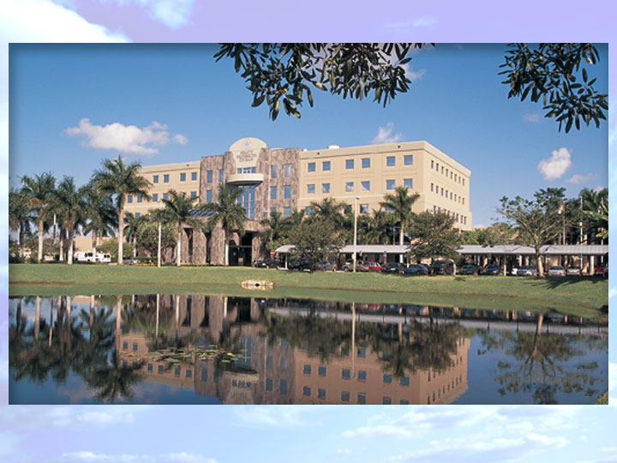
Nova Southeastern University
Main Campus
Terry Building

Slide 11
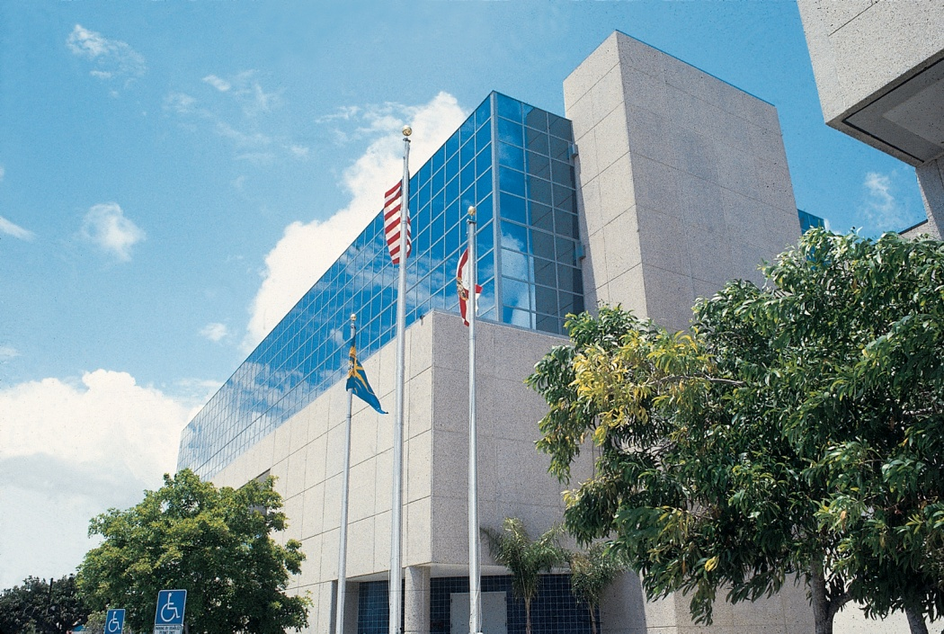
Nova Southeastern University
North Miami Beach Campus
Abraham S. Fischler School of Education

Slide 12
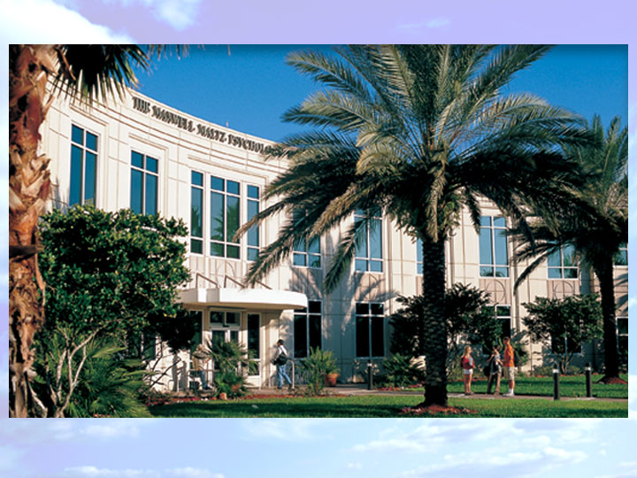
Nova Southeastern University
Main Campus
Maxwell Maltz Building
Center for Psychological Studies and
Graduate School of Humanities and Social Sciences

Slide 13
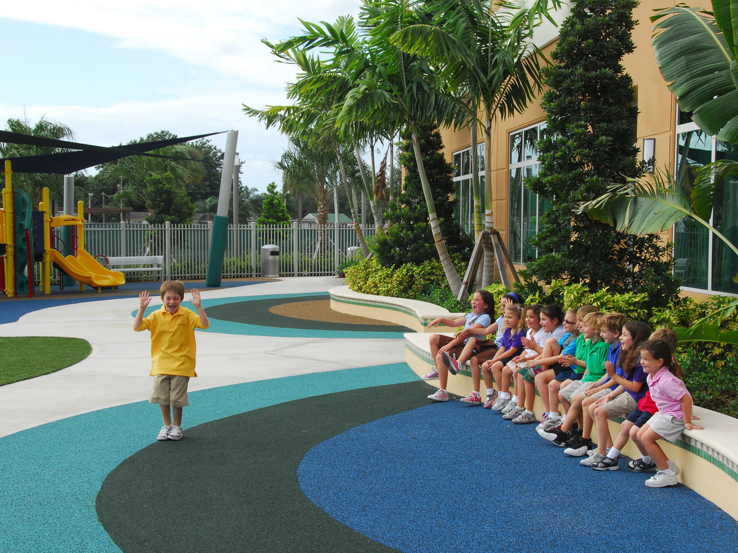
Nova Southeastern University
Main Campus
The University School, Lower School

Slide 14
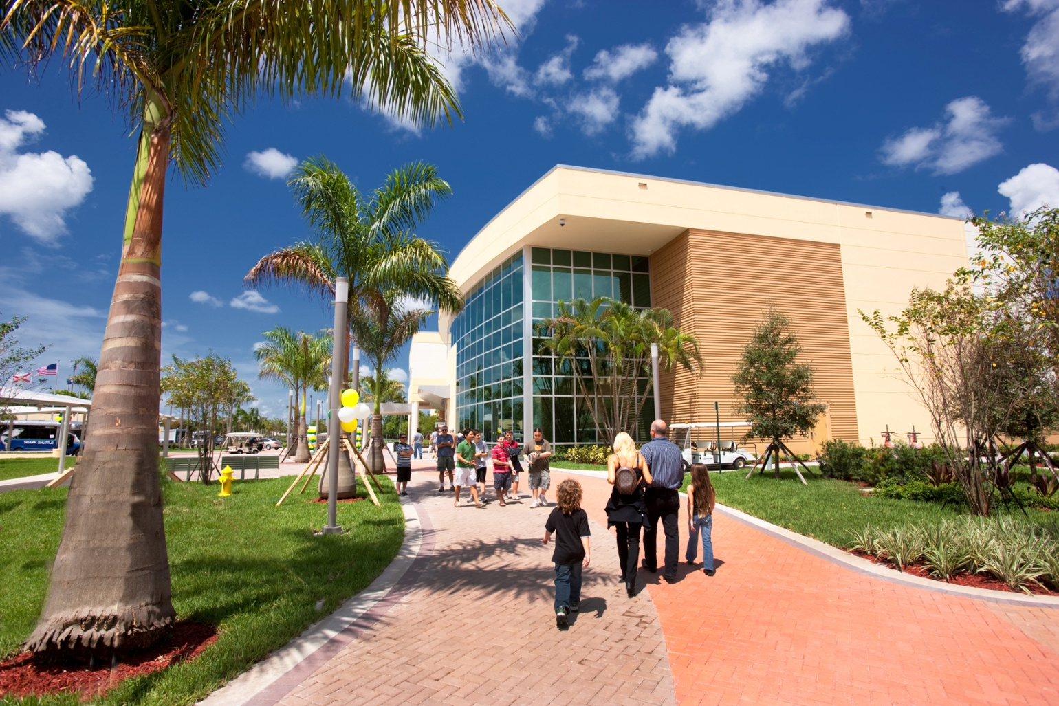
Nova Southeastern University
Main Campus
The University School
Epstein Center for the Arts

Slide 15
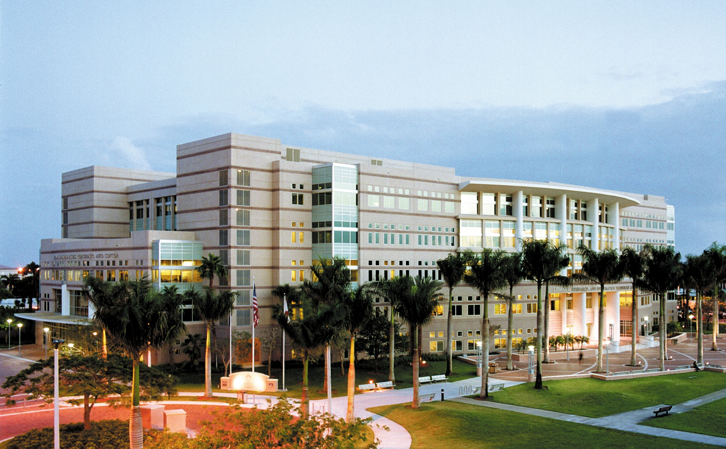
Nova Southeastern University
Main Campus
Alvin Sherman Library

Slide 16
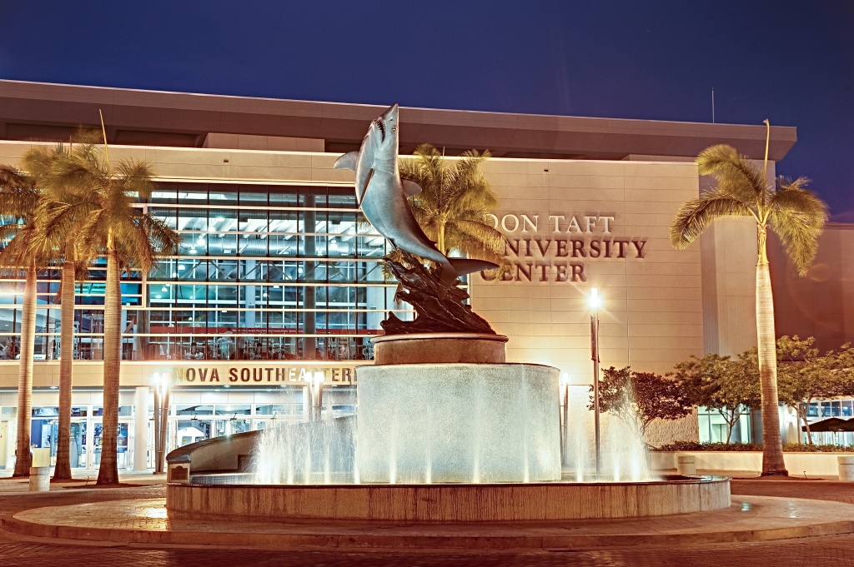
Nova Southeastern University
Don Taft University Center
Shark Fountain– by sculptor Kent Ullberg
Don Taft University Center
Shark Fountain
Don Taft University Center

Slide 17
Nova Southeastern University
Main Campus
The Commons Residence Hall

Slide 18
Student Educational Centers
Nova Southeastern University
Nassau, Bahamas
Fort Myers, Florida
Jacksonville, Florida
Miami, Florida
Miramar, Florida
Orlando, Florida
Palm Beach, Florida
Tampa, Florida

Slide 19
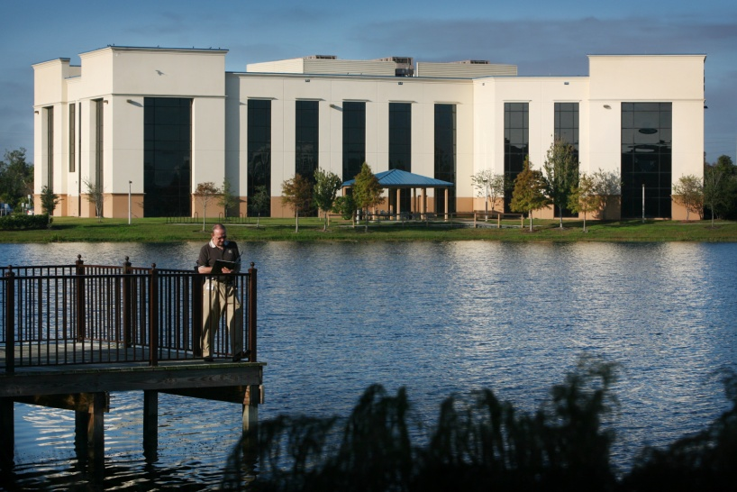
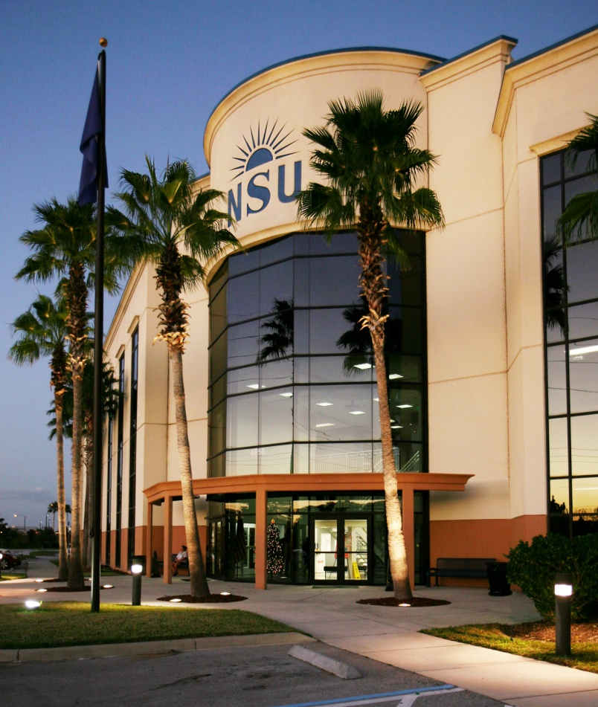
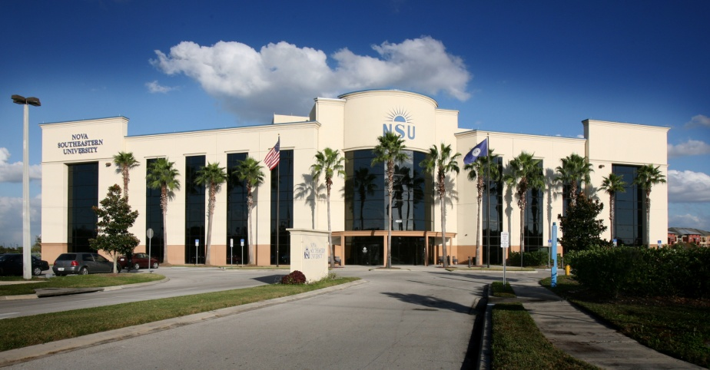
Nova Southeastern University
Orlando

Slide 20
Vision Statement Adopted by Board – March 28, 2011
Nova Southeastern University
By 2020, through excellence and innovations in teaching, research, service and learning, Nova Southeastern University will be recognized by accrediting agencies, the academic community, and the general public, as a premier private not-for-profit university of quality and distinction that engages all students and produces alumni who serve with integrity in their lives, fields of study, and resulting careers.

Slide 21
Mission Statement Adopted by Board – March 28, 2011
The Mission of Nova Southeastern University, a private, not-for-profit institution, is to offer a diverse array of innovative academic programs that complement on-campus educational opportunities and resources with accessible distance learning programs to foster academic excellence, intellectual inquiry, leadership, research, and commitment to community through engagement of students and faculty members in a dynamic, life-long learning environment.

Slide 22
Core Values Adopted by Board
– March 28, 2011
Academic Excellence
Student Centered
Integrity
Innovation
Opportunity
Scholarship/Research
Diversity
Community

Slide 23
Our Carnegie Disappointment in 2008
GREAT community outreach/partnerships/curricular activities BUT
No Centralized Office
No Centralized Repository
No Consistent, Centralized Assessment
No University-wide Recognition

Slide 24
Success in 2010!
Re-organized
Centralized
Revitalized Community Culture
Learned from 2008
BECAME ONE OF THE 311 Recognized Institutions with the Elective Carnegie Classification as Community Engaged!!!

Slide 25
What We Did: Timeline of Events
Apply for 2008 Carnegie Elective Classification
CCD Committee (University-wide)
Task Force Committee Formed
Apply for 2010 Carnegie ElectiveClassification
Third Year of Implementation
CCD Trainings
Awarded 2010 Carnegie Elective Classification
Second Annual Community Affiliates Survey
Collaboration on the CCD
' 08
Sep 2008
Mar 2009
Sep
Mar 2010
Sep
Mar 2011
Sep
Mar 2012
' 12

Slide 26
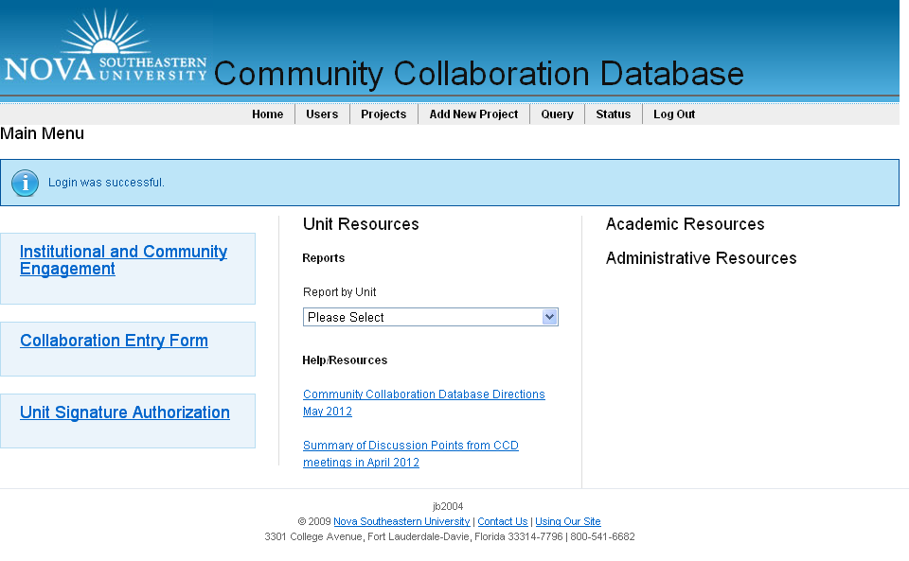
Home page CCD

Slide 27
Academic Unit | Total Collaborations | Types of Collaborations
 |  | Academic | Social | Service | Clinical | Research | Professional | Grants | Special Events/ Projects | Development | Other
CPS | 235 | 19 | 1 | 6 | 220 | 4 | 0 | 3 | 1 | 0 | 0
CAHN | 75 | 14 | 4 | 7 | 66 | 0 | 0 | 1 | 2 | 0 | 0
CDM | 11 | 4 | 0 | 7 | 0 | 0 | 1 | 3 | 2 | 0 | 0
COO | 107 | 5 | 3 | 30 | 63 | 3 | 18 | 3 | 9 | 1 | 0
COM | 494 | 104 | 17 | 109 | 355 | 11 | 35 | 16 | 20 | 1 | 16
COP | 27 | 3 | 0 | 4 | 24 | 0 | 2 | 0 | 26 | 0 | 0
FCAS | 64 | 59 | 1 | 5 | 1 | 1 | 10 | 1 | 8 | 0 | 3
FSEHS | 72 | 24 | 9 | 27 | 9 | 4 | 24 | 4 | 8 | 6 | 7
GSCIS | 5 | 1 | 0 | 3 | 0 | 2 | 4 | 0 | 0 | 0 | 0
HSHJ | 1 | 1 | 0 | 0 | 0 | 1 | 0 | 1 | 1 | 1 | 0
SBE | 5 | 4 | 0 | 1 | 0 | 1 | 5 | 0 | 2 | 0 | 0
SHSS | 45 | 3 | 1 | 2 | 35 | 5 | 1 | 1 | 9 | 0 | 1
MSC | 27 | 3 | 2 | 11 | 0 | 5 | 11 | 9 | 5 | 1 | 2
OSC | 1 | 1 | 0 | 0 | 0 | 0 | 0 | 0 | 0 | 0 | 0
LAW | 32 | 27 | 1 | 30 | 0 | 0 | 0 | 1 | 4 | 0 | 0
USC | 51 | 10 | 12 | 29 | 0 | 3 | 0 | 0 | 1 | 0 | 0
TOTALS: | 1252 | 282 | 51 | 271 | 773 | 40 | 111 | 43 | 98 | 10 | 29

Slide 28
Administrative | Total Collaborations | Types of Collaborations
 |  | Academic | Social | Service | Clinical | Research | Professional | Grants | Special Events/ Projects | Development | Other
Admissions | 1 | 1 | 0 | 0 | 0 | 0 | 1 | 0 | 1 | 0 | 0
Athletics | 17 | 2 | 2 | 14 | 0 | 2 | 1 | 0 | 1 | 1 | 0
Business Services | 1 | 0 | 0 | 0 | 0 | 0 | 0 | 0 | 1 | 0 | 0
Clinical Operations | 2 | 1 | 0 | 0 | 1 | 0 | 0 | 0 | 1 | 0 | 0
Community & Governmental Affairs | 0 | 0 | 0 | 0 | 0 | 0 | 0 | 0 | 0 | 0 | 0
ESS | 5 | 5 | 0 | 0 | 0 | 0 | 1 | 0 | 0 | 0 | 0
Finance | 3 | 0 | 0 | 0 | 0 | 0 | 0 | 0 | 3 | 0 | 0
Institutional Advancement | 106 | 0 | 7 | 6 | 0 | 0 | 0 | 0 | 97 | 1 | 0
Museum of Art | 73 | 4 | 8 | 0 | 0 | 0 | 1 | 0 | 73 | 2 | 0
Quality of Life | 0 | 0 | 0 | 0 | 0 | 0 | 0 | 0 | 0 | 0 | 0
Research & Tech Transfer | 11 | 1 | 0 | 1 | 0 | 10 | 10 | 0 | 1 | 11 | 0
Sherman Library | 21 | 9 | 5 | 7 | 0 | 1 | 0 | 1 | 3 | 0 | 3
Student Affairs | 142 | 4 | 10 | 136 | 2 | 2 | 1 | 0 | 20 | 0 | 1
SEC | 28 | 6 | 11 | 18 | 1 | 1 | 8 | 0 | 5 | 4 | 1
University Relations | 2 | 0 | 0 | 0 | 0 | 0 | 0 | 0 | 1 | 0 | 1
TOTALS: | 417 | 34 | 44 | 186 | 4 | 16 | 25 | 3 | 208 | 21 | 8

Slide 29
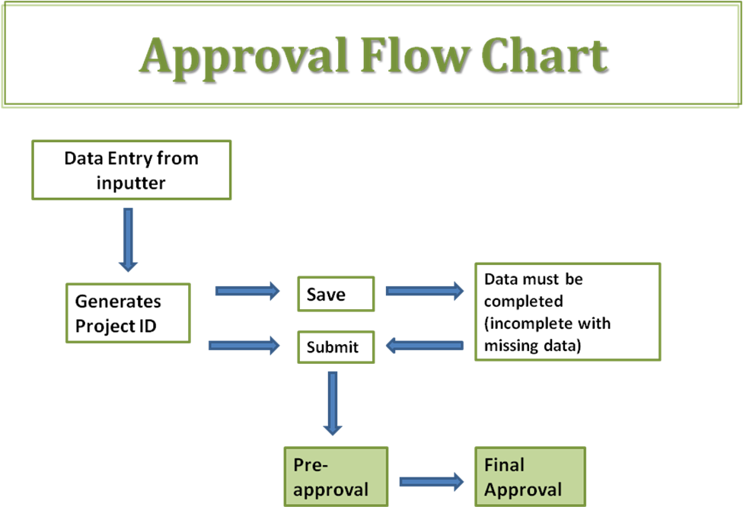

Slide 30
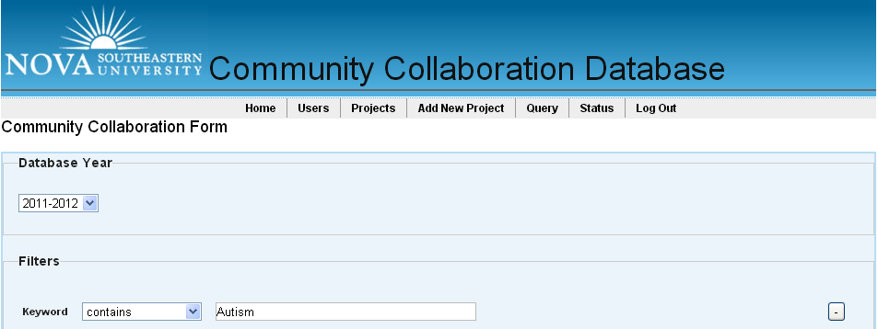
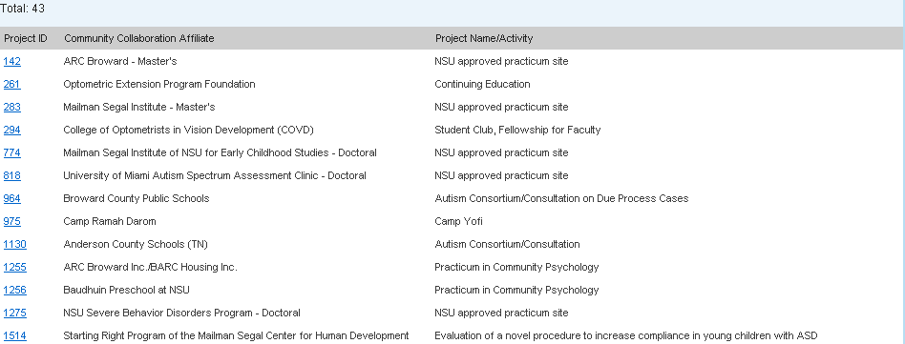

Slide 31
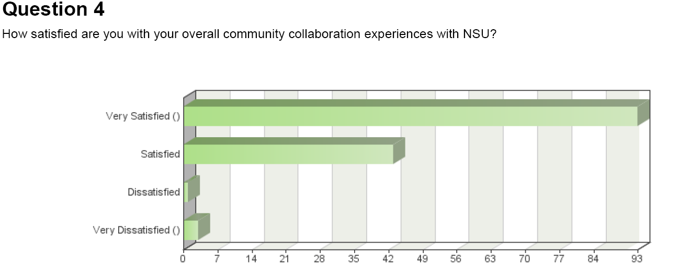

Slide 32
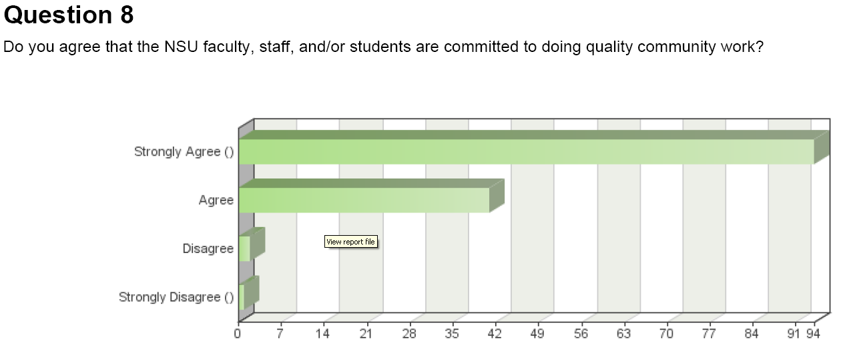

Slide 33
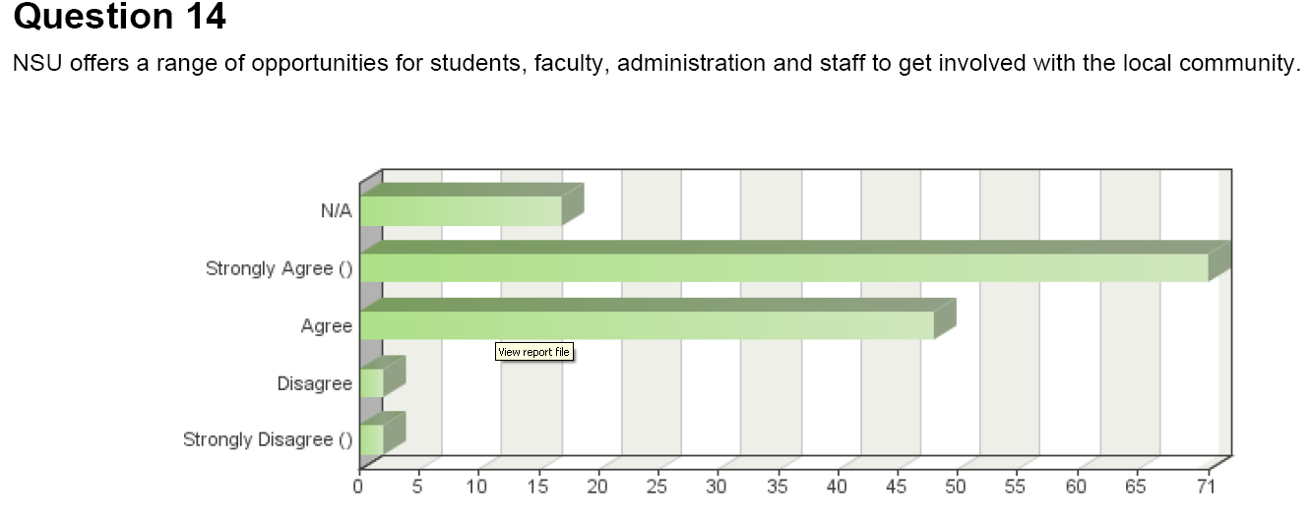

Slide 34
DASHBOARDS!

Slide 35
Suggestions:
Excellent communication with the Physical Therapy program but I know nothing about the other programs and what they are doing- maybe a quarterly bulletin highlighting events, etc..
A monthly or bimonthly meeting of the community events with the people in charge of each one. Many times I feel that they think they are competition for each other instead of an expansion of different avail abilities to them.
A simple brochure or one sheet on NSU programs interested in community outreach. It could include what they have done in the past, what days of the week or times of year are best for availability, what part of the community the program would like to focus on and who to contact. This would be an unbelievable resource for museums, schools and non-profit organizations.

Slide 36
Geriatric Blood Pressure Screening

Slide 37
Jacksonville SEC’s PA Second Harvest Food Drive

Slide 38
Students from NSU’s Oceanographic Center helped the FL Department of Environmental Protection officials save dozens of sea turtles who were dying in the cold waters of central and north FL during a cold snap!

Slide 39
Autism Walk

Slide 40
Epilepsy Foundation Event in Hyde Park

Slide 41
Habitat for Humanity
Paint Your Heart Out!

Slide 42
Relay for Life!

Slide 43
Science Alive!
Nova Southeastern University
NSU Students and Alumni bring science to life at a local elementary school with an evening of interactive experiments and scientific demonstrations

Slide 44
NSU Health Fair

Slide 45
Coastal Cleanup

Slide 46
Give Kids a Smile Day

Slide 47
Special Olympics

Slide 48
A Day for Children Health Fair

Slide 49
Upcoming Plans
Celebration of Excellence Award Focus
Excellence in Community Engagement
Student
Faculty
Alumna/us
Community Member

Slide 50
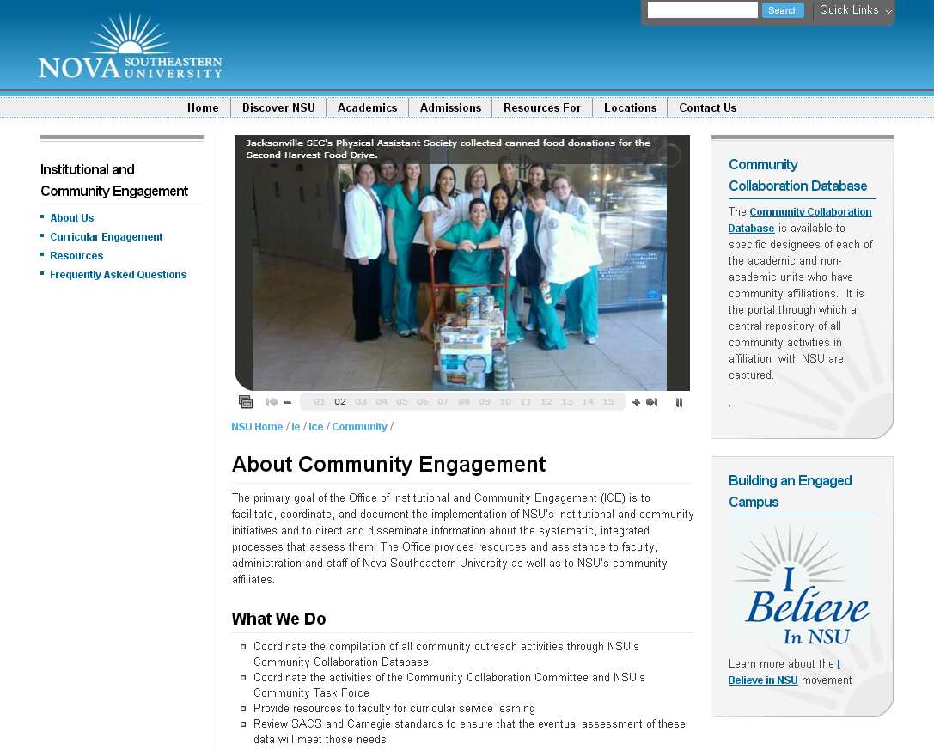

Slide 51
Contact Information:
Barbara Packer-Muti, Ed.D.
Executive Director, Institutional & Community Engagement
packerb@nova.edu

